Slide 1
Mukurtu CMS: Dictionary
Digital Stewardship Curriculum
Notes:
How can you use language elements, like words, or phrases in Mukurtu?
While fields are UTF-8 compliant, and language can be used in many places on your site, we have a specific Dictionary tool
It is a separate content type from DH items that allows us to better represent and work with language.

Slide 2
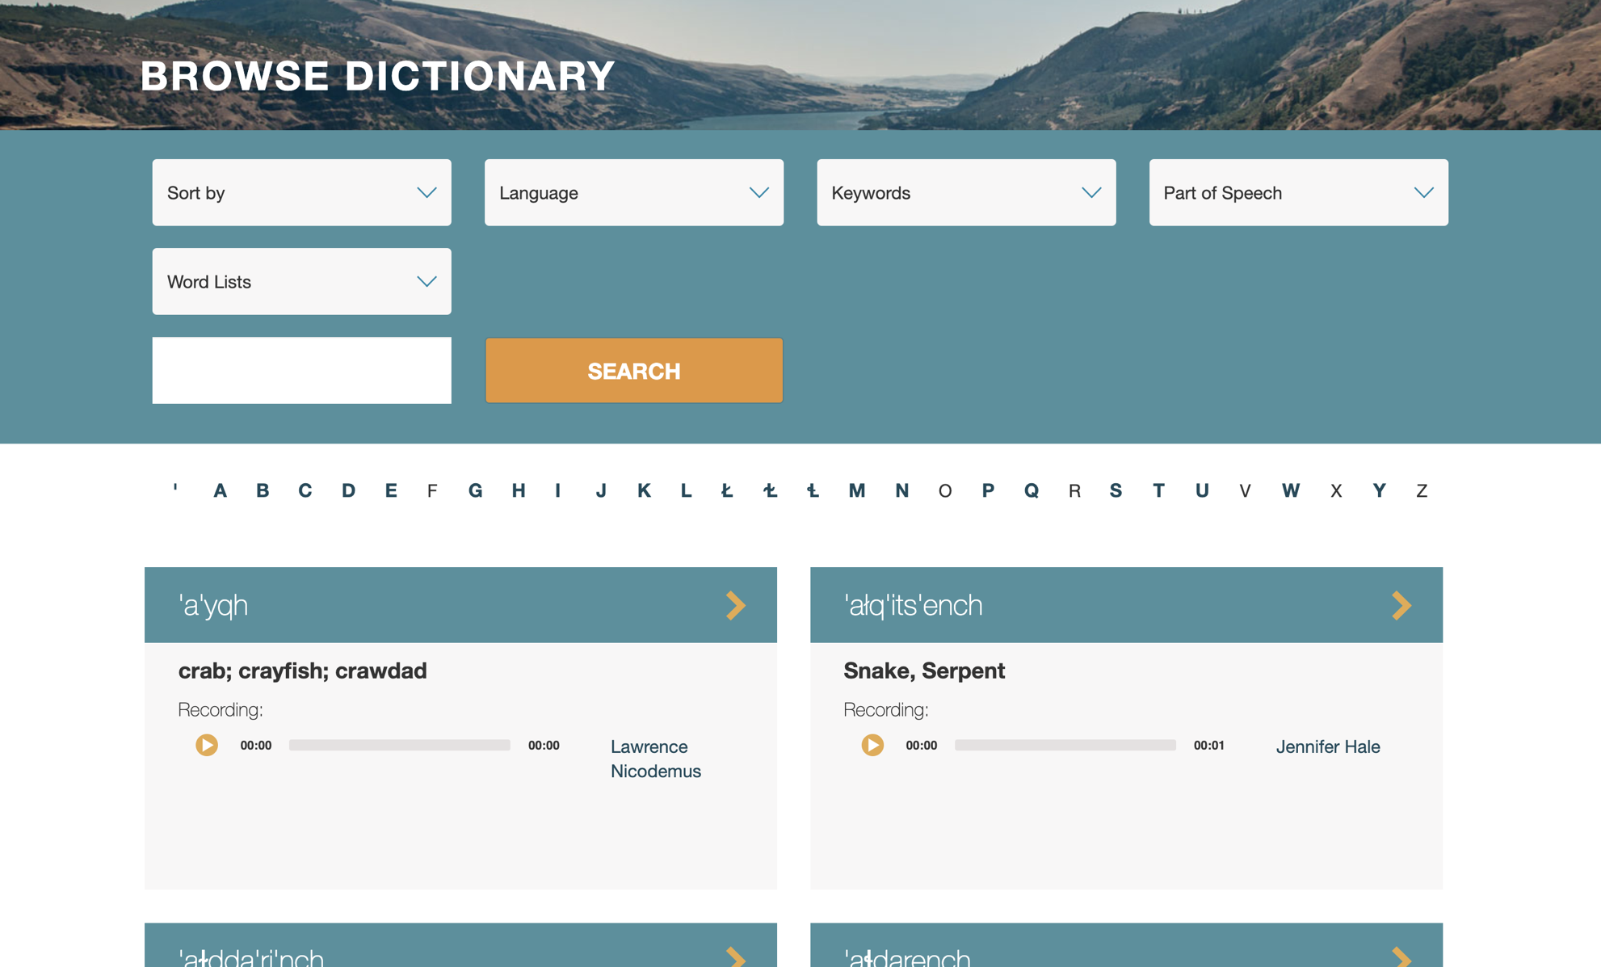
Notes:
This is the main dictionary browse page. From here we can search, filter, and sort based on things like language, keyword, first letter of the word.
We also see a preview of the dictionary entries - that includes the word in language, a translation if used, and the audio of the word alongside the speaker on the recording.

Slide 3
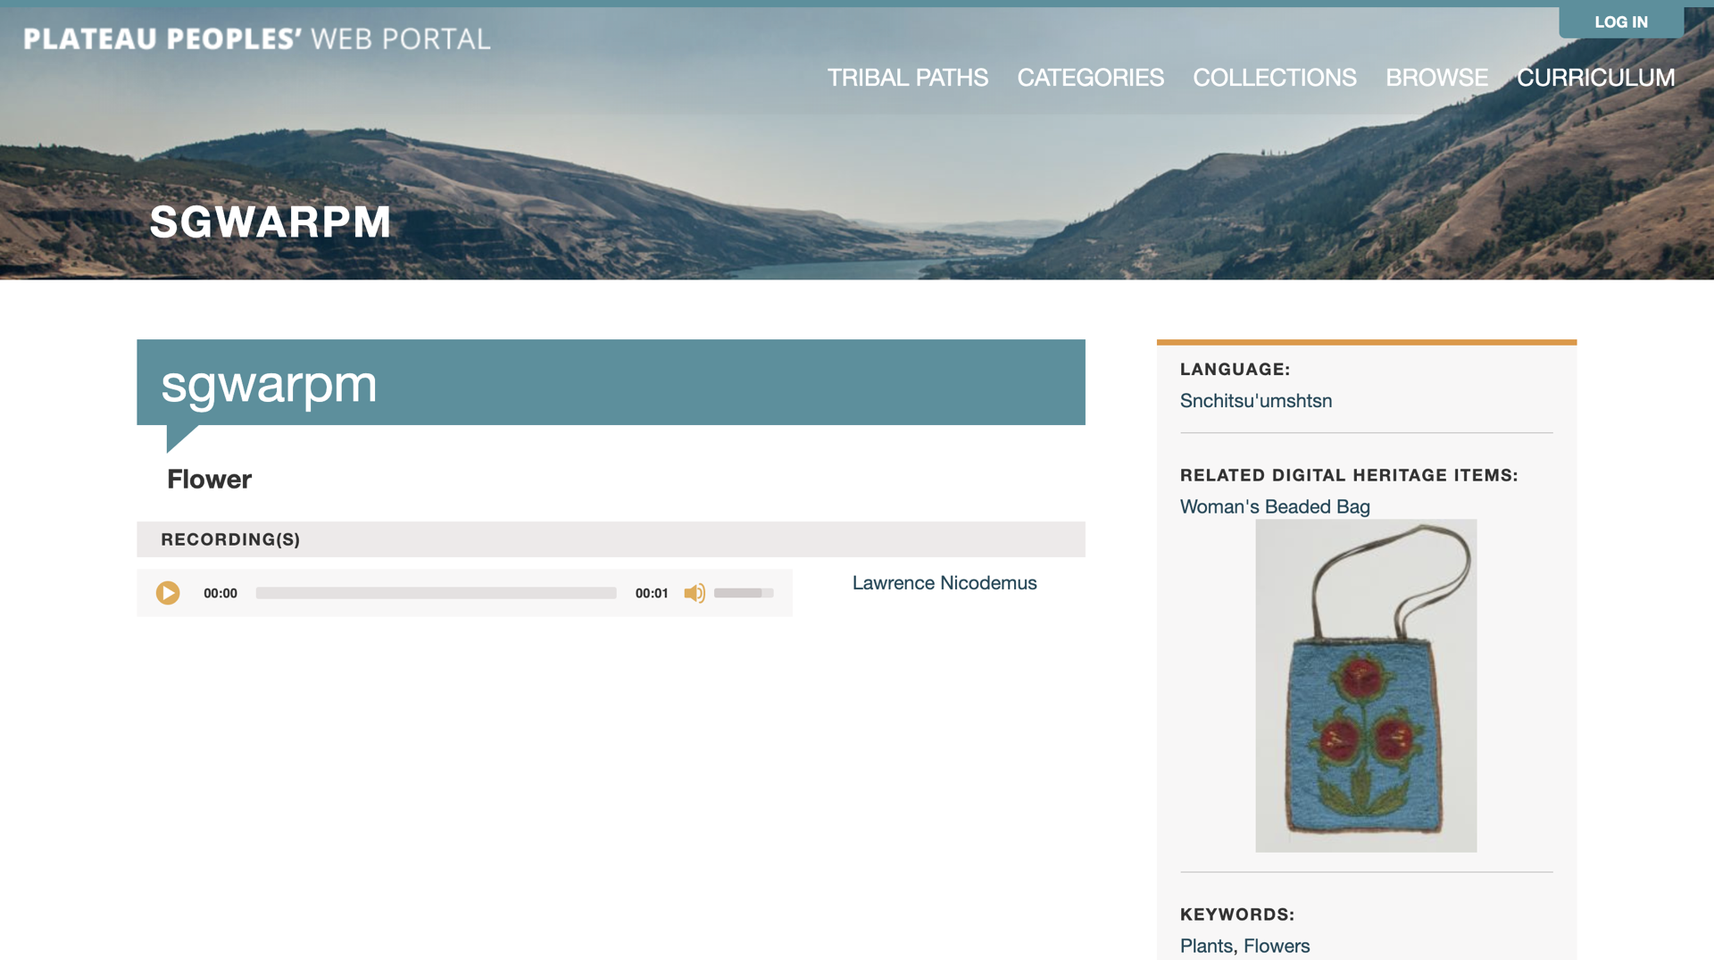
Notes:
This is a pretty short dictionary entry, but it highlights something that can be very helpful and important - connecting dictionary entries to digital heritage items.
This is the Schitsu'umsh word for flower, and we can see that there is at least one CDA item in the site that uses a flower motif. If we click on that preview...

Slide 4
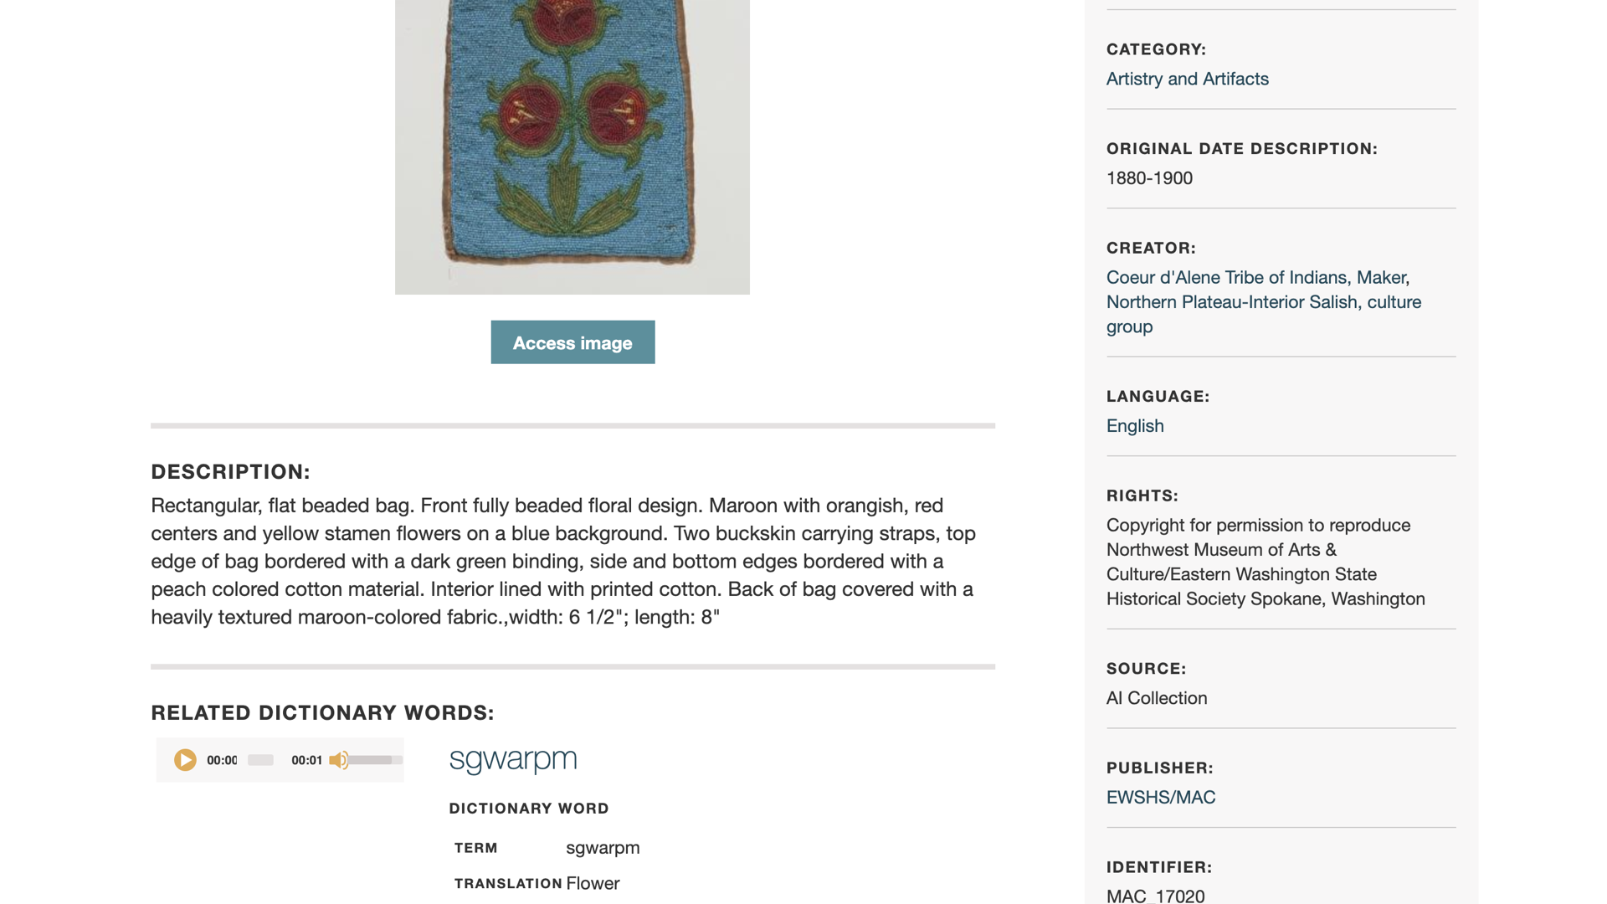
Notes:
It will take us directly to the digital heritage item.
DH items will also display the same kind of preview and link back to any dictionary words that they’ve been related to.

Slide 5
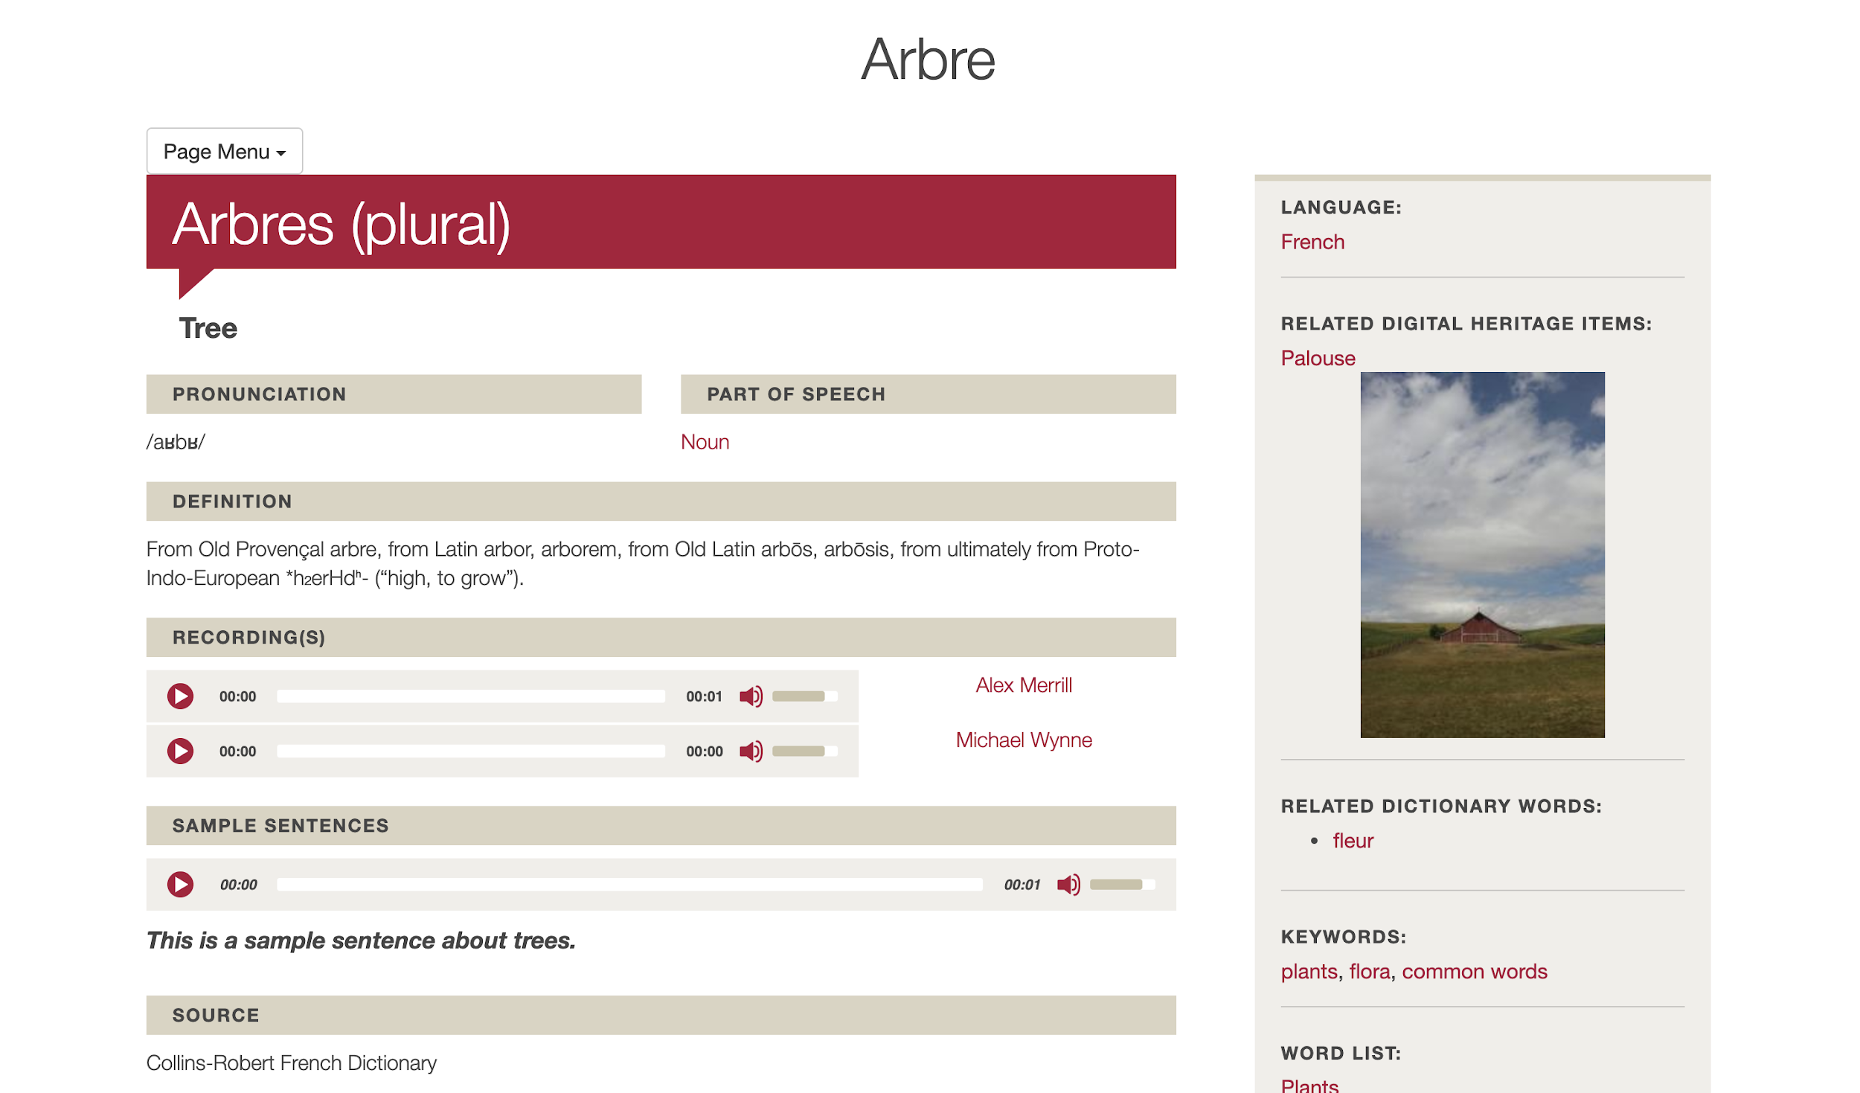
Notes:
Example of a richly detailed dictionary word
Many fields available to add information, examples, and connections

Slide 6
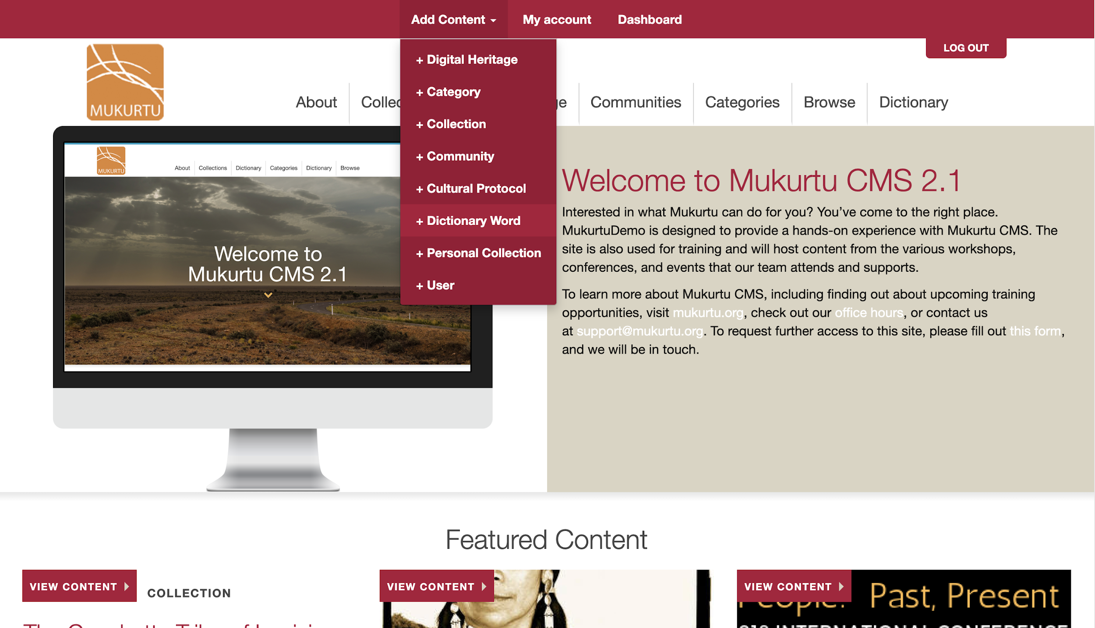
Notes:
To create a dictionary word, use the Add Content menu to select +Dictionary Word

Slide 7
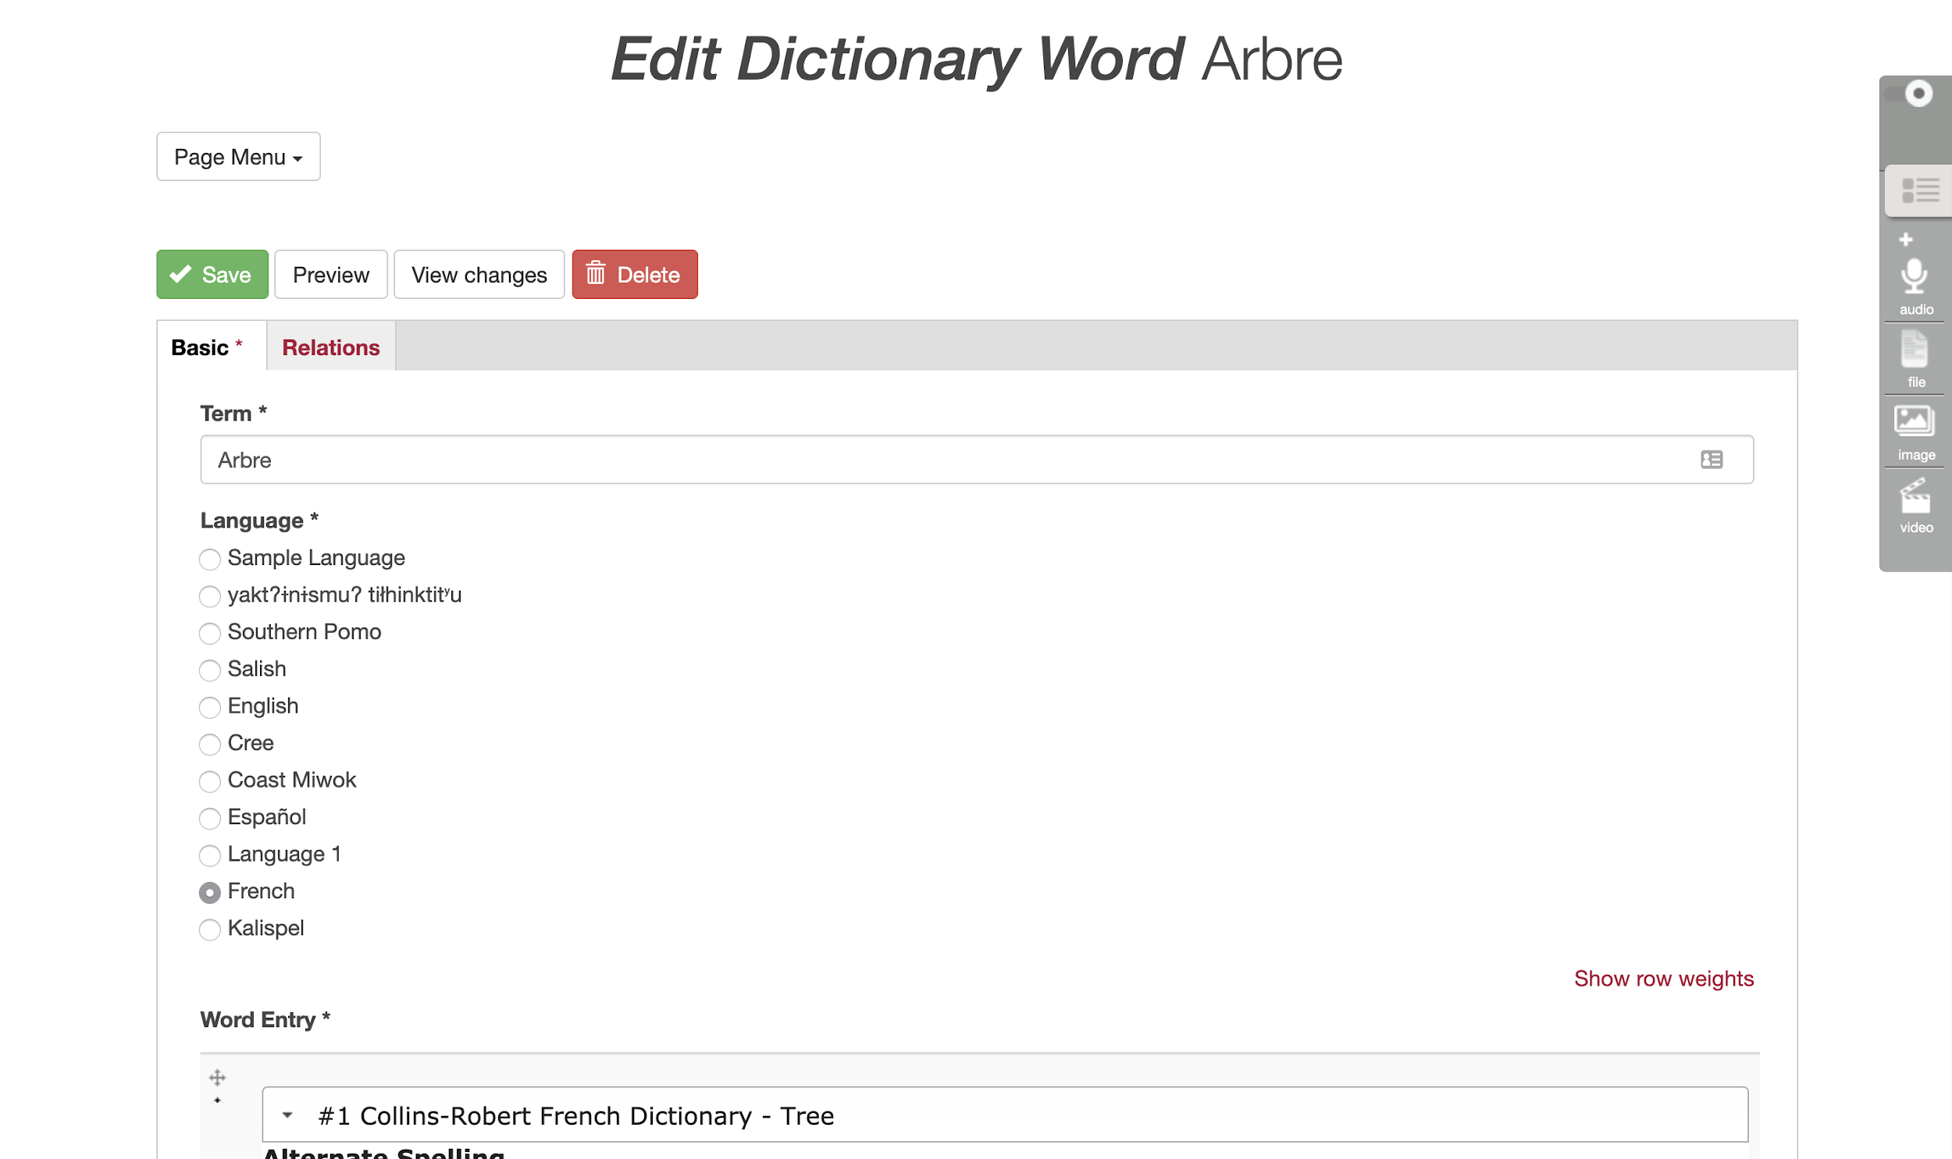
Notes:
The majority of the dictionary word metadata is in the Basic tab.
You have to enter the word in the Term field.
You also need to select a language, and you can see that each site can support multiple languages.

Slide 8
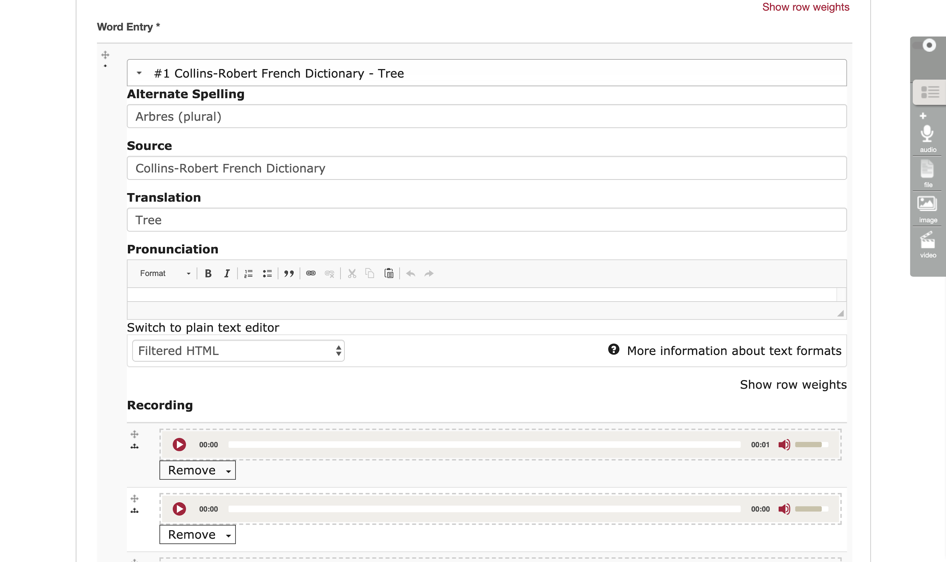
Notes:
There are actually quite a lot of fields… Most of them are optional, and you’ll want to experiment a bit and see what works best for your community of language speakers and learners.
Here we can see options to provider alternate spellings, source, translation, and pronunciation guides.
You can also include multiple recordings of the word, so if you want to have multiple speakers or something like that, you can add as many as needed.

Slide 9
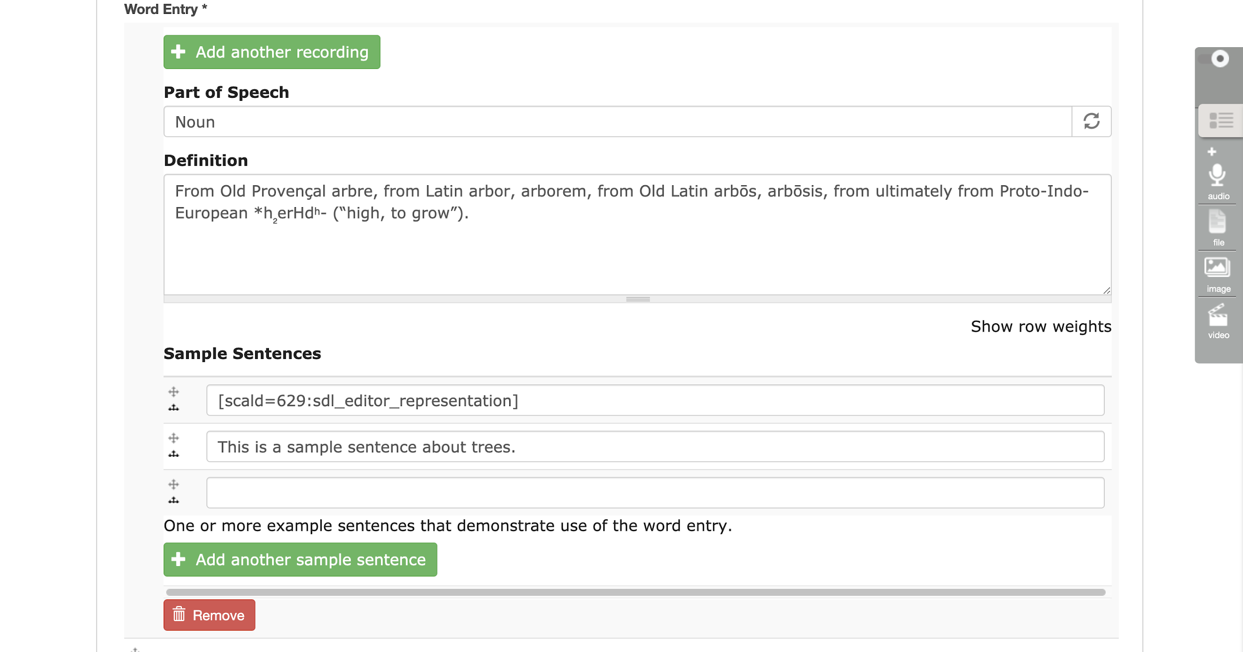
Notes:
There are also options to identify parts of speech, and add longer definitions.
You can add as many sample sentences as needed - and these can be either text OR audio recordings.

Slide 10
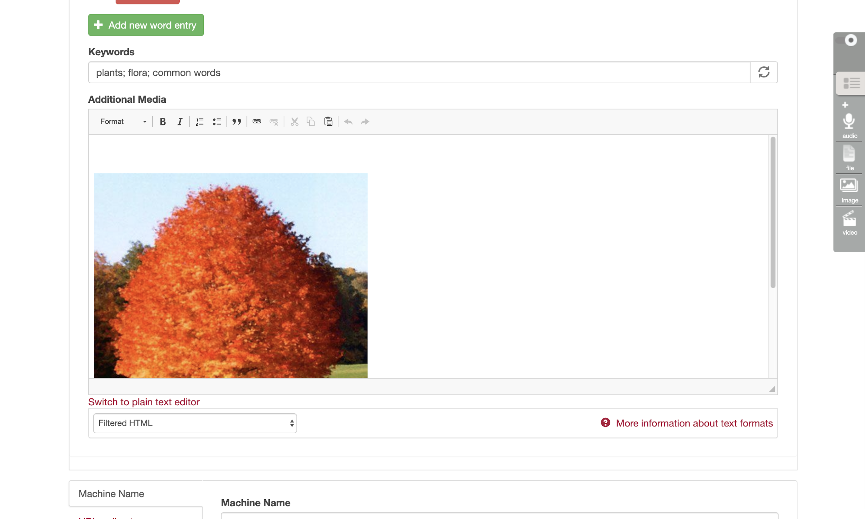
Notes:
Finally, you can include keywords, and add additional media files, for things like adding an image, or a video of the language in use.

Slide 11
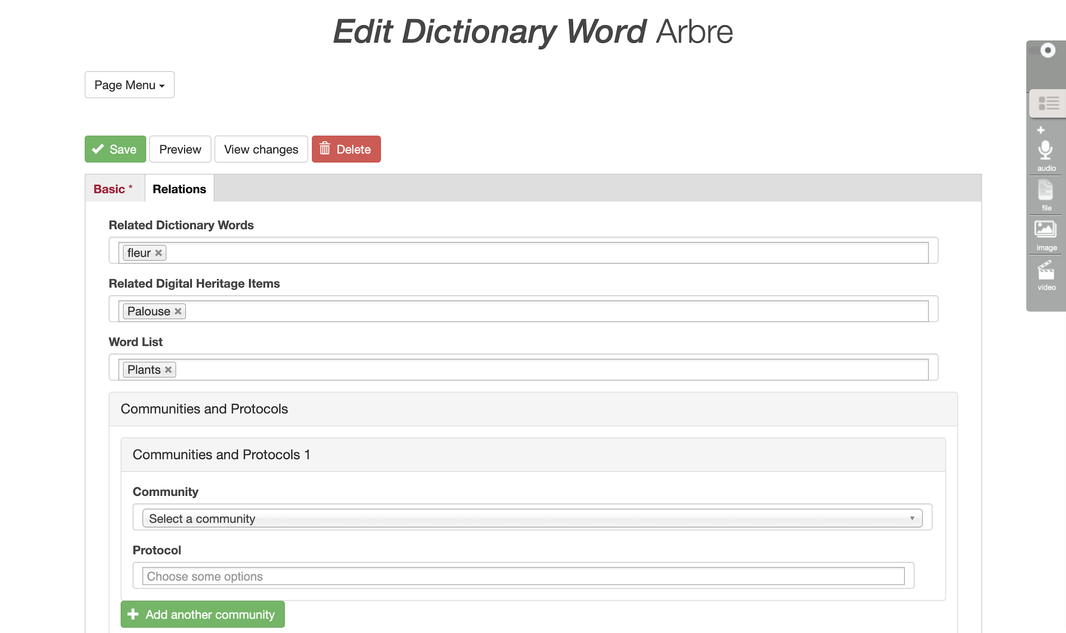
Notes:
The Relations tab is where you can connect words together, connect words with DH items, and add words to word lists.

Slide 12
Notes:
And all of that will come together to create really robust, rich, dictionary entries.

Slide 13
Credits
More resources at www.mukurtu.org/support
Screenshots from:
https://plateauportal.libraries.wsu.edu/
This template is free to use under Creative Commons Attribution license.
Presentation template by SlidesCarnival.
Minicons by Webalys
These slides contain changes to color scheme and content.

Slide 14
Using this Resource
The Digital Stewardship Curriculum is an Open Educational Resource created by the Center for Digital Scholarship and Curation.
All presentations and resources created by the CDSC are licensed under a Creative Commons Attribution-NonCommercial-ShareAlike 4.0 license (CC BY-NC-SA). Please share, reuse, and adapt the resources and provide attribution to the Center for Digital Scholarship and Curation, Washington State University.

