Slide 1
Mukurtu CMS: Collections
Digital Stewardship Curriculum
Notes:
These slides will introduce a feature that will give you more tools to organize and enrich your site content: Collections

Slide 2
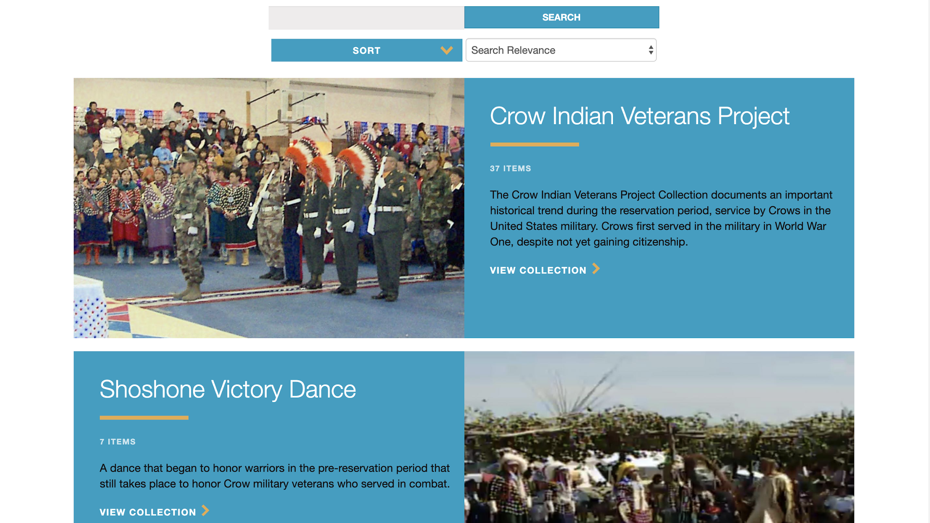
Notes:
When you browse the collections page, you’ll see the title, summary, and featured image for each collection.

Slide 3
Notes:
Within a collection, you’ll again have the title, summary, and featured image.
You’ll also be able to add a longer description...

Slide 4
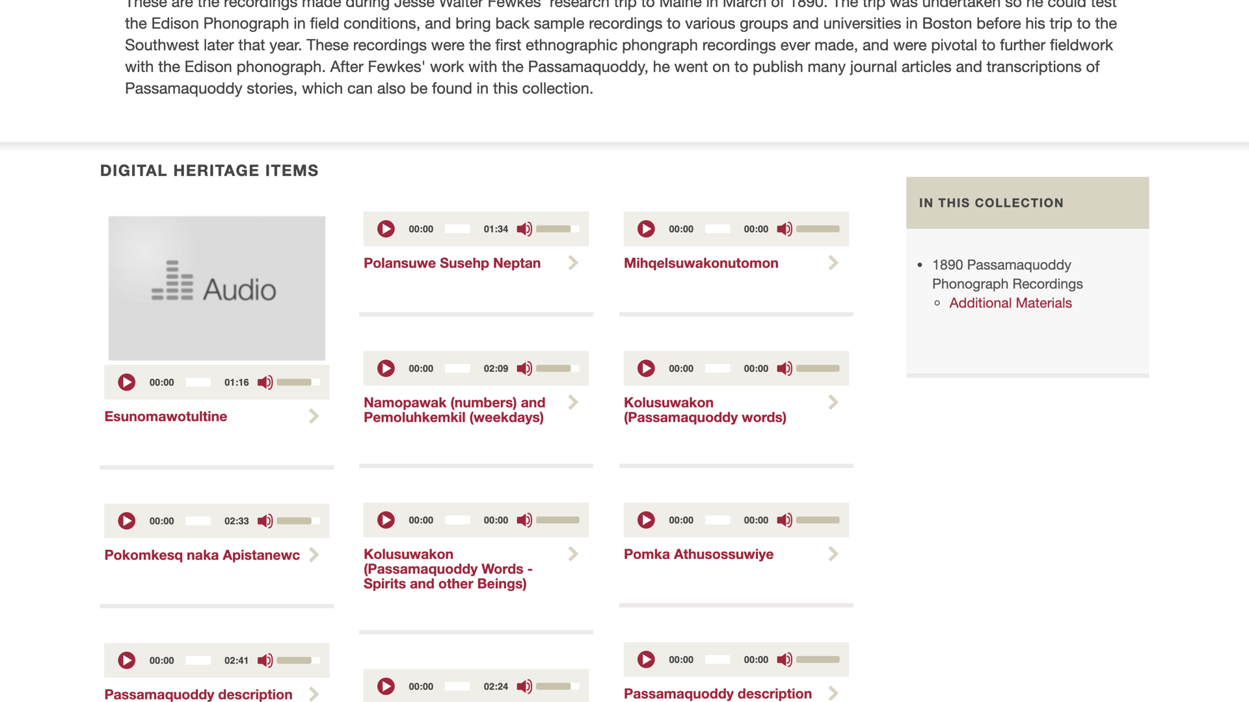
Notes:
And then there will be a display of all the items within the collection.
You can also see on the right sidebar that we can include sub-collections, so a collection within a collection. This is really useful when recreating archival boxes and folders as collections.

Slide 5
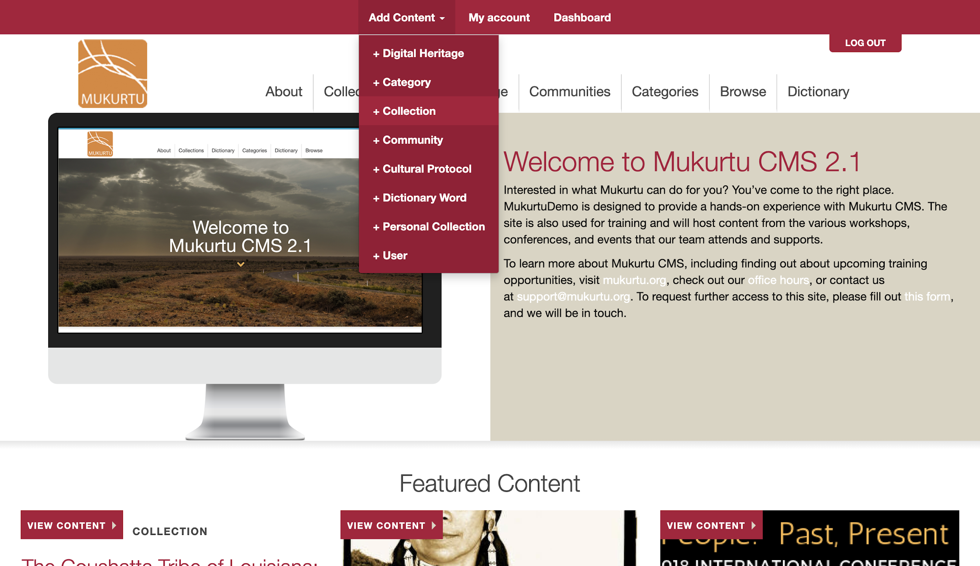
Notes:
To create a collection, from the add content menu, select +Collection

Slide 6
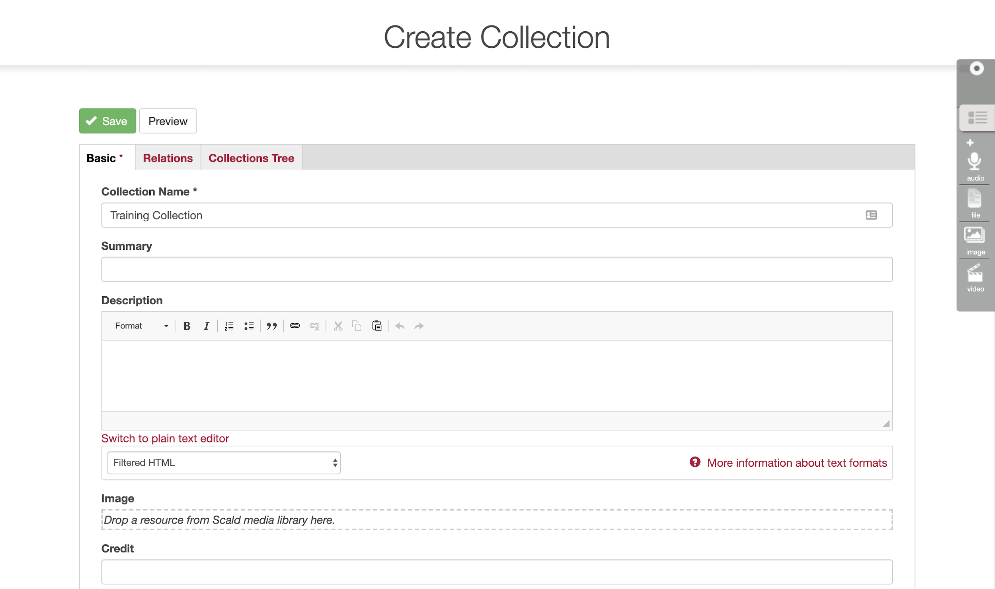
Notes:
From here, in the Basic tab, make sure to give the collection a name.
You can also add a summary, description, and featured image. You can always come back and add these later as well.

Slide 7
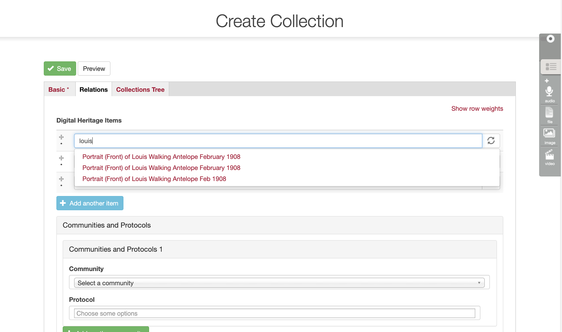
Notes:
On the relations tab, you can search for digital heritage items to add to the collection. Search for them by title, and then choose them from the dropdown list.

Slide 8
Discuss or Reflect
How might you use the Collections feature to
organize content on your Mukurtu CMS site?
Notes:
How might you use the Collections feature to organize content on your Mukurtu CMS site?
Reflect existing structures in your collections and materials
Use new ways to group content together in a digital space
Any special uses like “Identify These Pictures” to hold all content that needs community input to identify people, places, or dates

Slide 9
Credits
More resources at www.mukurtu.org/support
Screenshots from:
https://passamaquoddypeople.com/
Little Big Horn College
This template is free to use under Creative Commons Attribution license.
Presentation template by SlidesCarnival.
Minicons by Webalys
These slides contain changes to color scheme and content.

Slide 10
Using this Resource
The Digital Stewardship Curriculum is an Open Educational Resource created by the Center for Digital Scholarship and Curation.
All presentations and resources created by the CDSC are licensed under a Creative Commons Attribution-NonCommercial-ShareAlike 4.0 license (CC BY-NC-SA). Please share, reuse, and adapt the resources and provide attribution to the Center for Digital Scholarship and Curation, Washington State University.

