Slide 1
Planning a First Mukurtu CMS Project
Digital Stewardship Curriculum
Notes:
These slides give project planning advice for getting started with a creating content on a Mukurtu site
Examples from sites in use today (2020), are also included

Slide 2
Mukurtu Project Planning
Goals and outcomes
Audiences
Scope
Timeline
Community contribution
Measuring success
Notes:
Having an effective and clear plan is important to the successful outcome of a project.
It’s important to be specific - something like “we are doing to digitize everything in our collections and put them online” is ,first, not really realistic, but also not very effective and brings up a lot of questions!
Try to break a project up to make it achievable in a certain amount of time - especially for a first project
Goals and Outcomes
WHY are you going to put things online? - what are the goals of your community and institution
Audiences
For whom?
Scope
WHAT collections/materials will you digitize/upload? How will you prioritize?
WHO is going to do the work? Are staff or equipment needed?
Timeline
WHEN will it be complete? Will you work in multiple stages to create a larger project?
Community contribution
Will you want your community members involved in the project?
How will that work? What do you hope people will contribute?
How will you show gratitude or compensate people for their time (if appropriate)?
Measuring success
HOW will you know it is successful?

Slide 3
General Mukurtu Project Ideas
Tribal Digital Stewardship Cohort Program training model
One year time frame
Learning Mukurtu functions, testing out skills
Options for project structure
One collection or group of materials
Sampling of different collections/formats
General website, audience, and outreach planning
Notes:
We have one example of a Mukurtu Project from a previous Tribal Digital Stewardship Cohort Program year (http://archives.hunaheritage.org/ )
Generally, these were projects accomplished (or started out) in ONE YEAR on a practice site, while their staff were learning how to use Mukurtu
Some people focused on specific collections or groups of materials in their projects,
One collection or group of materials
“Case study” approach
Sometimes helpful if already focused on specific collection, topic, or format through a grant or Tribe-wide priority
While others took a sampling of different collections and formats to showcase and test the many uses
Trying out as many Mukurtu features as possible with many different formats and items
A variety of photographs, audio, video, documents, collections, community records, dictionary words, etc.
And still others focused their project on general website and outreach planning
Focus on front page and about page
Some people would take their practice project, and turn it into a real online collection for their community. Other people would delete their practice project and save the ideas and knowledge for another time.
There are many ways to start out
Our other example in these slides is not from a Tribal Digital Stewardship Cohort Program practice site, but from a website that started with a specific purpose and focus https://passamaquoddypeople.com/

Slide 4
Notes:
Our first example is from the Huna Heritage
The Huna Heritage Foundation decided to start with a pretty narrow scope, with the intent of growing the project in the future.
One of the best things about starting small is they were able to kick off with high interest materials that they KNEW the community was interested in. High interest means a lot of community engagement and buy in, and that translates to more support to expand later.

Slide 5
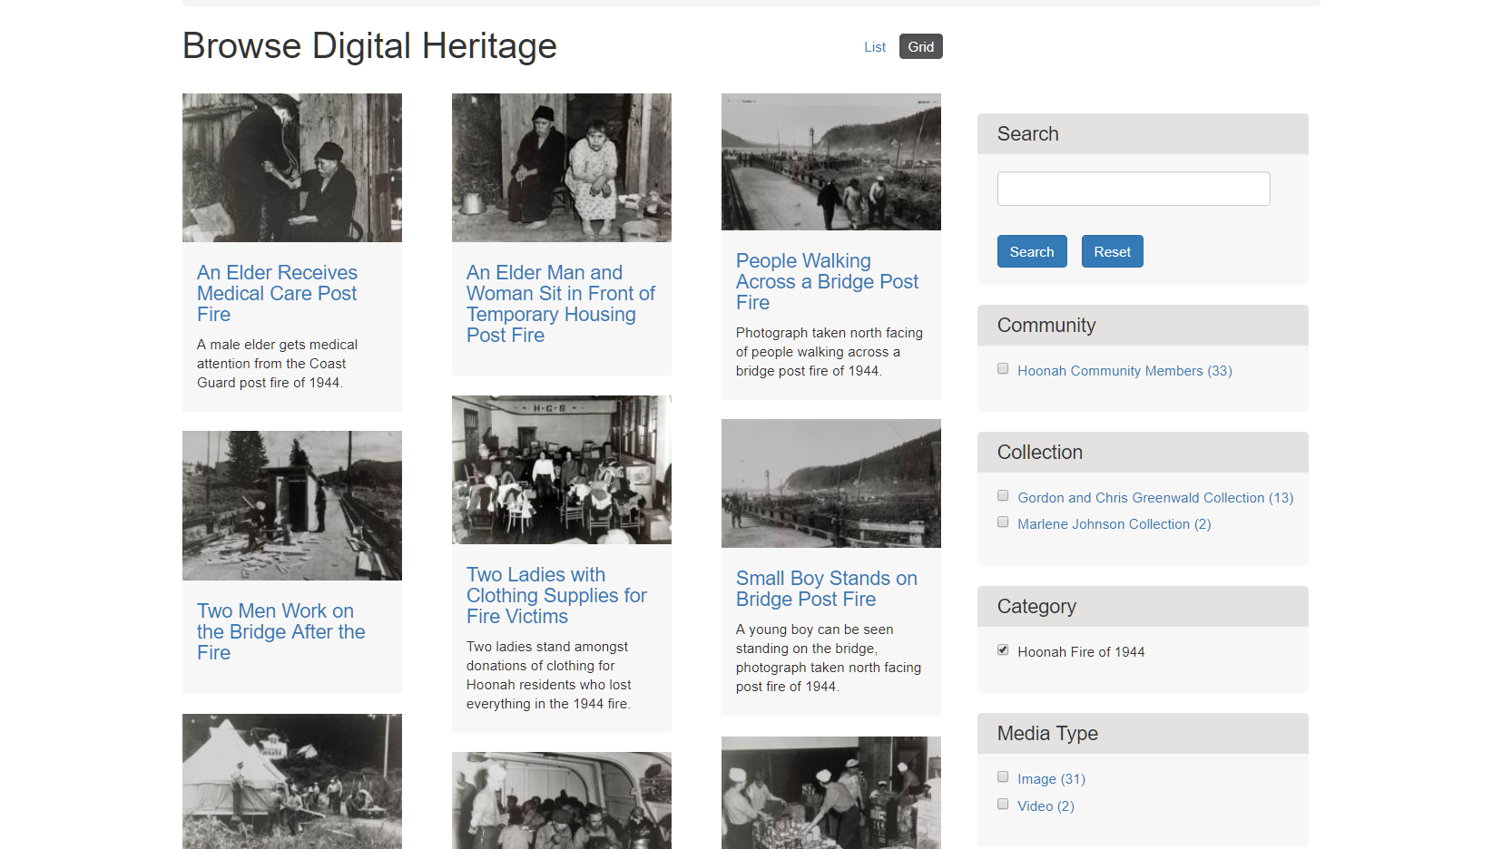
Notes:
Hoonah was struck by a massive fire in 1944. People are always interested in photos from that time and event, so that was one of their top priorities.

Slide 6
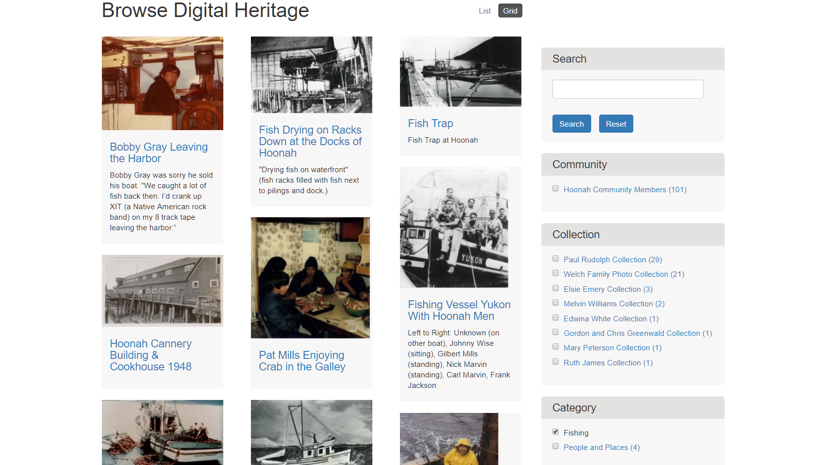
Notes:
Hoonah also is well known for their fishing history and culture. Amelia Wilson (HHF Director) also prioritized photos of the fleet and fishing life. Since putting these photos up, they have spent a lot of time doing community outreach to collect more photos and stories from community members.

Slide 7
Notes:
The Passamaquoddy nation also have a site that started with a very specific focus.

Slide 8
Notes:
The collection of wax cylinder recordings produced by Jesse Walter Fewkes in 1890. This is a relatively small set of items, but they’ve focused on enriching them with information, narratives, and new recordings from community members, as well as bringing in other related materials like Fewkes’ journal and publications.

Slide 9
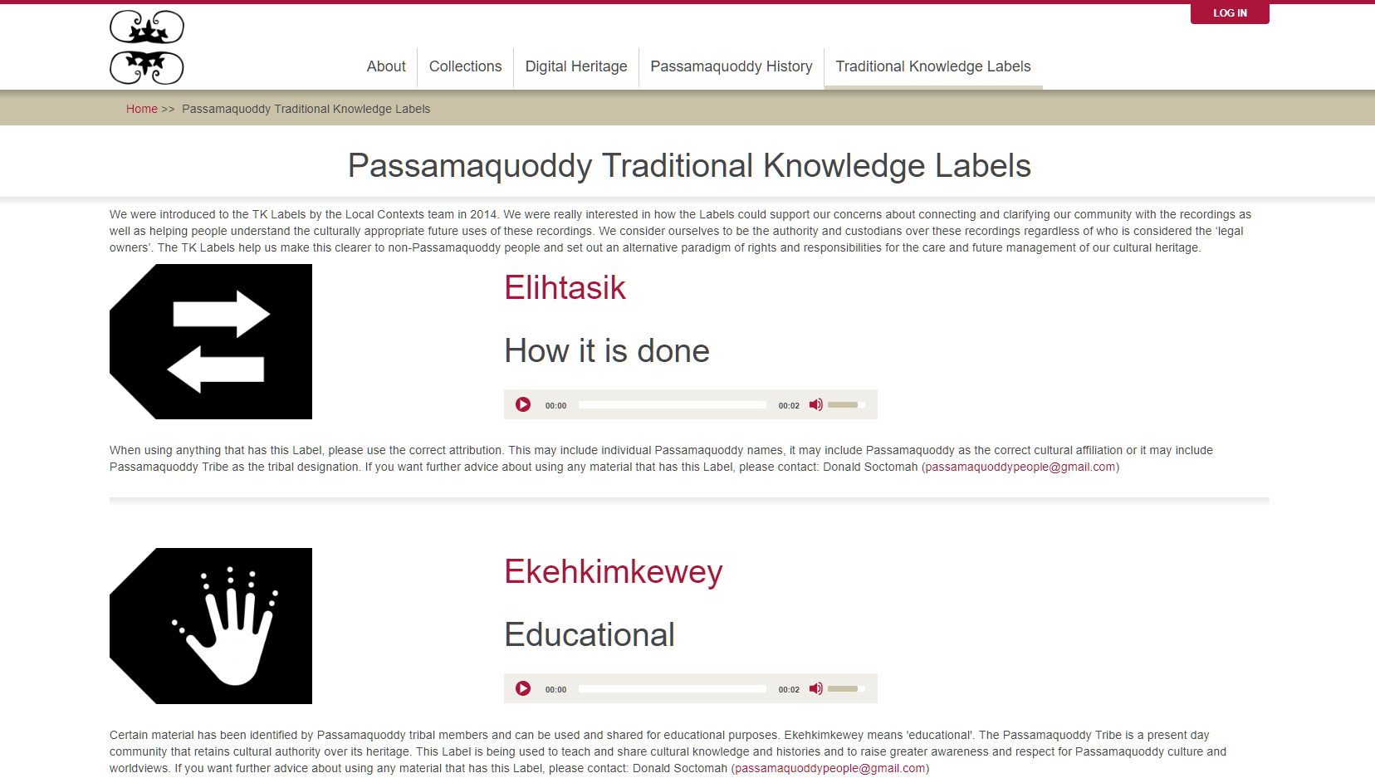
Notes:
In addition to cylinders and recordings, including TK Labels on all items was a big priority.

Slide 10
Mukurtu Project Planning Worksheets
These worksheets are meant to be used at the beginning of a project, paired with Mukurtu training.
Mukurtu CMS Project Worksheet: Part 1
Initial priority setting and idea brainstorming
Mukurtu CMS Project Worksheet: Part 2
Defining project and exploring Mukurtu features
Notes:
These worksheets are meant to be used at the beginning of a project - while also doing mukurtu training, learning, and practice
Please use other Mukurtu CMS resources from the Sustainable Heritage Network and Mukurtu Support www.mukurtu.org/support for general Mukurtu training, site planning and setup, and other skill and knowledge building needs
Part 1 gets you brainstorming and thinking about what you want your project to accomplish, for whom, and when
Part 2 gives space to plan out more specifics and define your project, the specify the Mukurtu features your project will utilize

Slide 11
Mukurtu CMS Support
www.mukurtu.org/support
Helpful for overviews, and detailed steps
Reach out with questions or issues after checking site
support@mukurtu.org
When you are confident
Create your own Mukurtu manual/instructions
Tailored to your website
Notes:
The best place to learn how to use Mukurtu, short of a workshop
The site and resources are fantastic for getting a larger view of Mukurtu and possibilities, but also for checking the technical details of how to do a specific task
Use the support email for needs that are not answered by the support site
Use Mukurtu support articles to create your own Mukurtu manual or instructions

Slide 12
Credits
Slides 4-6: http://archives.hunaheritage.org/
Slides 7-9: http://passamaquoddypeople.com/
Presentation template by SlidesCarnival.
Minicons by Webalys
This template is free to use under Creative Commons Attribution license.
These slides contain changes to color scheme and content.

Slide 13
Using this Resource
The Digital Stewardship Curriculum is an Open Educational Resource created by the Center for Digital Scholarship and Curation.
All presentations and resources created by the CDSC are licensed under a Creative Commons Attribution-NonCommercial-ShareAlike 4.0 license (CC BY-NC-SA). Please share, reuse, and adapt the resources and provide attribution to the Center for Digital Scholarship and Curation, Washington State University.

