Slide 1
Traditional Knowledge Labels
Digital Stewardship Curriculum
Notes:
These slides share information about the Local Contexts Initiative, and Traditional Knowledge labels

Slide 2
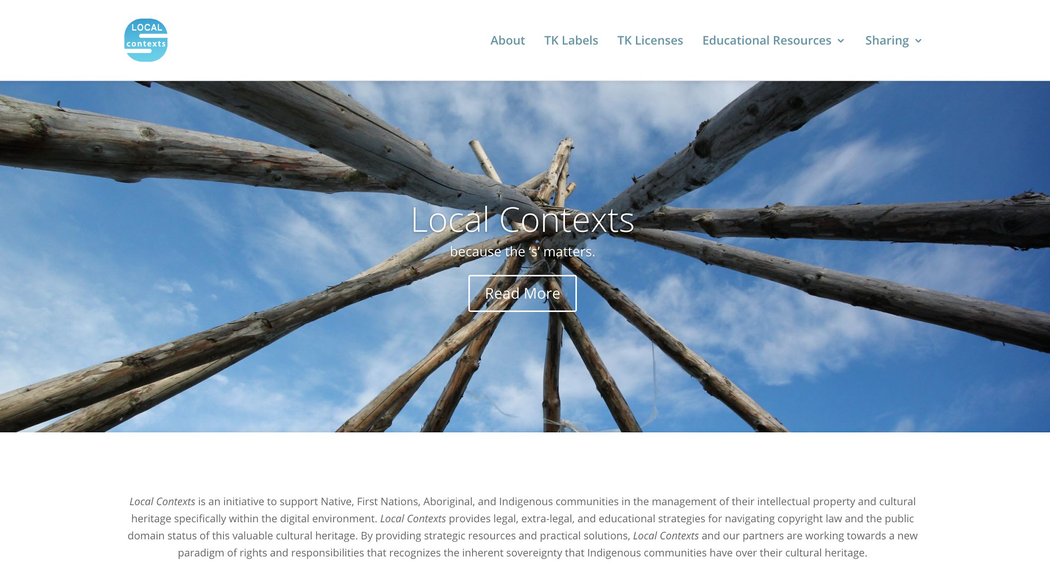
Notes:
Local Contexts focuses on the unique needs faced by Indigenous peoples who need to manage, share, and steward their digital cultural heritage materials.
The Local Contexts initiative has a few goals
Answer general questions produced by Intellectual Property laws—
Honor the fact that the specific local context for indigenous cultural materials drives how materials should be accessed, circulated and shared.

Slide 3
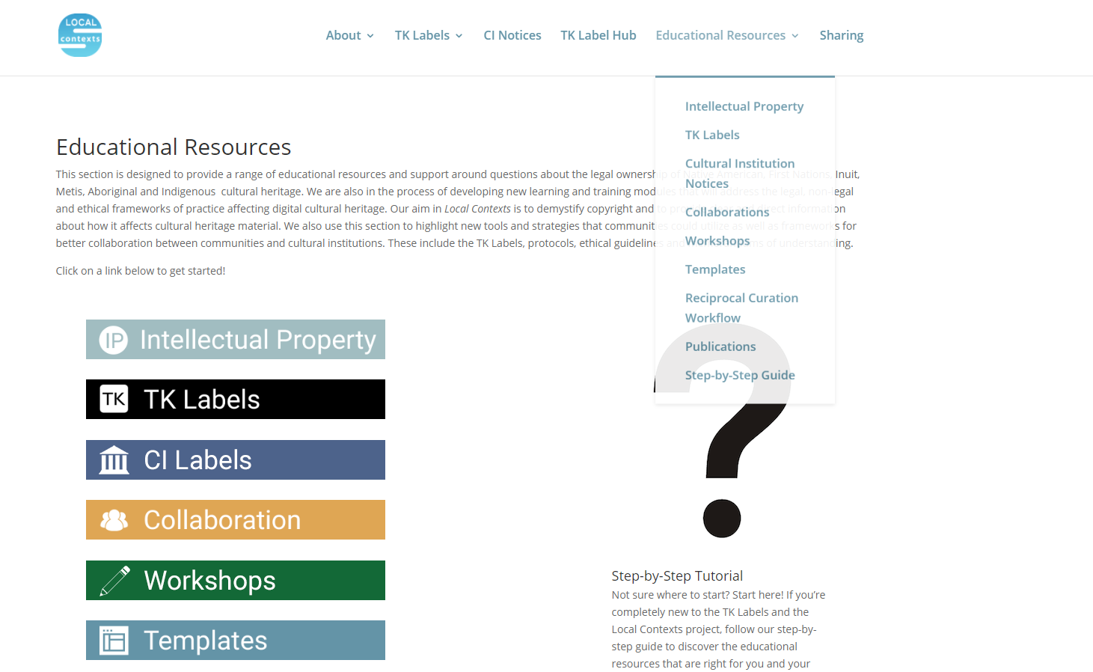
Notes:
The site contains general educational information about intellectual property rights on everything from copyright to MOUs.
Our focus in this presentation is the Traditional Knowledge Labels
Over the last four years Local Contexts has developed a set of Labels to deal specifically with the circulation and citation of digital heritage in the context of collecting institutions —our libraries, archives and museums—
As well as in the public domain, online in social and educational settings.

Slide 4
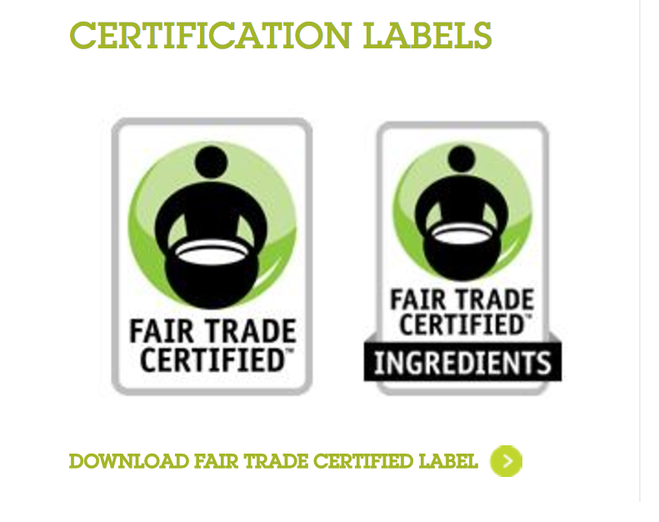

Creative Commons
Notes:
These traditional knowledge labels are Inspired by Creative Commons licenses that purposely DISRUPT models of circulation and access within traditional copyright. (jodi will be diving into CC)
The Local Contexts initiative seeks to EDUCATE library professionals, collectors, museum curators and academics about
the considerations that Indigenous cultural materials bring to ideas of OPEN ACCESS and the appropriate reuse of digital materials.
Fair Trade labels, provided the inspiration for the project to provide a LABELING scheme that would be flexible, educational, and accommodate communities locally and globally [next]

Slide 5
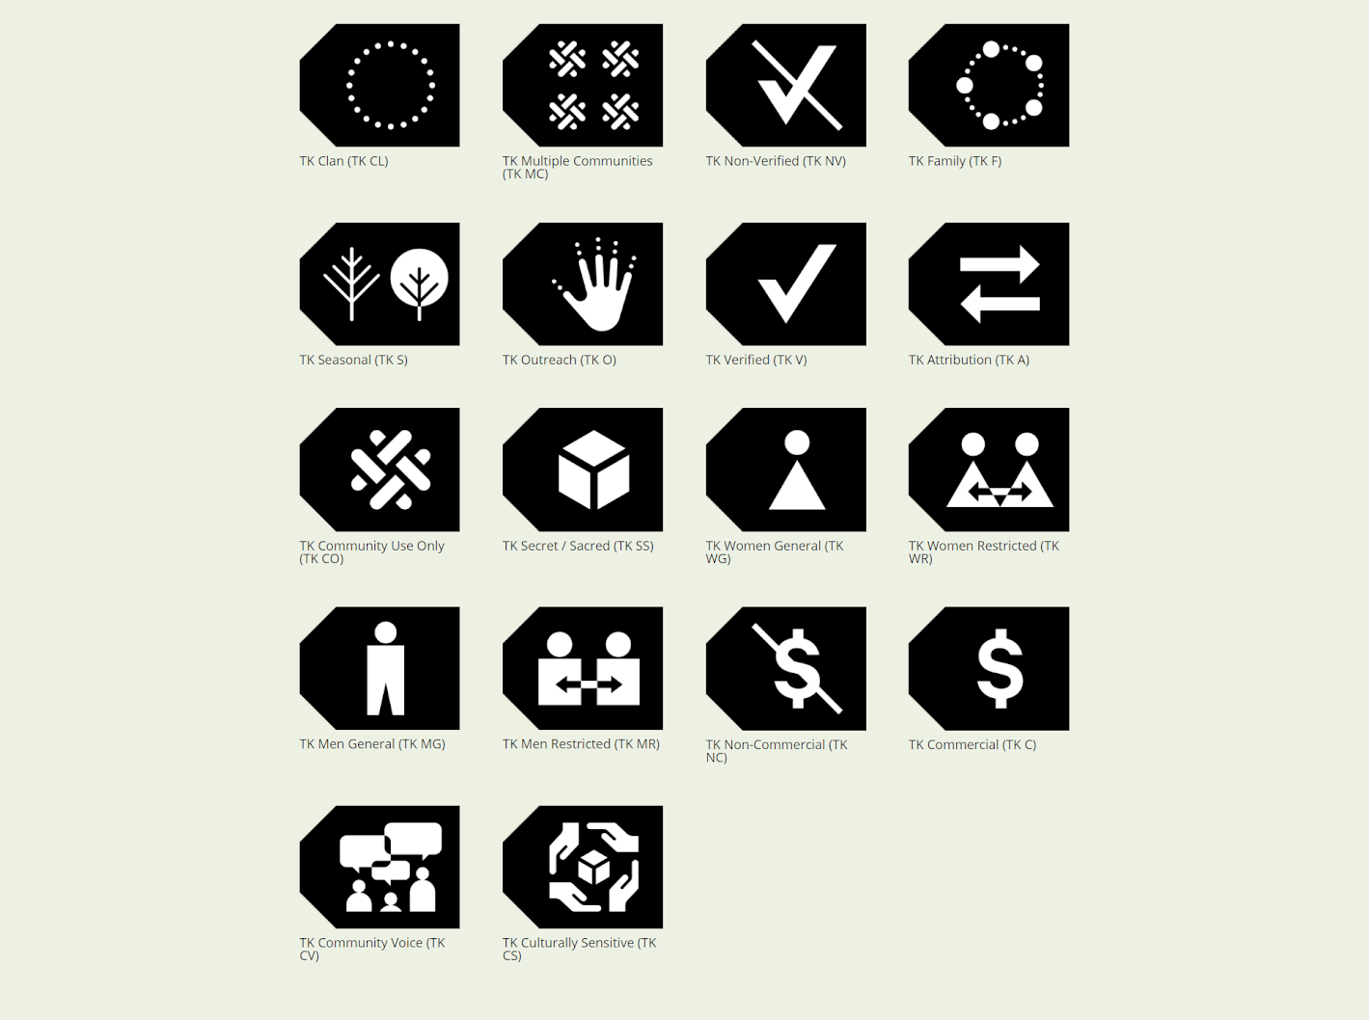

Notes:
The project has created a set of 18 TK labels as of Fall 2020
They address various aspects of the local needs for circulation, use, access and reuse of digital materials.
So far ATTRIBUTION (click) is one of the first and most often used labels
This is not surprising given the colonial histories of collecting
Professional practices of defining AUTHORSHIP by the person who took the photo, recorded the audio and wrote down the language.
Another example is the SEASONAL label - communities that use this label may have some stories should only be told in certain seasons, or other seasonal protocols.

Slide 6
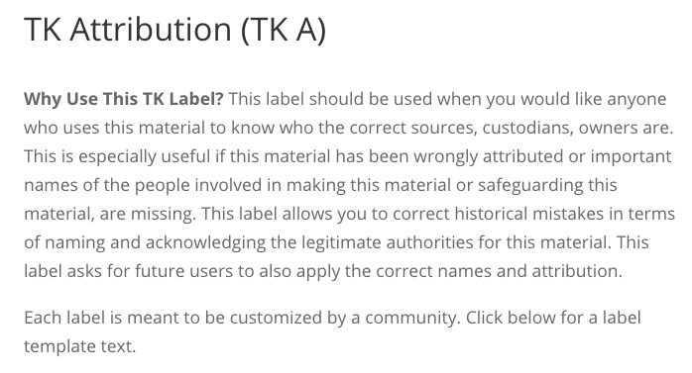

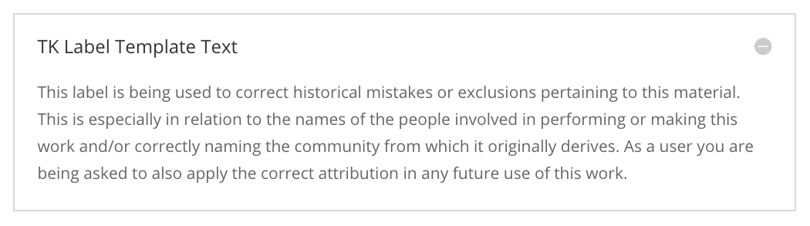
Notes:
On the website The Labels have general descriptions so that communities can use them as is. Some communities who use TK Labels choose to adapt and customize the label descriptions in their own words—bringing back to the foundation of the local context.
I’ll share an example of one project that will help you see the TK labels in action.

Slide 7
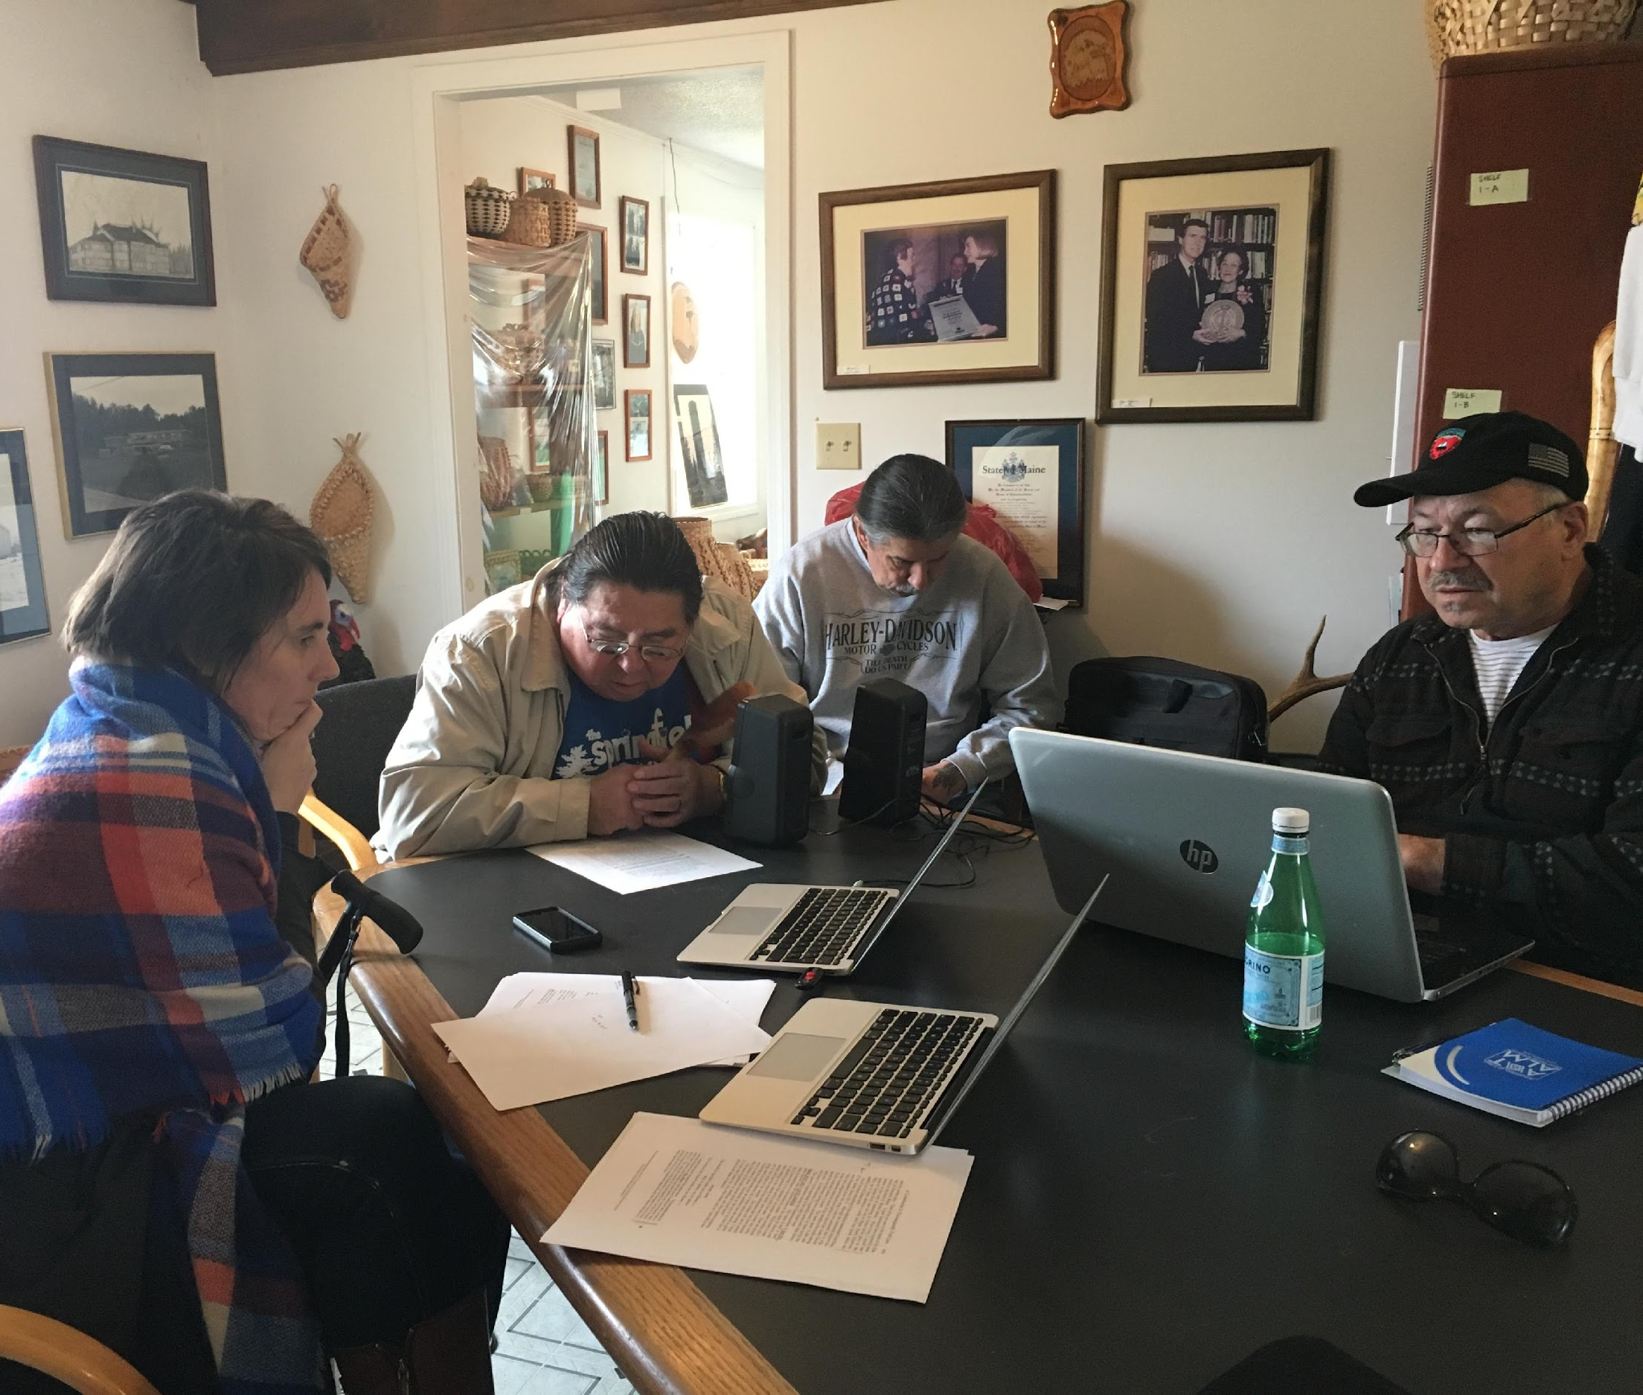
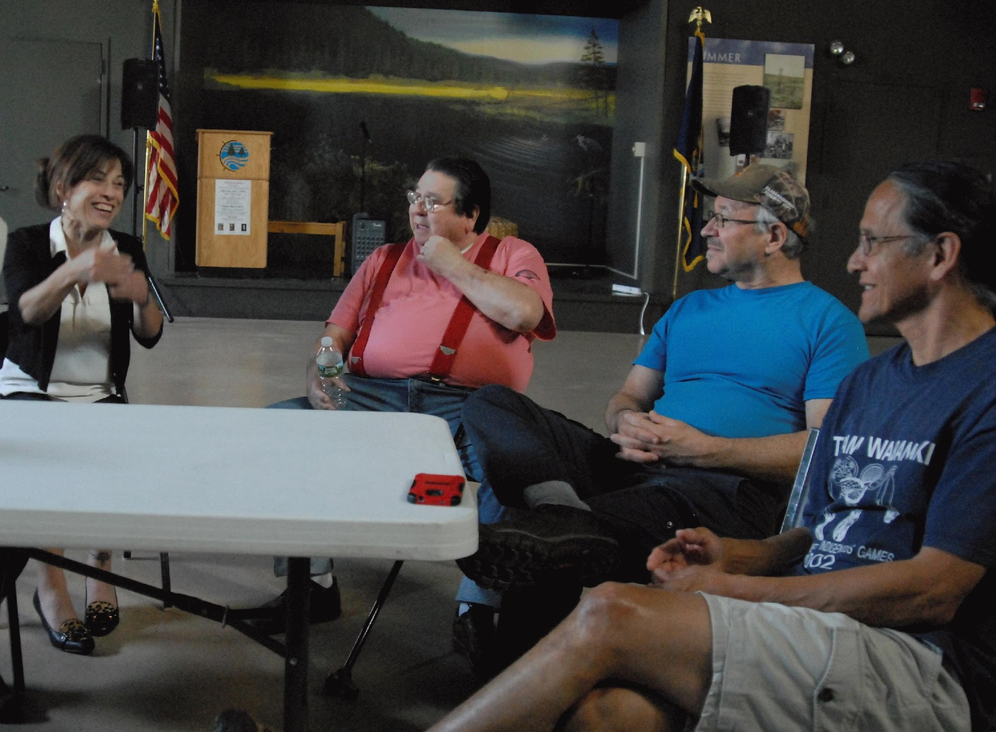
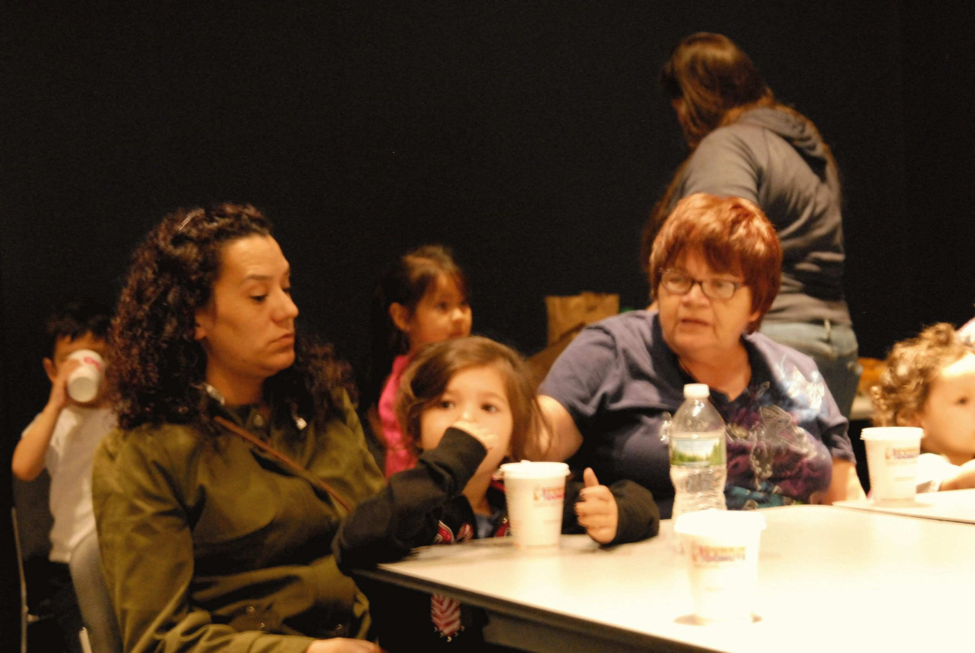
Notes:
The Local Contexts project team is working with the Passamaquoddy Nation and a collection of wax cylinder recordings of anthropologist Jesse Walter Fewkes from 1890.
There are 31 digital files that have been returned from the Library of Congress— beginning in April 2016 — they were taken to the Passamaquoddy Nation and over the year and a half they have had listening sessions throughout the community (without outside staff).
For this project the Passamaquoddy have crafted TK Labels to be attached to the updated record in the Library of Congress’ online catalog

Slide 8
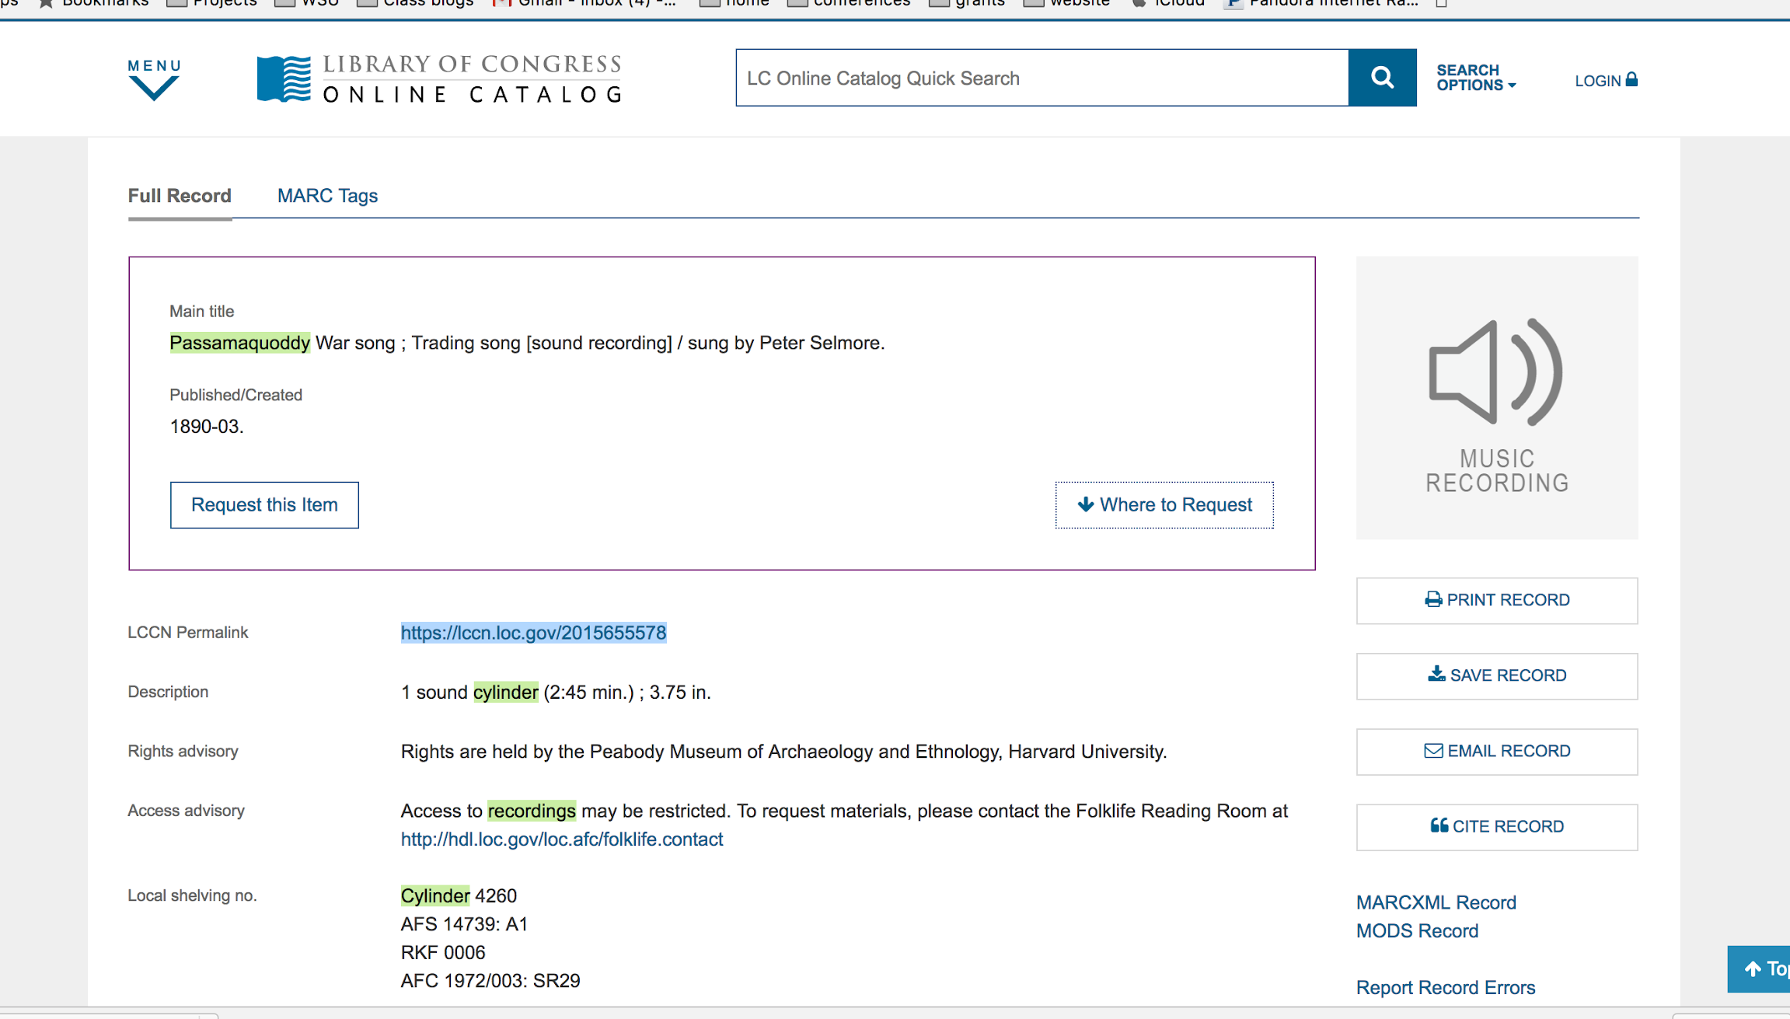


Notes:
Here is the previous record:
Title: Passamaquoddy War Song; Trading Song
Rights: held by the Peabody Museum of Archaeology and Ethnology, Harvard University

Slide 9
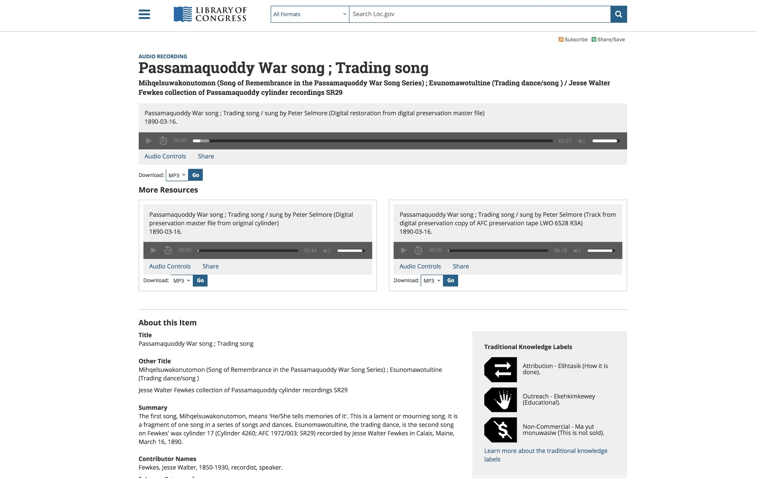
https://loc.gov/item/2015655578
Notes:
Now as of spring 2018—there is an updated Library of Congress record
The TITLE: now lists two separate songs (not one as it had been listed prior) with Passamaquoddy names in their language.
And there are three TK labels: ATTRIBUTION, OUTREACH and NON-COMMERCIAL which all have been defined by the Passamaquoddy
Exciting project and partnership
https://loc.gov/item/2015655578

Slide 10
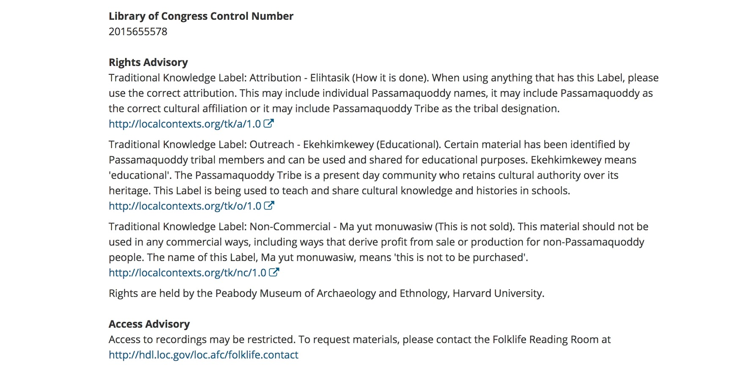
Notes:
(Continued)
Each label’s title is translated into the Passamaquoddy language and the text has been customized so we have, for example: Attribution: “How it is Done” with instructions for proper attribution.
And finally we see that the Peabody Museum listed beneath the Passamaquoddy labels now as the rights holder. While copyright may not have shifted, indeed we could not change that structure, the TK Labels provide an important intervention allowing viewers to see the proper use and attribution these materials.

Slide 11
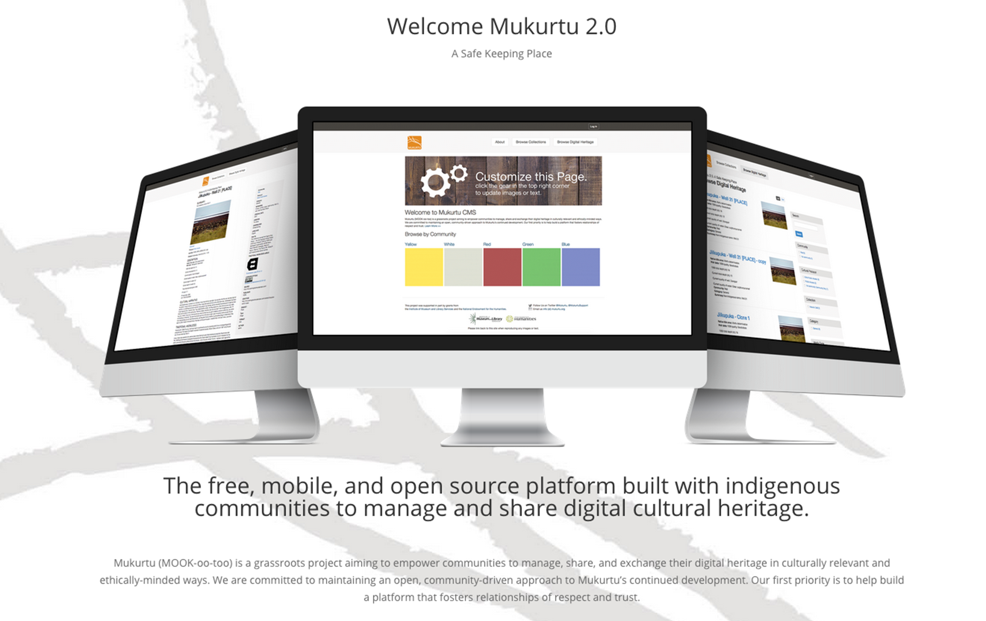
Notes:
For another couple examples:
Mukurtu CMS sites have labels embedded
As standard TK label text
Can customize text according to local needs
Specifically, the Passamaquoddy people have created a website using TK Labels,

Slide 12
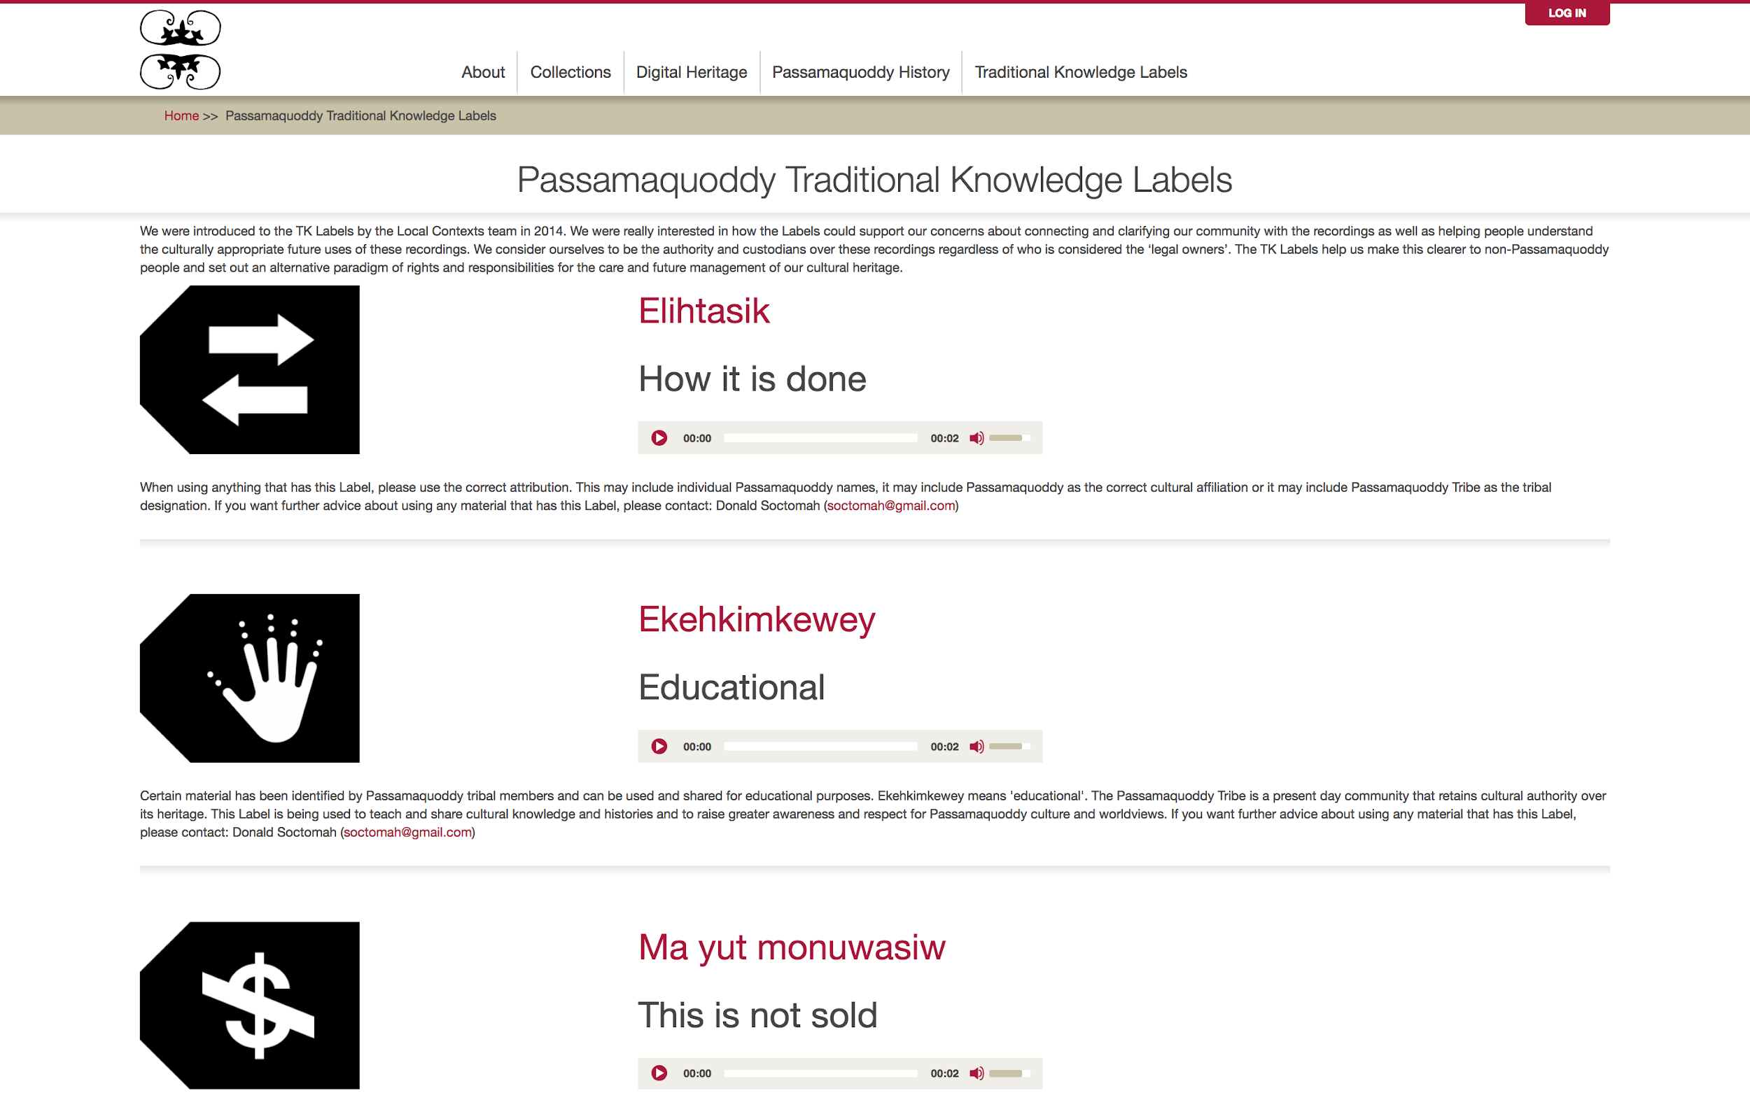
Notes:
This is an explanatory page used to explain why the TK Labels are being used on the Passamaquoddy site and state clearly that “We consider ourselves to be the authority and custodians over these recordings regardless of who is considered the ‘legal owners”
Each of the labels has been translated into Passamaquoddy and their is contextual text explaining the meaning of each label — so for example

Slide 13
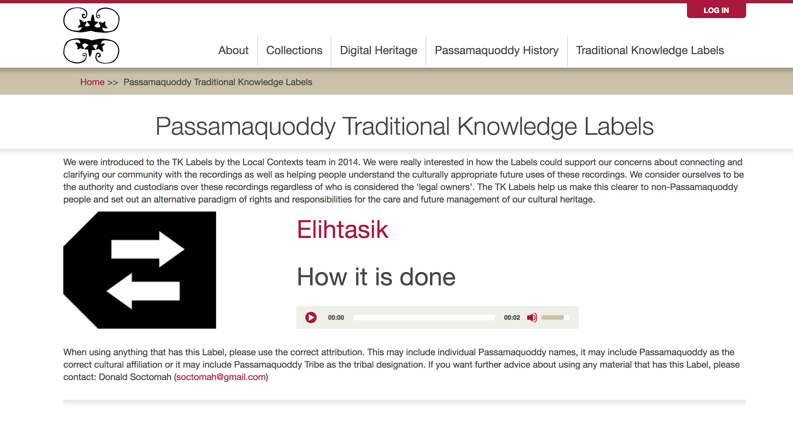

COMPANY / PRESENTATION NAME
Notes:
The Attribution label is translated to “Elihtasik” in the Passamaquoddy language
With the context and history for the materials in the site, Donald and his staff decided to use the new collections feature in Mukurtu quite extensively to curate the returned materials

Slide 14
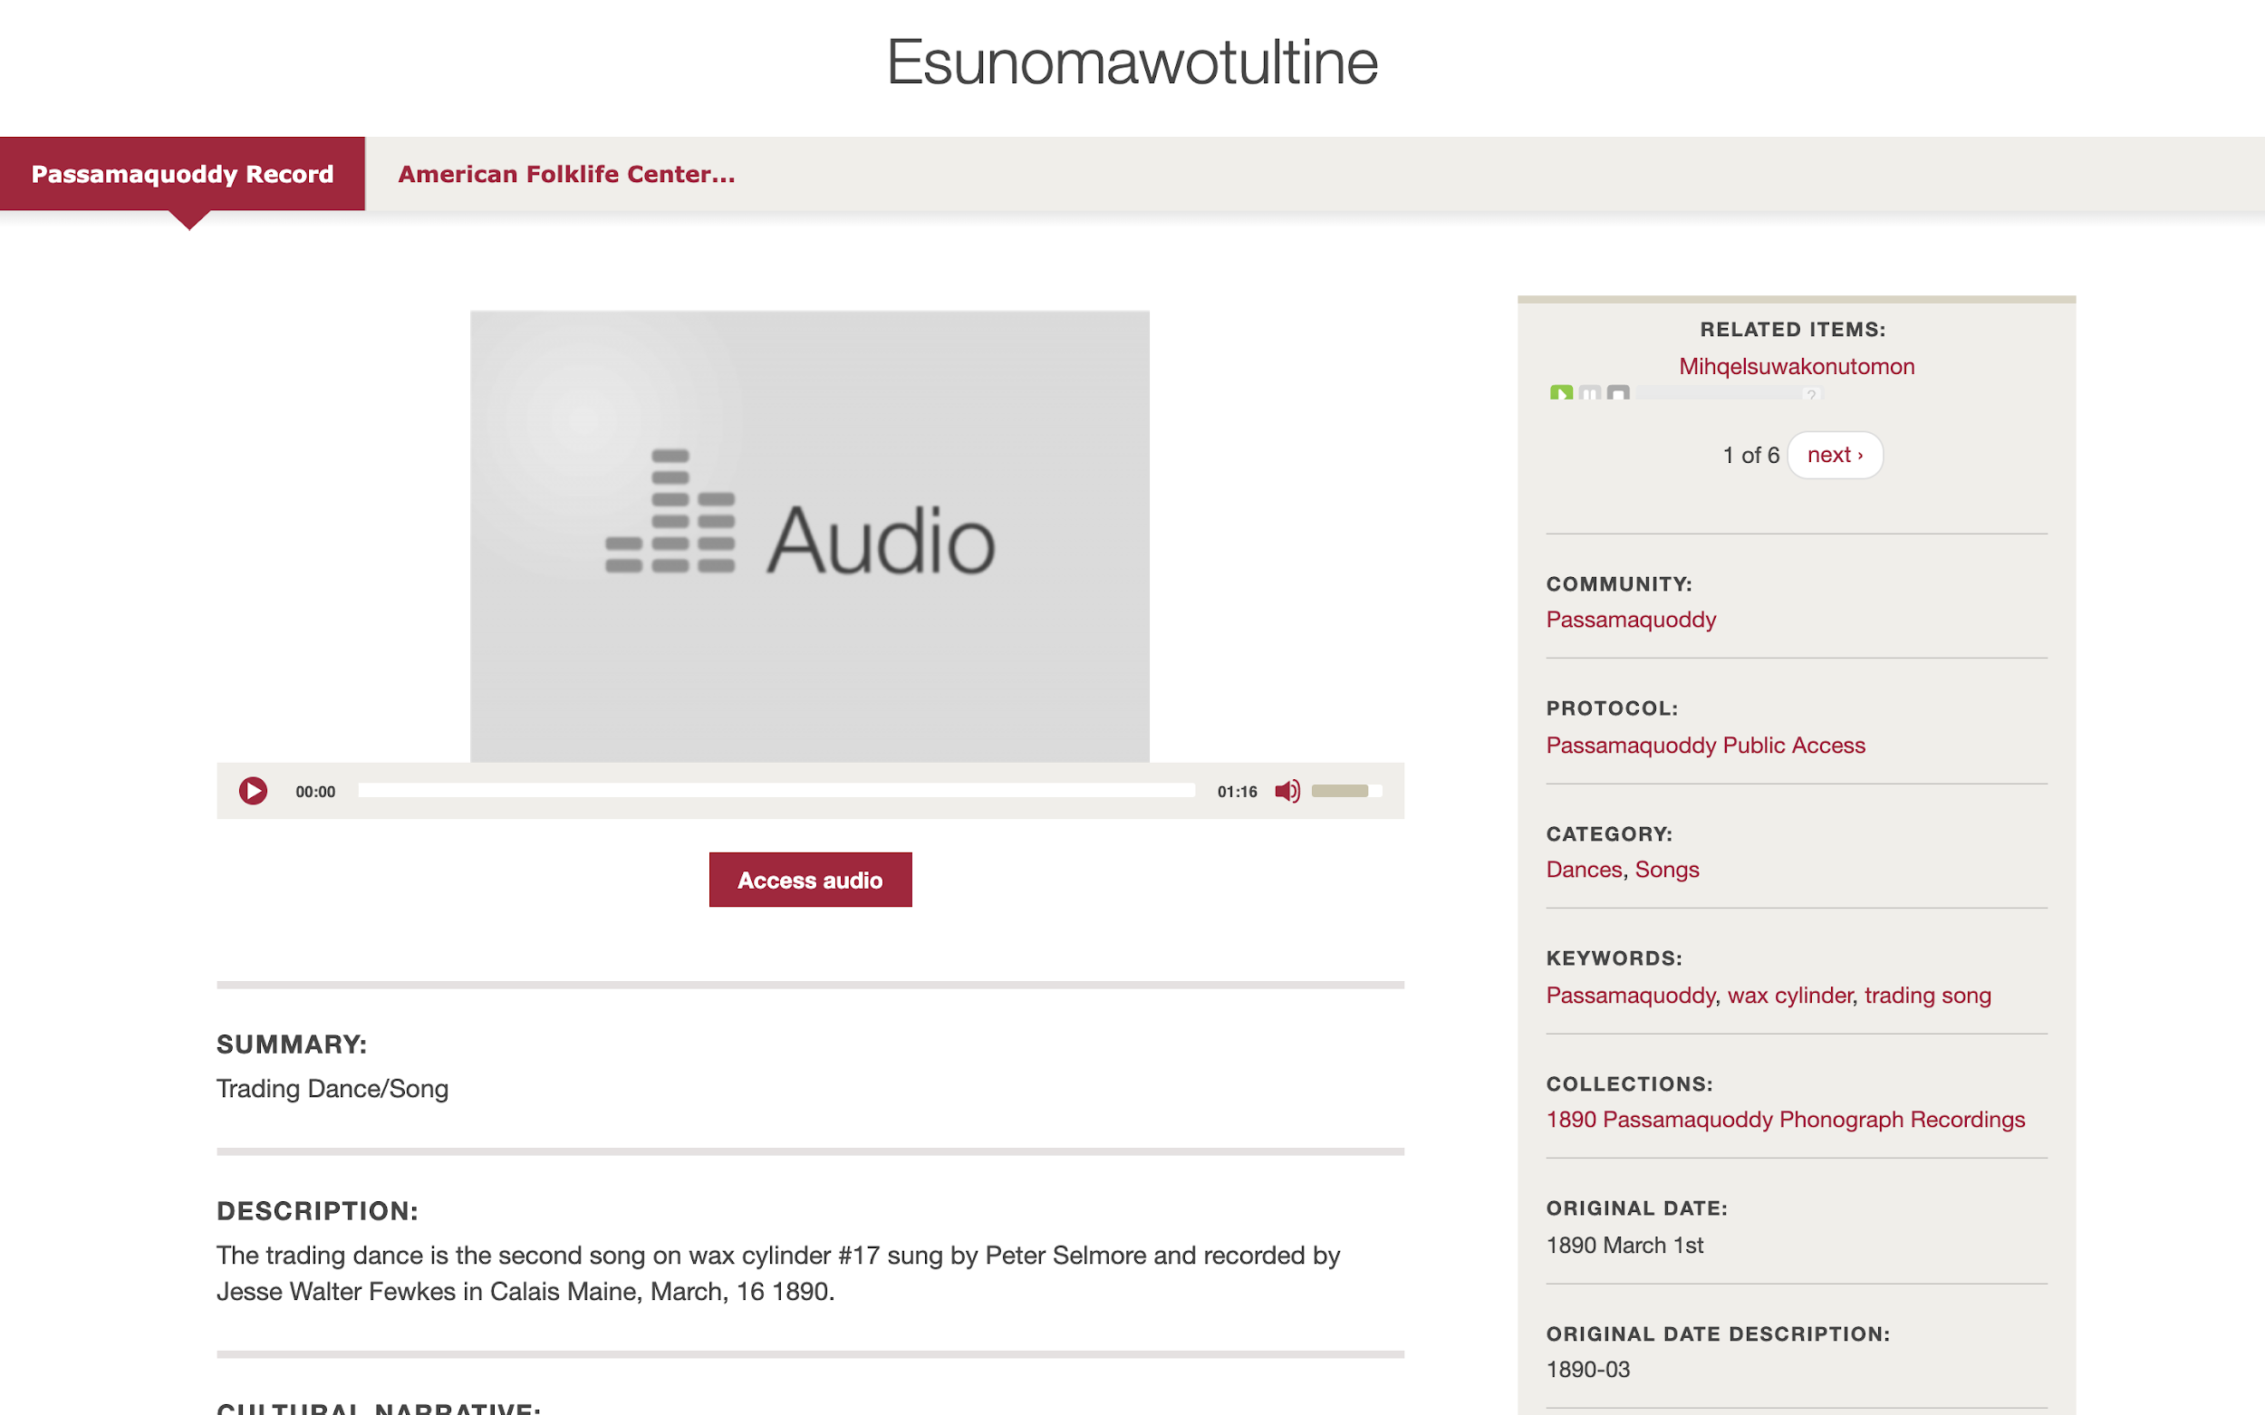
Notes:
We see on the top right there are seven related items— all that the Passamaquoddy have added to this one song —
And then as we scroll down we get to the other Mukurtu metadata fields —

Slide 15
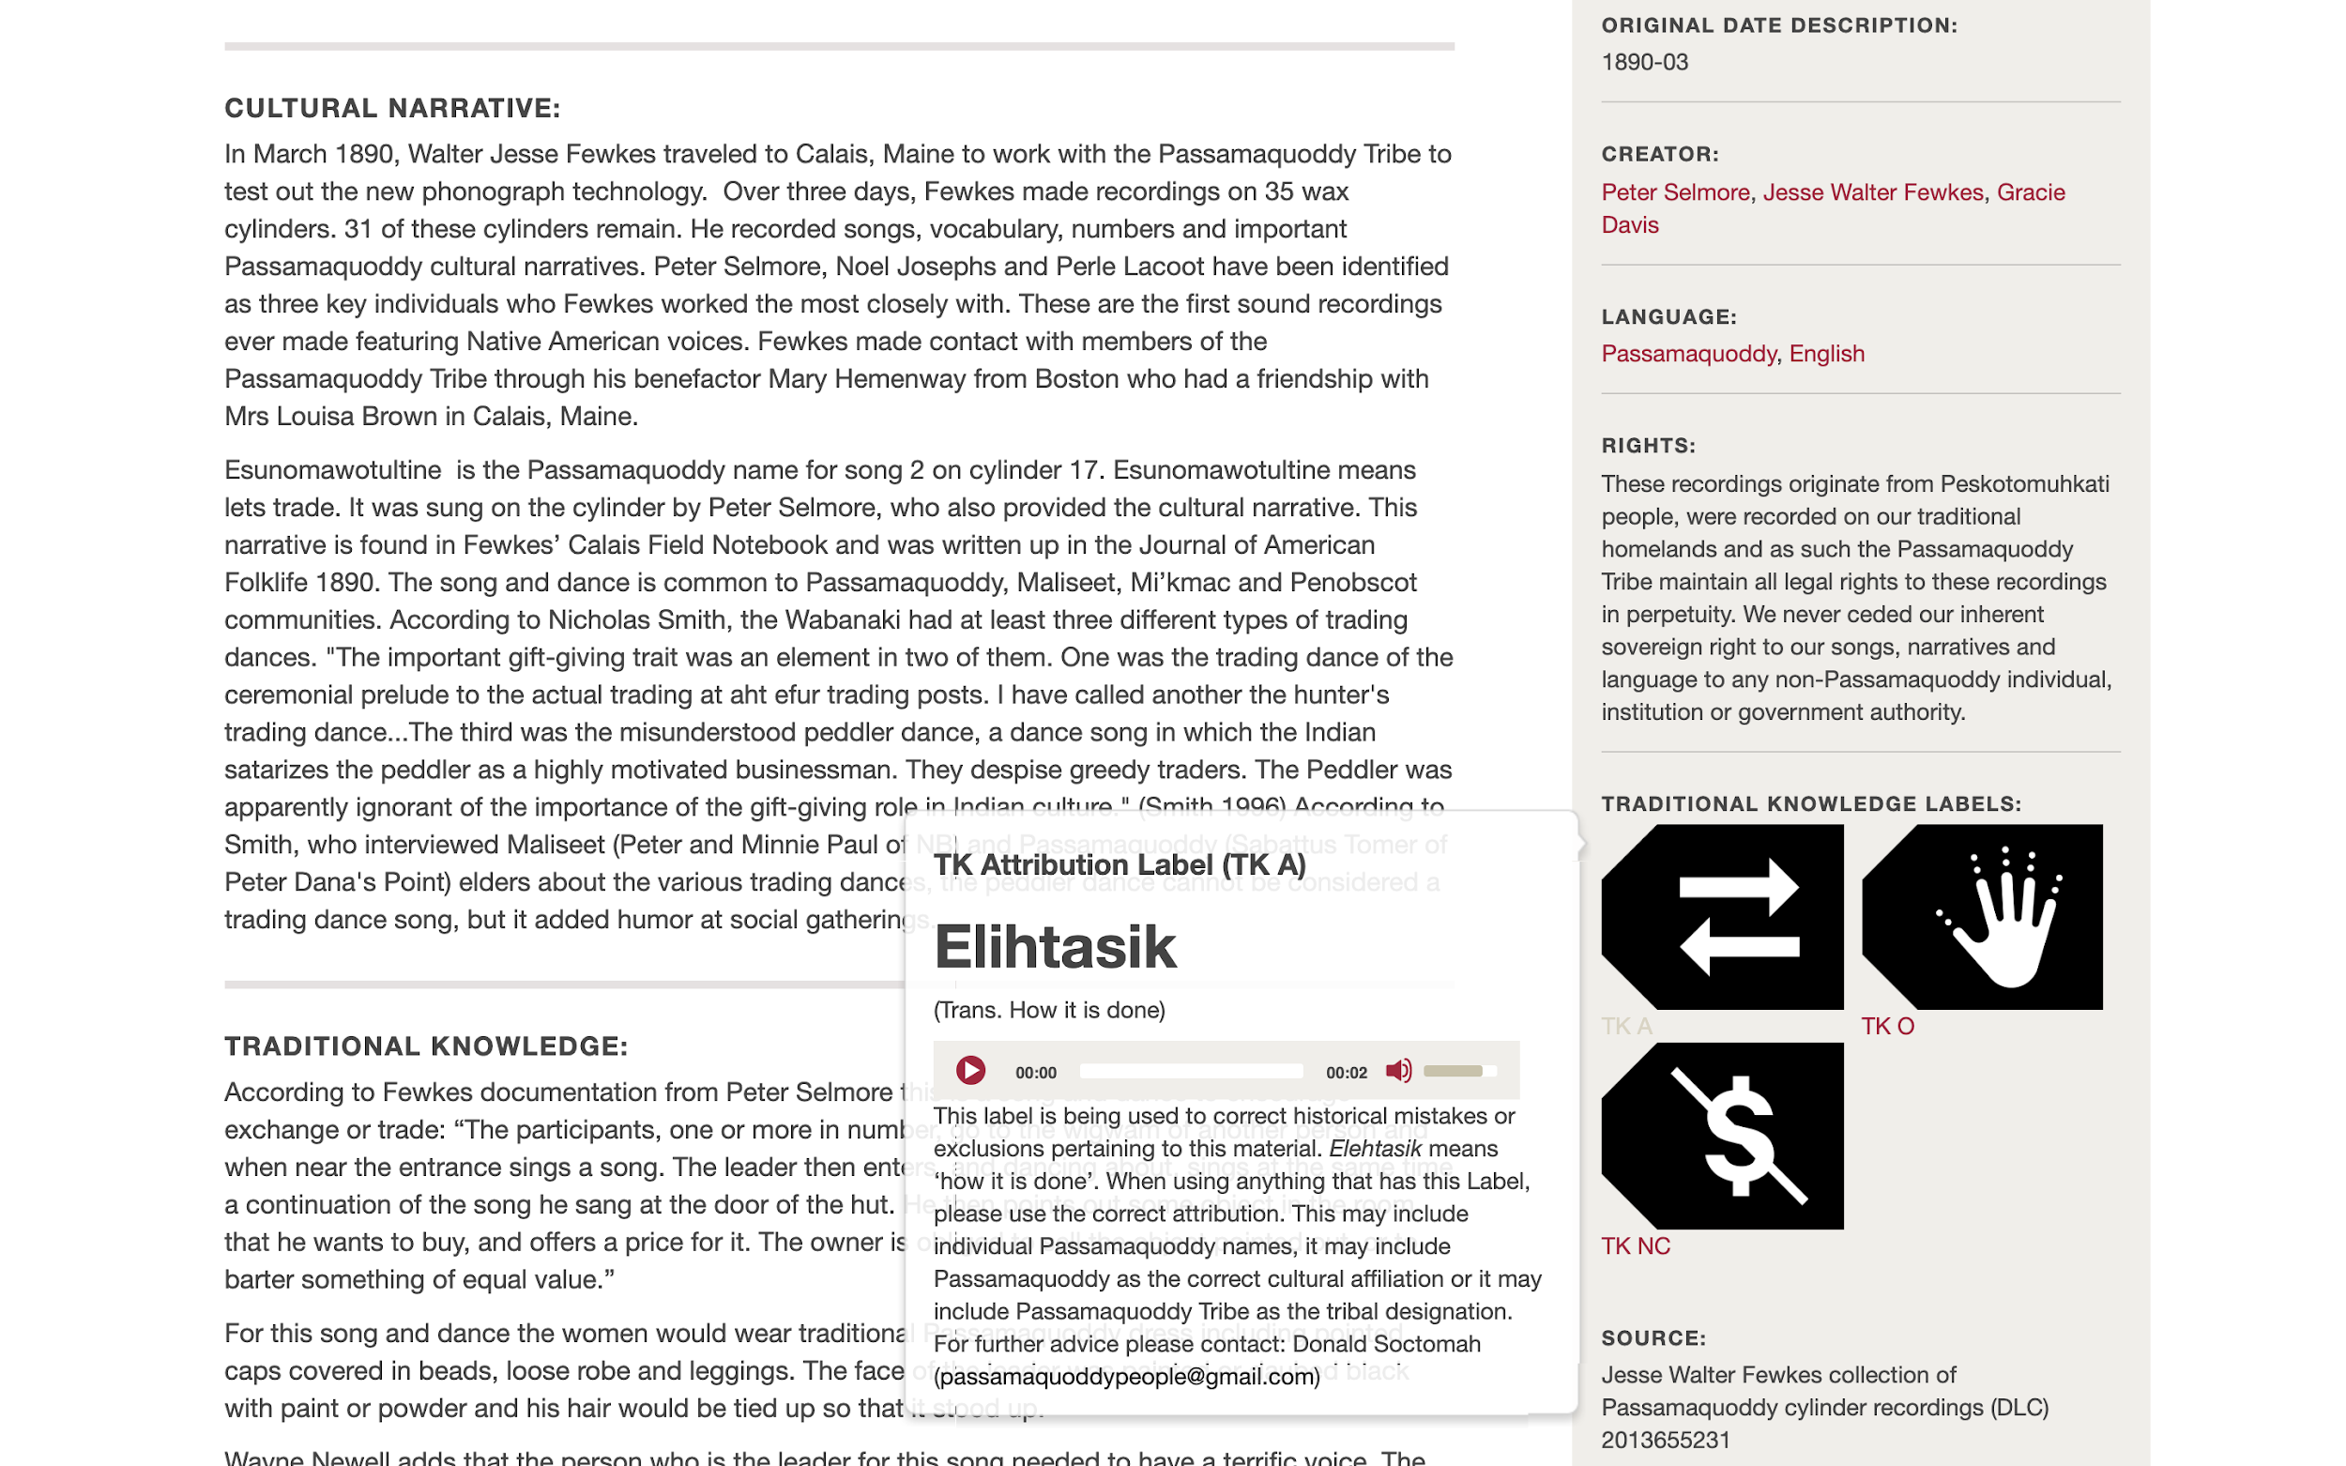
Notes:
We see here three TK labels on the right and then the cultural narrative added by community members— and in the Traditional knowledge field we have a textual narrative

Slide 16
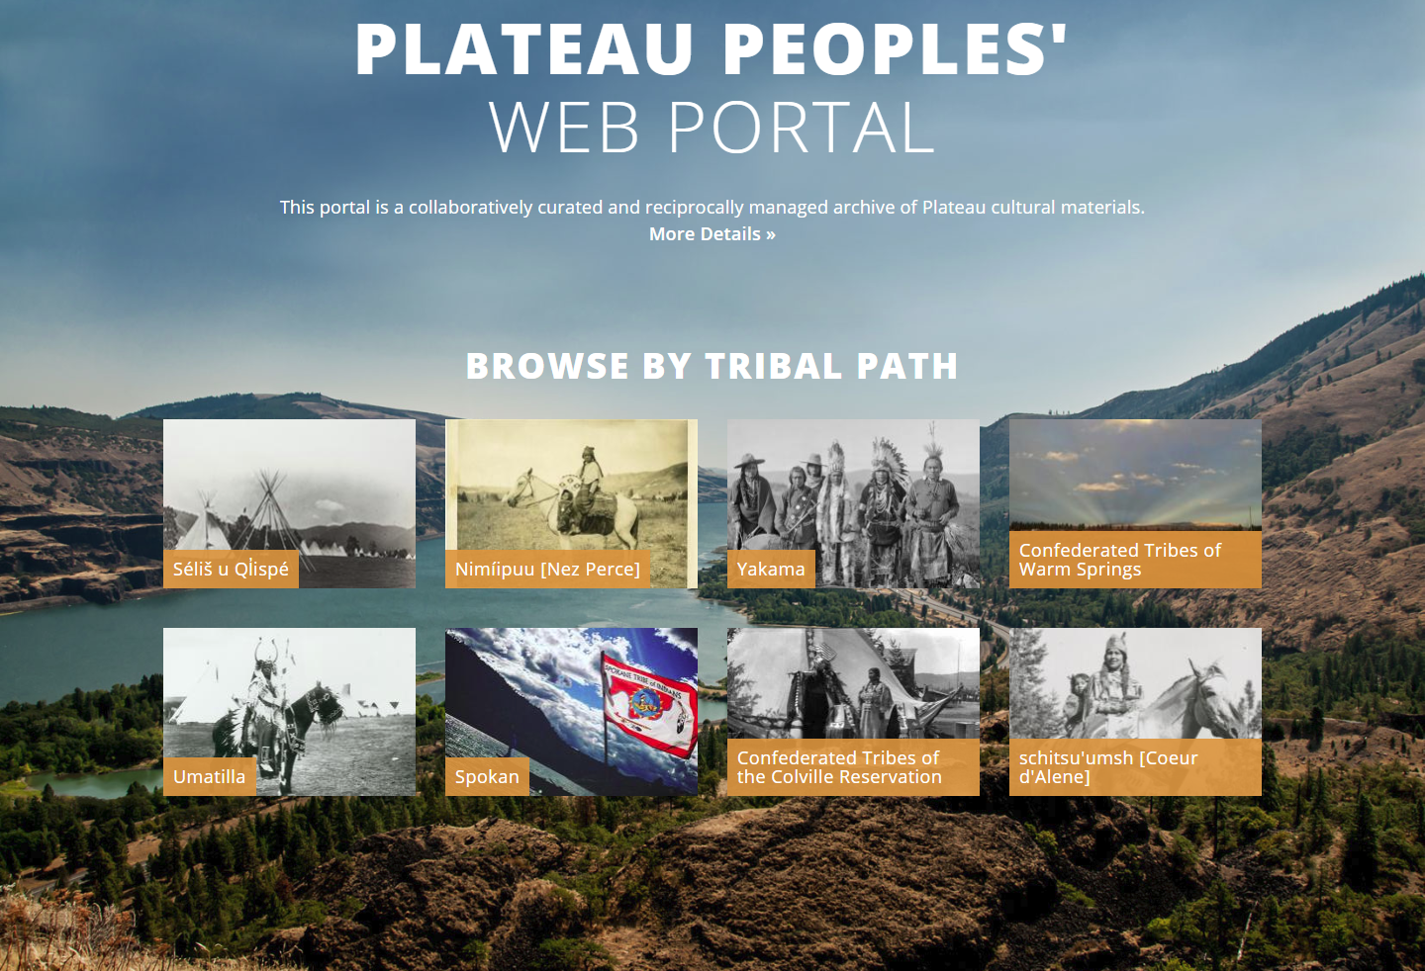
Notes:
As an additional example, Tribal partners on the Plateau Peoples’ Web Portal use TK labels as well
The most important thing about the Portal, is that selection of materials, community information provided, and access to all materials is controlled independently by each Tribe or Nation through their path.

Slide 17
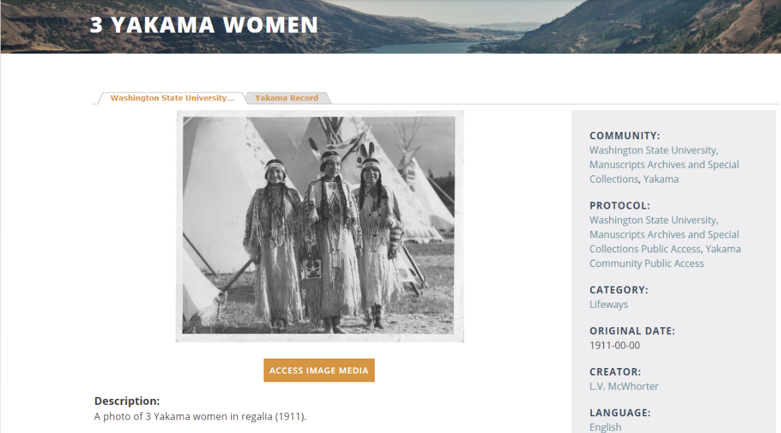
Notes:
This is one example of TK labels in the portal:
In cases where the original photograph, audio clip, or other type of material is located at a state or federal repository, we work to facilitate a digital return. This example in particular is from the Washington State University Archives. It has the standard WSU rights statement included. The Yakama Nation Library selected this photograph to be included in the Portal

Slide 18
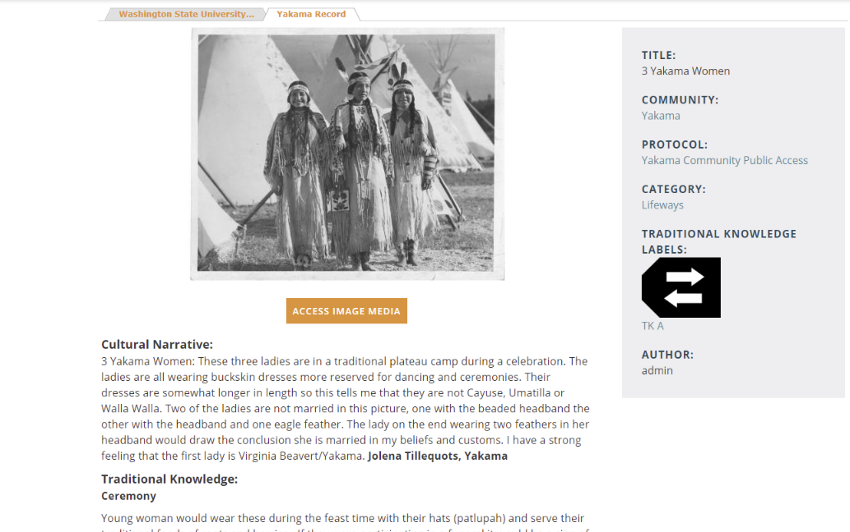
Notes:
But then, clicking on the next tab over (the Yakama Record), Yakama Nation Library added a tab of community-provided information - including a text description that is many paragraphs long, describes their regalia and the meaning and background, and names at least one of the women. All of this information about the photograph is attributed to the Yakama community through the TK Attribution label.

Slide 19

Adapting TK Labels

Slide 20
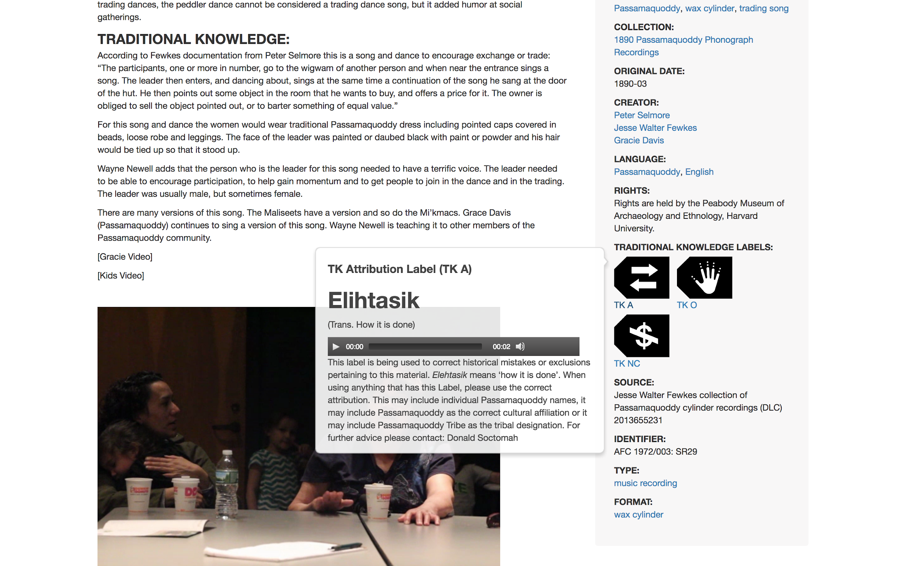
Notes:
You see the customized text under Elihtasik, We have the Passamaquoddy word for “Attribution” and an English translation of the word to “this is how it is done” this is the right way
They have also customized their labels to add audio…so others can hear the Passamaquoddy translations
The Passamaquoddy Mukurtu site provides a great example of managing materials digitally returned to the community

Slide 21
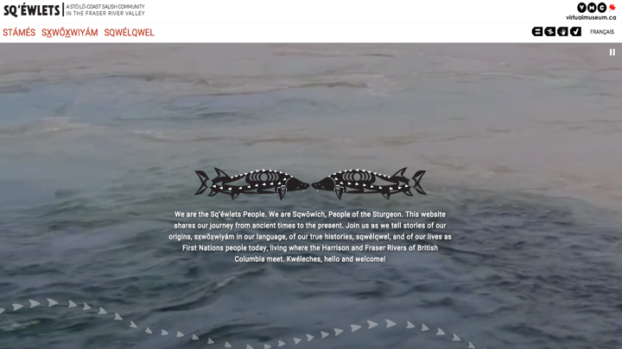

Notes:
The Sq’éwlets band of the Stό:lō First Nation in Canada have used Traditional Knowledge Labels on their Frasier Valley River website—a site with the express purpose of educating the non-First Nations Canadian viewers about the Sq’éwlets people and culture and very specifically archaeological sites. http://digitalsqewlets.ca/
You can see on the top of the site they’ve chosen four TK Labels to run across the whole site…

Slide 22
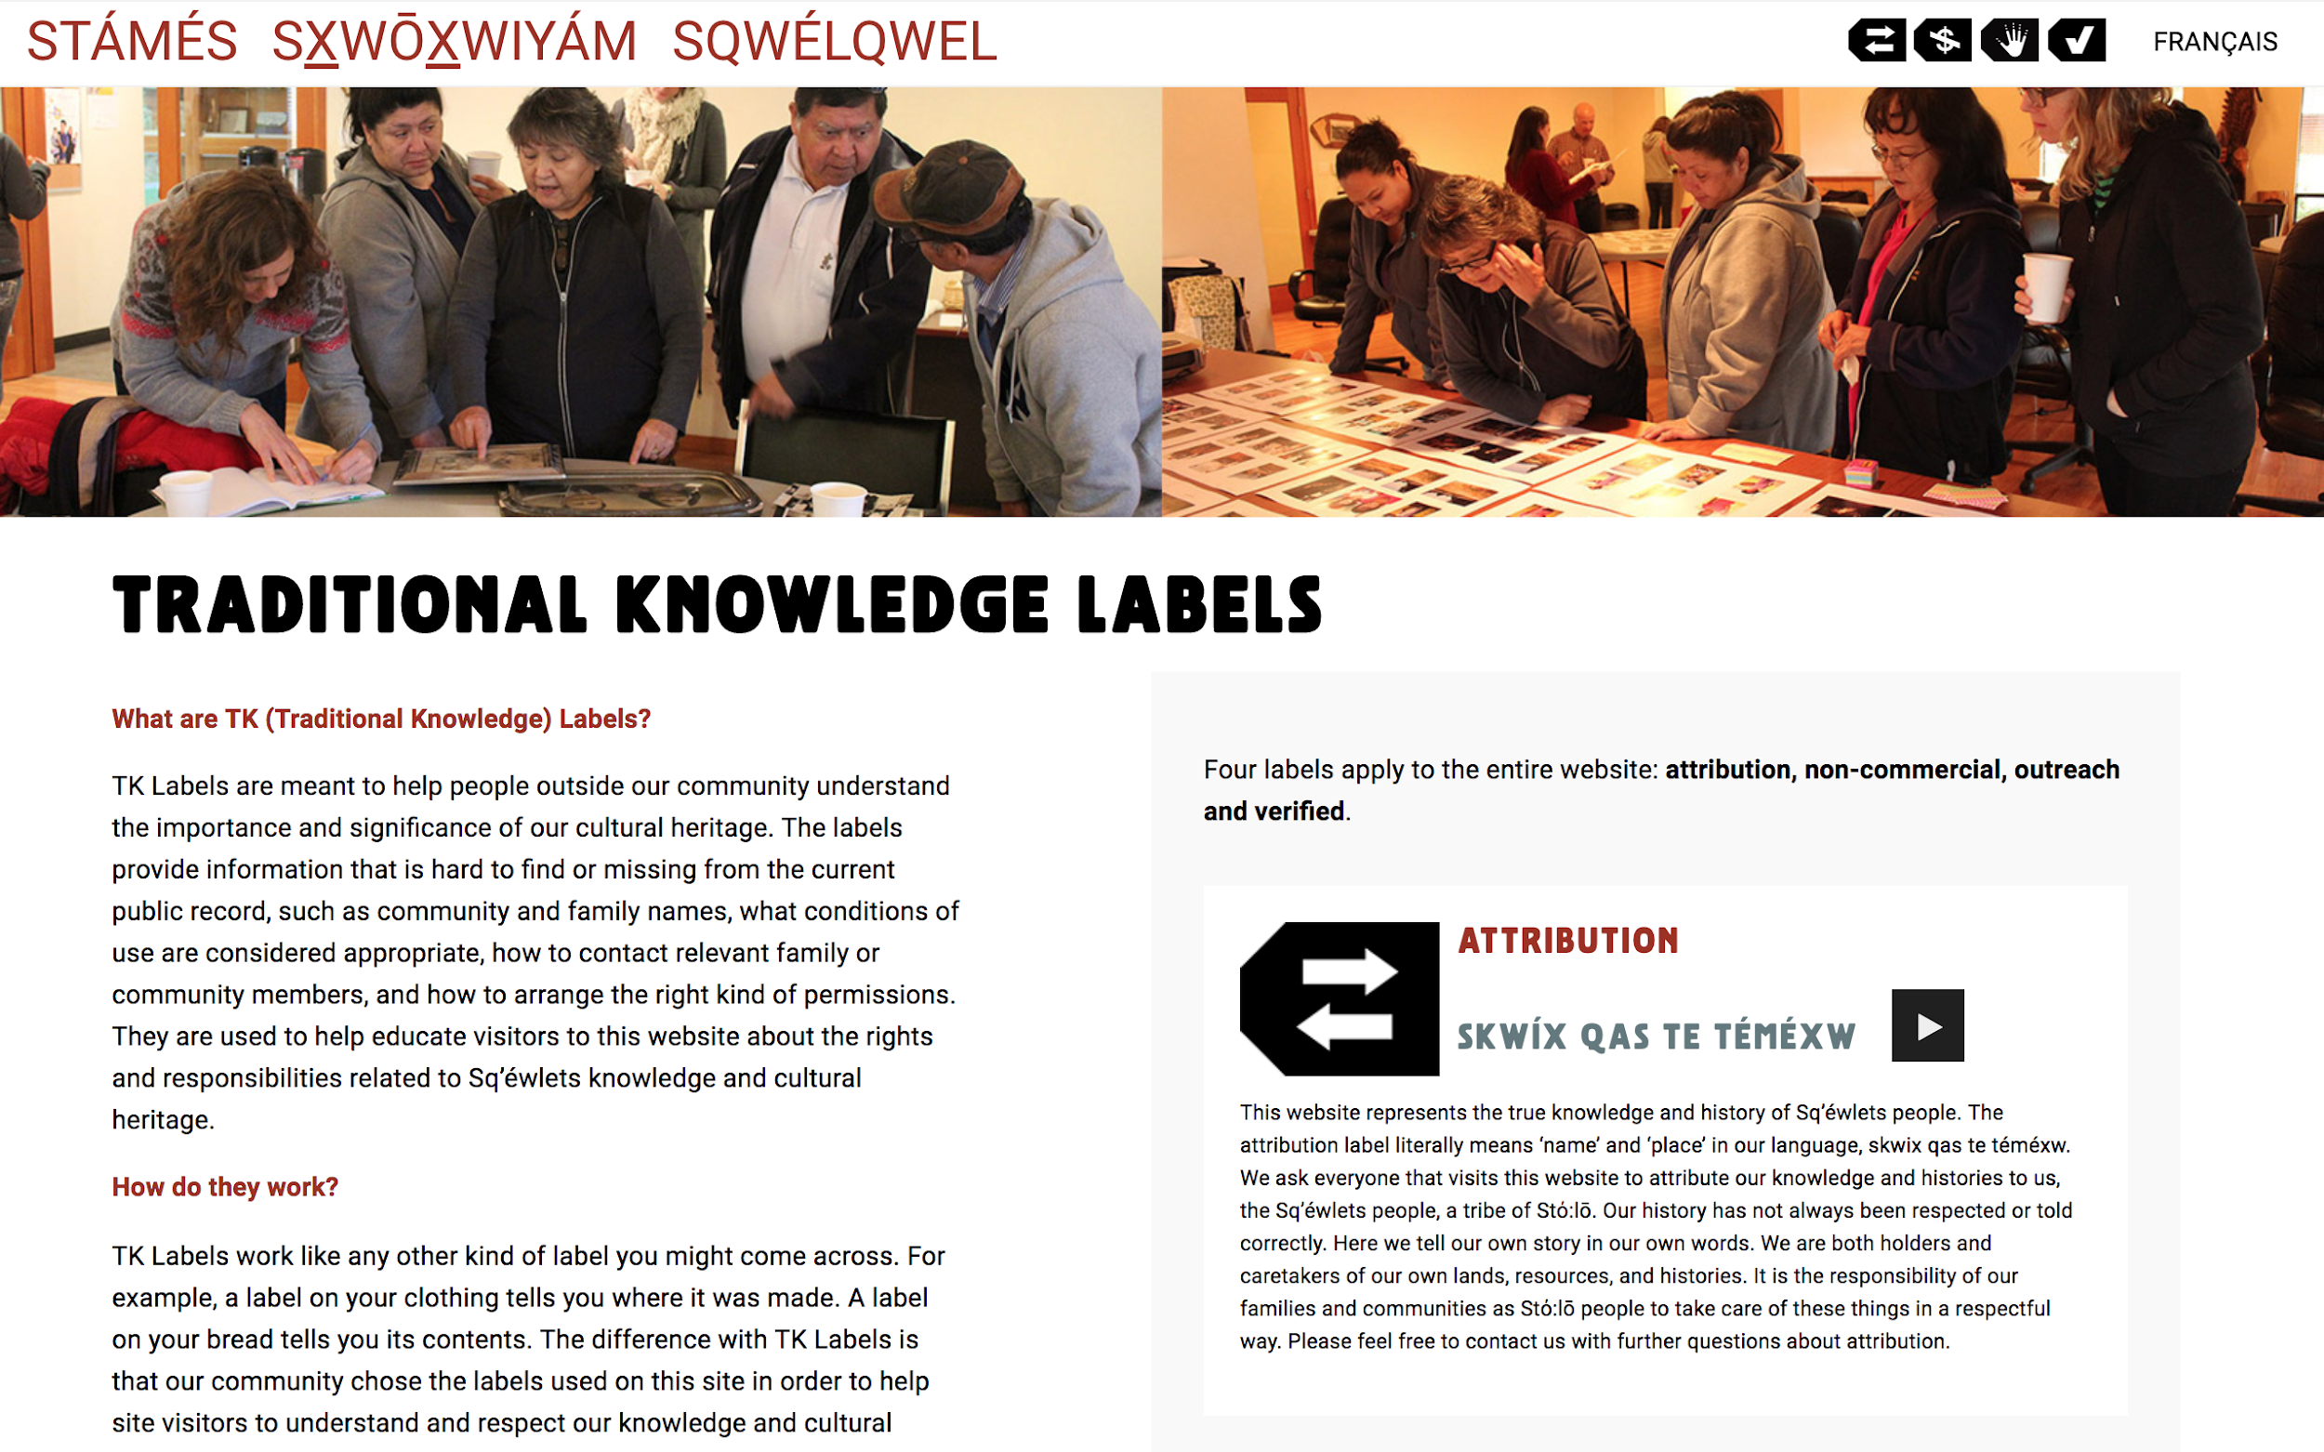
Notes:
Similar to the Passamaquoddy site, there is a page explaining what the TK labels are, and how they work generally and specifically for their project

Slide 23
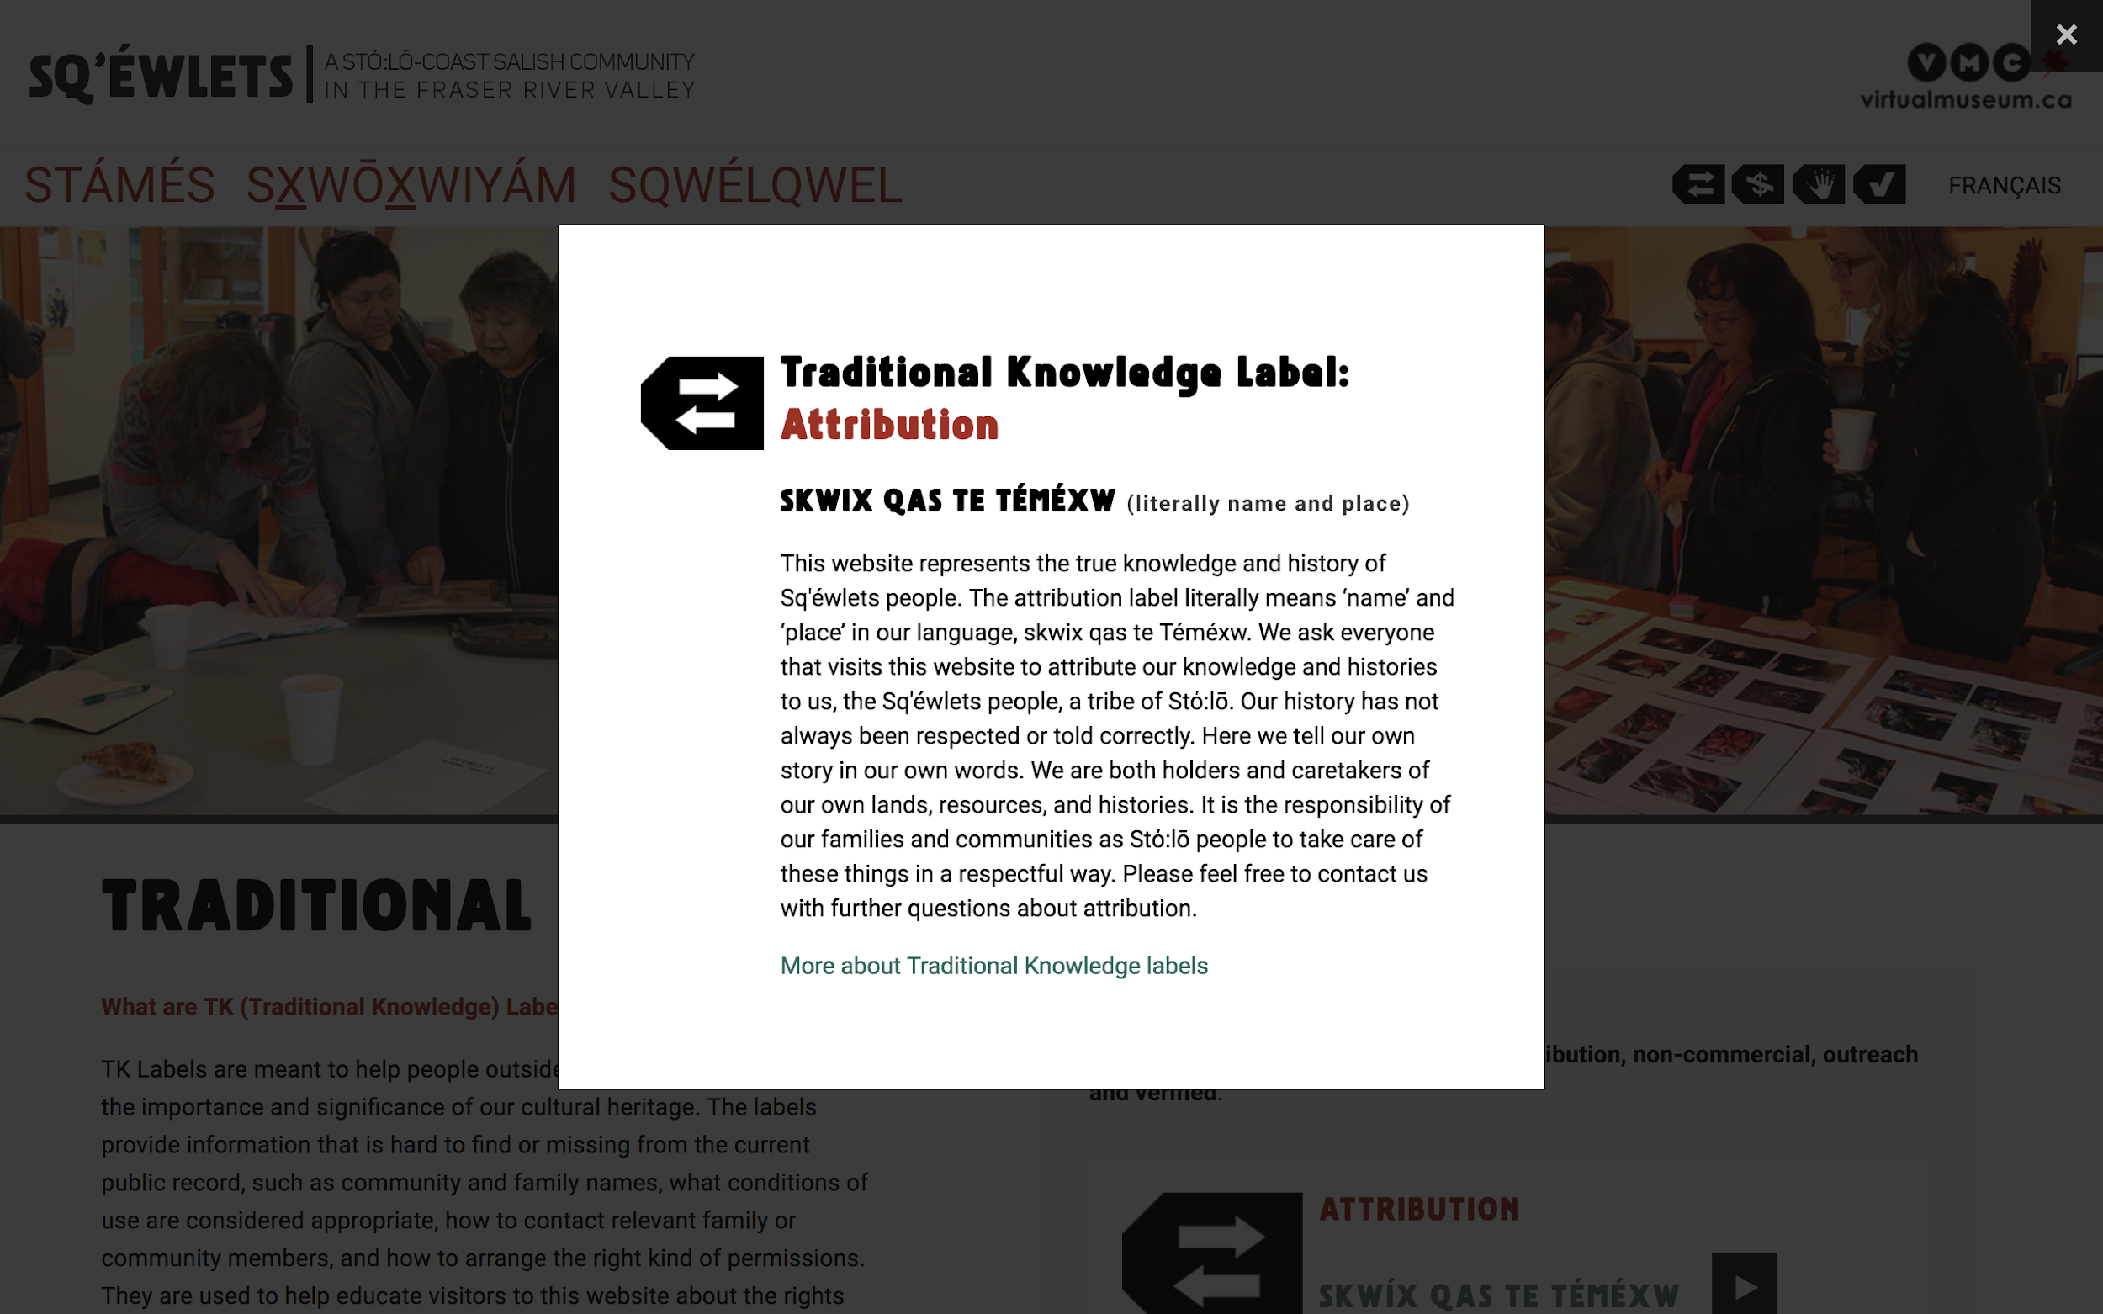
Notes:
This label has been adapted
Text: SKWIX QAS TE TÉMÉXW (literally name and place)
This website represents the true knowledge and history of the Sq’éwlets people. The attribution label literally means ‘name’ and ‘place’ in our language…We ask everyone that visits this website to attribute our knowledge and histories to us, the Sq’éwlets people, a tribe of Stό:lō. Our history has not always been respected or told correctly. Here we tell our own story in our own words. We are both holders and caretakers of our own lands, resources, and histories. It is the responsibility of our families and communities as Stό:lō people to take care of these things in a respectful way. Please feel free to contact us with further questions about attribution.

Slide 24
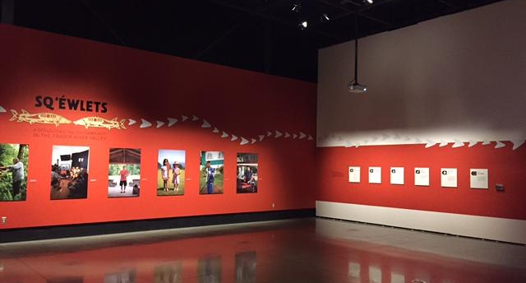
Notes:
These labels were also adapted for use in an in-person exhibit

Slide 25
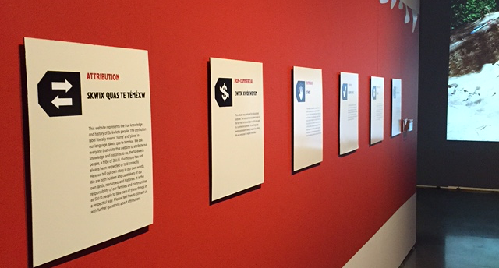
Notes:
With the adapted labels explained in a similar way to the digital space

Slide 26
TK Labels: thinking ahead...
First, look at TK labels on the the Local Contexts website
Which labels apply to your collections, community?
Which might you want to adapt?
What is the highest priority?
Notes:
If you are interested in potentially implementing TK labels, here are some first steps
If you have others in your organization or community interested in this topic, it may be a good idea to arrange a meeting of a small group of people
Think about the questions listed on the slide, discuss them with others, look at the other examples of people using TK labels

Slide 27

Activity Idea:
Adapt the Attribution Label
Work in a group
Create your own Attribution Label
  Translate or otherwise adapt “Attribution” for your community
  Define
Notes:
Another focused idea is to try adapting the “Attribution label” Template text found here in English, Spanish, French, and Māori: https://localcontexts.org/tk/a/1.0
This would be another good opportunity for discussion in a small group
Take time to discuss what would make sense in your language to translate the concept of Attribution
Write a short paragraph of description and direction/education for the reader to define your adapted label
All labels on Local Contexts website are meant to be adapted for use in your community

Slide 28
Credits
Screenshots from localcontexts.org, Plateau Peoples’ Web Portal, and Passamaquoddy Nation Mukurtu CMS sites, and the Sq’éwlets band of the Stό:lō First Nation Frasier Valley River website http://digitalsqewlets.ca/
This template is free to use under Creative Commons Attribution license.
Presentation template by SlidesCarnival.
Minicons by Webalys
These slides contain changes to color scheme and content.

Slide 29
Using this Resource
The Digital Stewardship Curriculum is an Open Educational Resource created by the Center for Digital Scholarship and Curation.
All presentations and resources created by the CDSC are licensed under a Creative Commons Attribution-NonCommercial-ShareAlike 4.0 license (CC BY-NC-SA). Please share, reuse, and adapt the resources and provide attribution to the Center for Digital Scholarship and Curation, Washington State University.

