Slide 1
COPYRIGHT ISSUES – IDENTIFICATION AND STRATEGY
Digital Stewardship Curriculum

Slide 2


DR. JANE ANDERSON
COPYRIGHT ISSUES – IDENTIFICATION AND STRATEGY

Slide 3
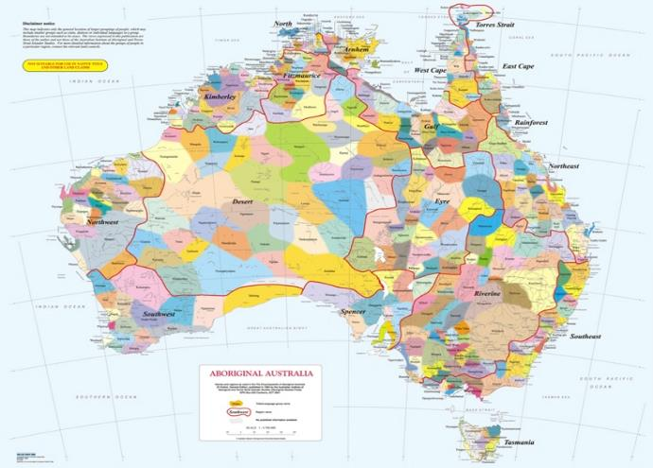
Map of Aboriginal Languages
AIATSIS 1994

Slide 4
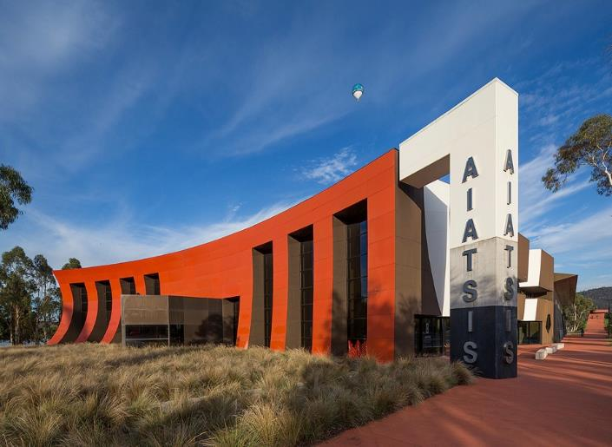
Australian Institute of Aboriginal and Torres Strait Islander Studies
Canberra
In its first incarnation
“AIAS was established by statute in 1964 undeniably to conduct 'salvage' operations amongst traditional cultures to record language, song, art, material culture, ceremonial life and social structure before those traditions perished in the face of European ways.”
D.Mulvaney 2006

Slide 5
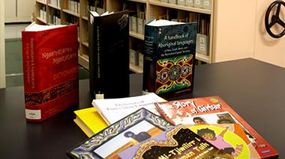

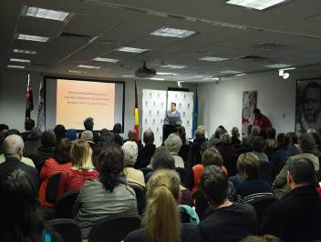
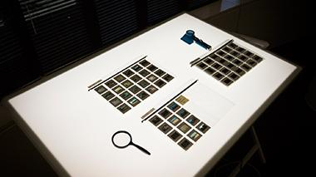
Australian Institute of Aboriginal and Torres Strait Islander Studies
8 million feet of film
650,000 photographs
40,000 hours of sound-recordings
rare books
manuscripts

Slide 6
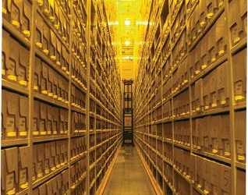
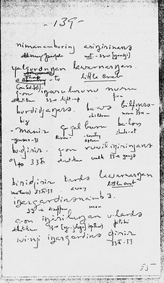
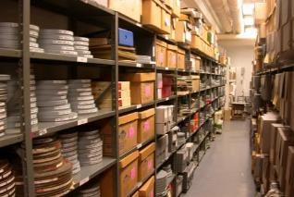
WHERE IS COPYRIGHT?
Photographs
Sound-recordings
Films
Manuscripts
Wordlists
Dictionaries
Largely non-NAGPRA material that is already or is currently being digitized.

Slide 7
Intellectual Property law is an umbrella term used to link several different and discrete areas of law together. These include:
COPYRIGHT
PATENTS
DESIGNS
TRADEMARKS
CONFIDENTIAL INFORMATION
GEOGRAPHIC INDICATORS
What is Intellectual Property?
Legally?
Culturally?

Slide 8
COPYRIGHT protects a vast range of cultural works.
Literary works like books, manuscripts etc
Compositions like songs and music
Photographs, films and visual material culture
Compilations like databases
Three key requirements for copyright protection:
The work must be fixed in material form
The work must have been produced/created by an (individual) author or authors
The work must be original and not a copy
The period of protection (generally) is life of the author plus 75 years.
COPYRIGHT

Slide 9
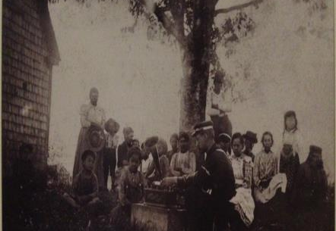
SOUND RECORDINGS
All sound recordings In the US made before 1976 are protected under copyright till 2067. Then they will be in the public domain.
Why?
Copyright Act of 1909
Copyright Act 1976
In Canada – 1965 earlier in public domain.
Who is the owner of the Fewkes recordings?
Jesse Fewkes on his return trip to Maine, May 1890

Slide 10
Culturally Specific – Protects some important cultural heritage but not all
Individualistic – Does not recognize community, family or tribal ownership
Property – it makes cultural knowledge into a form of property
Commercialization – Seeks to foster and support commercial use
Duration – Has a set time period for protection
Public Domain – Once in the PD can be used by anyone at anytime
Other key problems:
Works made by researchers working in tribal communities are owned and controlled by those researchers.
Cannot recognize different forms of knowledge stewardship and custodianship
Has difficulty in appreciating the inter-connectedness of knowledge/land/culture
Privileges some kinds of knowledge over others
Cannot be corrected retrospectively
Problems of wrong authorship continue into the digital environment
Problems with COPYRIGHT

Slide 11
ARCHIVES, LIBRARIES AND MUSEUMS
Can utilize the exemptions within copyright law to:
        Make archival copies of works for preservation
        To provide access for educational reasons
Without getting permission from the copyright owner
Without paying any licensing fee
FAIR-USE IS THE MOST IMPORTANT EXEMPTION
FOR TRIBAL INSTITUTIONS. SOVEREIGN IMMUNITY MIGHT ALSO BE IMPORTANT

Slide 12
When digitizing documents or other objects to be made available to wider audiences, it is necessary to first determine whether the item is protected by copyright or whether it is in the public domain. These are key questions you need to ask:
1. What is the material being digitized?
2. Is the item published or unpublished?
3. What year was it published, or if unpublished, what year was it created?
4. If published before 1989, does it have a notice of copyright (© or the word Copyright or Copr.)?
5. If published between 1923 and 1963, was the copyright renewed before 1964 when renewal became automatic?
6. Is the author dead, and if so, in what year did he or she die?
7. Are pre-1972 unpublished sound recordings included? (If yes see below)
Digitization and Copyright

Slide 13
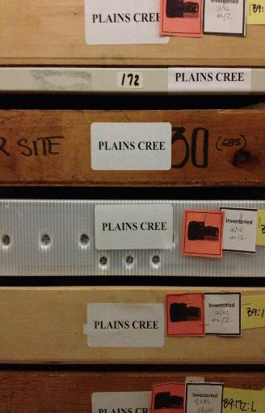
Published; 1922 or earlier; author dead or alive
In the public domain. No permission is necessary.
Published without © notice before 1989
Probably in public domain. Works published without © before 1978 are definitely in the public domain. No permission necessary
.
Published with a © notice between 1923-1963 and renewed, or published between 1964 and 1977
Will be protected by copyright until 95 years after date of publication. Get permission from current copyright owner.
Published with a © notice between 1923-1963 and NOT renewed
In the public domain. No permission necessary.
Published; 1978 - present; author dead or alive
Will be protected by copyright until at least 70 years after the death of the author. Get permission.
If Published
Peabody Archive
Photograph by
Paulina Johnson

Slide 14
Unpublished; created in 1977 or earlier; author died more than 70 years ago
In the public domain. No permission necessary.
Unpublished; created in 1977 or earlier; author died within the last 70 years
Will be protected by copyright until 70 years after the death of the author. Get permission from current copyright owner.
Unpublished; created in 1977 or earlier; author alive
Will be protected by copyright until 70 years after the death of the author. Get permission from current copyright owner.
Unpublished; created in 1978 or later; author dead or alive
Will be protected by copyright until 70 years after the death of the author. Get permission from current copyright owner.
If Unpublished
Peabody Archive
Photograph by
Paulina Johnson

Slide 15
THE BIGGEST ISSUES ARE:
ACCESS, CONTROL AND OWNERSHIP
Providing access, making collections available
Incorporating tribal perspectives into collection management
Returning cultural materials (material and digital)
Collaborating in the repatriation process
Divesting control to tribal authorities
Addressing tribal concerns about public domain material
Recognizing the legitimacy of cultural protocols
Recognizing past injustices in how Indigenous and Native communities and their cultural heritage has been collected and treated.
Problems for Tribes and for Institutions

Slide 16
OTHER ISSUES
Knowing how copyright affects your institution
Informing community members about copyright
Developing a shared understanding of tribal IP (something that may go beyond the traditional boundaries of IP law)
Developing infrastructure to help make decisions
Getting access to useful resources
Building a institutional/community IP strategies that suit your needs and issues

Slide 17

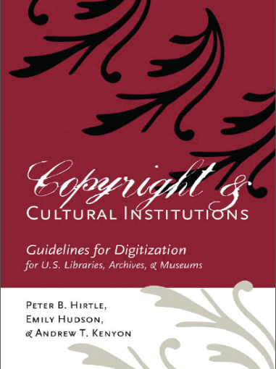

Slide 18
STRATEGIES
1. Do the legal research on specific collections. Sometimes ownership is not what it seems.
2. Develop specific protocols to deal with legal categories and cultural categories.
3. Develop Cultural Protocols for use and access of materials.
4. Think about research happening now – or collections being created now – can the future ownership of these collections look different?
5. Utilize TK Labels and Local Contexts for templates and useful information.
6. We are working to set up a interconnected legal clinic to help provide support on these issues as well as develop training for non-Native institutions that hold material.

Slide 19
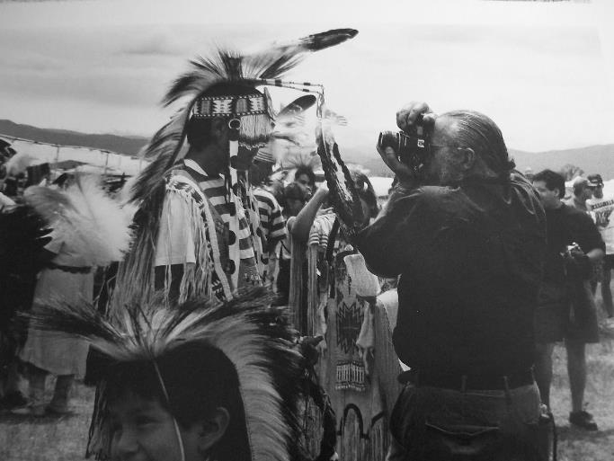
Indian
photographing tourist photographing Indian.
Zig Jackson 1994

Slide 20
About this template
What’s this?
This is a free presentation template for Google Slides designed by SlidesCarnival.
We believe that good design serves to better communicate ideas, so we create free quality presentation templates for you to focus on the content.
Enjoy them at will and share with us your results at:
twitter.com/SlidesCarnival
facebook.com/slidescarnival
How can I use it?
Open this document in Google Slides (if you are at slidescarnival.com use the button below this presentation)
You have to be signed in to your Google account
Edit in Google Slides
Go to the File menu and select Make a copy. You will get a copy of this document on your Google Drive and will be able to edit, add or delete slides.
Edit in Microsoft PowerPoint®
Go to the File menu and select Download as Microsoft PowerPoint. You will get a .pptx file that you can edit in PowerPoint. Remember to download and install the fonts used in this presentation (you’ll find the links to the font files needed in the Presentation design slide)
This template is free to use under Creative Commons Attribution license. If you use the graphic assets (photos, icons and typographies) provided with this presentation you must keep the Credits slide.

