Slide 1
Arrangement and Levels of Processing
Digital Stewardship Curriculum

Slide 2
Work on Collections
Helpful before digitization:
Arrangement
Description
Preservation
Rights and restrictions
Notes:
Processing, management
Takes a lot of work!
We will focus a lot on digital projects in the future, for this 30 minutes, I want to think about some work you might do with collections before starting a digital project, or in preparation for a digital project
Arrangement of a collection
Physical - how are you organizing things within a box, how are you putting things on a shelf.
Intellectual -how are you listing, ordering, and understanding a collection.
Description
How are you describing and documenting information about a collection - context, history, people and organizations involved
Housing and preservation
How are you caring for items, keeping them safe from damage like mold, pests, weather, and pressure.
Rights and restrictions
How are you managing privacy, copyright, intellectual property rights.

Slide 3
Definition of Arrangement
The physical arrangement or organization of a collection.
Making the collection physically ready for researchers and community members to use.
Goes along with intellectual arrangement: making the collection understandable.
Notes:
What is arrangement? It is the physical arrangement/processing of a collection.
Getting it organized in folders and boxes -- which will match the *intellectual arrangement* of how you convey how it is arranged.

Slide 4
Provenance
Definition: “The archives of a given records creator must not be intermingled with those of other records creators.”
Keeping collections separated, not mixed.
Preserving context.
Notes:
The history of the collection -
Context - the condition under which the collection was created -
Historical, social, family dynamics.
Exceptions - subject files, items with no collection.

Slide 5
Original Order
Records should be maintained in the order in which they were originally kept while being used by the record creator.
Notes:
Alphabetical, chronological, functional/activity
Type/format

Slide 6
No Original Order?
“Original order” does not mean “original chaos”
Try to reconstruct if misfiled/out of order.
If an original order doesn’t exist, you must create a logical order.
Notes:
If the collection comes to you in a very unorganized way, you do not need to preserve that “original chaos”

Slide 7
Series
A group of similar records within a collection, can be simple or complex.
Can have series and subseries. Or none at all. Files can also be a way of grouping, more specific.
Notes:
Date, Type (correspondence, financial records, census records, sketches)
Can separate materials and still have them in the same series/related (oversize, flat)
Examples?
Can arrange and process series in different ways, depending on what is contained.

Slide 8
Levels of Arrangement and Processing
High level of detail
Item-level
File level
Medium level of detail
Series level
Box level
Minimum level of detail
Collection level
Notes:
Can have multiple levels in the same collection

Slide 9
Flexible, “good enough” processing
Every collection is different. Objective should be to make the information findable.
If something is stuck in your backlog waiting for detailed processing, it is not useful to anyone.
Notes:
What may be necessary for one collection could be overkill for another

Slide 10
Tailor Work to Collection/Project
Be flexible
Adapt to collection/project
Use concepts of “Good Enough” processing
Prioritize and plan out projects
Notes:
Tempting to do every project and collection to the highest standard, and it can be frustrating if you don’t have enough time or resources to to this for each collection
You want to tailor your work plan EACH TIME you start working with a new collection
Be flexible with each of those arrangement, description, steps
Each collection might need a different level of detail and amount of work, depending on your needs
You can change your plan for each collection - but you don’t need to wing it each time, you can do this in a strategic way
“Good enough” means not doing more than you need to, to successfully share the materials
For some collections that might mean a lot of work, for others it might be minimal - important to keep things moving, and not be paralyzed
Find your priorities, then plan out each project

Slide 11
Create a Processing Plan
Overall strategy for each collection
Documented steps and notes
Helpful to others and yourself
Notes:
This is a strategy for each collection
Working with some sort of documentation of decisions and steps you will take
This extra time of making a project plan can save you a lot of time in the long run
This is definitely helpful if you need to pass off work to an intern, staff, or volunteer
But also helpful for you if you are the only one working on things

Slide 12
Elements of a Processing Plan
Collection/materials information
Arrangement scheme
Series and subseries (if any)
Include arrangement within series
Levels of Processing for each stage
Use grid
Time estimate
Date created
People
Notes:
This information can be found on the SHN resource “Processing Plan Form and Levels of Processing Matrix,” which is a template for creating your own processing plan form

Slide 13
Other elements to consider
Biographical/historical notes
Use of staff - who will be able to carry out the processing
Supplies: folders/boxes, anything unusual?

Slide 14
Other elements to consider (cont.)
Duration: How long will it take?
Other considerations:
Preservation needs?
Anything out of the ordinary?
Donor agreement factors?
Notes:
Come up with a general timeline, but also look into the multiple steps.
How long will each step take? It may be hard to estimate when starting from scratch, but as you complete projects you can keep track of time and labor, and better estimate for future projects.
Sometimes preservation or conservation steps need to happen before other steps like arrangement or description
Does anything stick out to you as odd about the collection? Do you need information?
Do you need to work more with the donor? Or did you agree to anything special in the donor agreement/deed of gift?

Slide 15
SHN Resources: Jennifer O’Neal
Processing Plan Form and Levels of Processing Matrix
Creating a Processing Plan [Tutorial]
Physical Order Versus Intellectual Order [Tutorial]
Notes:
One document and two videos that will be incredibly helpful to you in planning for processing and arrangement. Created by SHN partner Jennifer O’Neal

Slide 16
Processing Plan Form and Levels of Processing Matrix
Archive Processing Plan
Collection info, blank form for levels of processing
Levels of processing matrix
Suggestions for work that goes into each level of detail
Range from Baseline, Item-level (6)
Categories of:
Intellectual Arrangement
Physical Arrangement
Description
Housing/Preservation
Restrictions/Privacy
Notes:
This information can be found on the SHN resource “Processing Plan Form and Levels of Processing Matrix,”

Slide 17
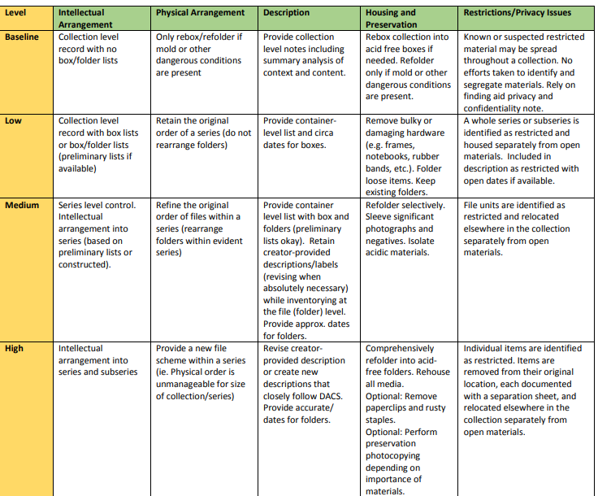

Slide 18
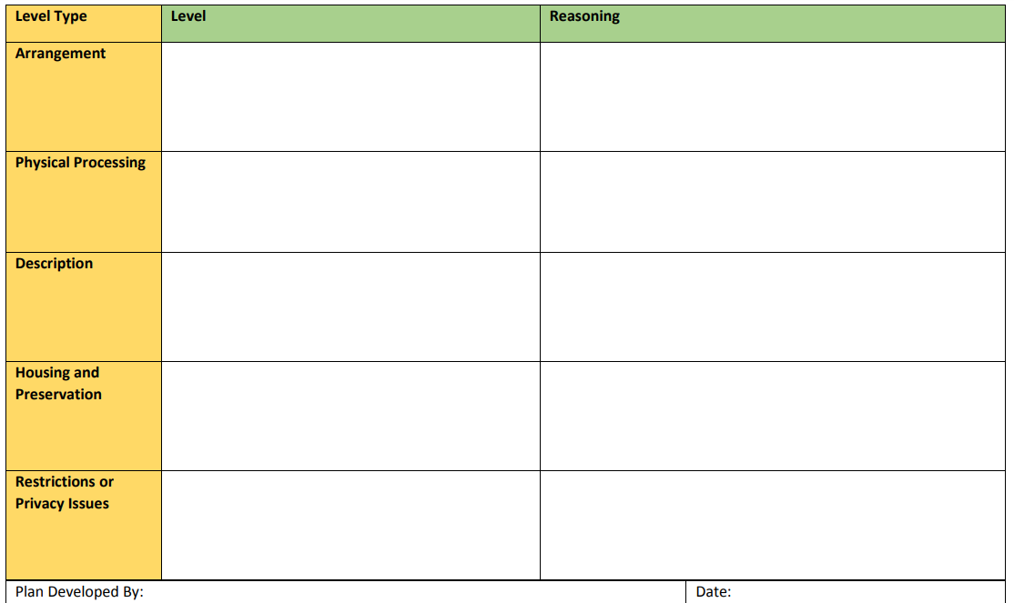
Notes:
Look at example on SHN
CAN USE FOR OTHER categories and projects too

Slide 19
Discuss or Reflect
Think of your collections. Generally, what is your ideal level of processing?
Then, what is your realistic level of processing for now?
Notes:
Discuss with others if possible, or reflect on your own for 20-30 minutes
If you want to continue this discussion, look at your collections more in depth along with the Archive Processing Plan form and Levels of Processing Matrix.
Here are some ideas for approaching processing your collections at differnet :
Decide the level of detail for processing steps, including arrangement
Highest or Item Level
Baseline

Slide 20
Credits
Presentation template by SlidesCarnival.
Minicons by Webalys
This template is free to use under Creative Commons Attribution license.
These slides contain changes to color scheme and content.

Slide 21
Using this Resource
The Digital Stewardship Curriculum is an Open Educational Resource created by the Center for Digital Scholarship and Curation.
All presentations and resources created by the CDSC are licensed under a Creative Commons Attribution-NonCommercial-ShareAlike 4.0 license (CC BY-NC-SA). Please share, reuse, and adapt the resources and provide attribution to the Center for Digital Scholarship and Curation, Washington State University.

