Slide 1
Introduction to Images: Care and Identification
Digital Stewardship Curriculum

Slide 2
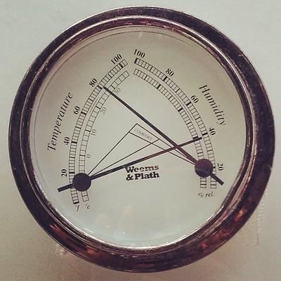
Temperature and Relative Humidity for Photographs
Temperature: 65-70 degrees Fahrenheit
Relative Humidity: 30-40% (fluctuating < 10% per day)
Cold storage for:
Sensitive materials
Color photographs
Nitrate film
Acetate film
Notes:
(room temperature or below), clean, and stable environment (avoid attics, basements, and other locations with high risk of leaks and environmental extremes) - Recommendations can also range 30-50% rh
FLUCTUATION is a big factor to keep an eye on, can be very damaging to materials
40 degrees or below for cold storage - some articles out there about using household freezer units with certain requirements
Image: Public Domain https://www.flickr.com/photos/tiktik/14193716990/

Slide 3
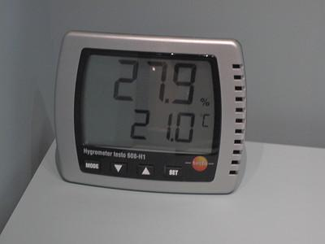
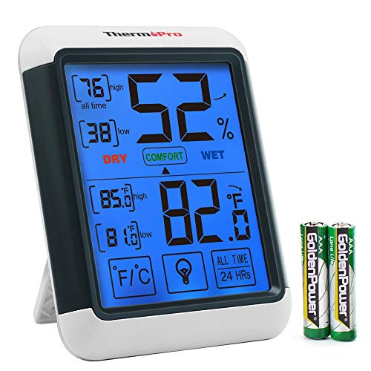
Monitoring Temp and RH
“Snapshot” monitoring
Continuous monitoring
NEH Preservation Leaflet
Monitoring Temperature and Relative Humidity
Image Permanence Institute
Environmental Management Quick Reference
Notes:
Can capture info only at certain intervals.
Or continuously
Variety of equipment and tools available for any budget.
https://www.nedcc.org/free-resources/preservation-leaflets/2.-the-environment/2.2-monitoring-temperature-and-relative-humidity
https://www.imagepermanenceinstitute.org/education/publications.html
Image: CC Kai Hendry Attribution 2.0 Generic (CC BY 2.0) https://www.flickr.com/photos/hendry/4166174159/
Image: Public domain https://www.flickr.com/photos/185642833@N06/49109978666/

Slide 4
Handling, Storage, Display
Clean hands
Gloves in some circumstances
Avoid any food or drink near materials
Photographic Activity Test
Simulated aging test for storage materials
Storage material - passed PAT
If on display - be careful in lighting and mounting techniques (use duplicates when possible)
Notes:
Clean hands -enforce this with staff/interns/students, gloves can be problematic sometimes but really useful sometimes for glass, metal, film.
Have rules posted.
No food or drink, houseplants also are a risk.
Photographic Activity Test - https://www.imagepermanenceinstitute.org/testing/pat - safest to use, make sure your supplies have passed this test!
display - use duplicates, avoid natural and artificial light (filters, sleeves), safely mount -
If you have to use originals, make sure to rotate - don’t leave on display.
Use proper materials for mounting, learn safe techniques, do not damage originals.
SHN resource showing you how to mount in different styles.
Light can fade prints AND paper - both natural and unnatural light
Different prints have different types of sensitivities
Can get filters for lights - esp in storage rooms - but keep dark when not in use.
Image: Public domian slush1000 / CC0 https://upload.wikimedia.org/wikipedia/commons/c/c3/Washyourhands.svg

Slide 5
Storage Enclosure Options
Sizing
Organize by similar size
Avoid overcrowding
Make sure materials are supported in folder or box
Type of storage material depends on photograph
Paper, mylar
Variety of vendors
Notes:
When possible, match the size of storage folder or box to the material.
Exceptions to box storage - flat storage -
storing large photos flat, or cased images
Storing in evenly filled boxes, with supports if needed SO IMPORTANT.
Too many items in a box overcrowds - too much pressure, weight, and stress on materials.
Too few items leaves items loose in folder/box, can warp, rest at angle, uneven pressure.
Types of material -
Some photos do better in paper than plastic.
Offgassing is an issue if enclosed in plastic, also has the risk of moisture.
However, mylar can be a great option if the photographs are frequently viewed and touched.
Mylar, uncoated polyester, polypropylene, or polyethylene (when viewing frequently).
Many vendors (taken from ATALM list of preferred vendors) -
Archival Products www.archival.com
Gaylord Archival www.gaylord.com
Hollinger Metal Edge www.hollingermetaledge.com

Slide 6
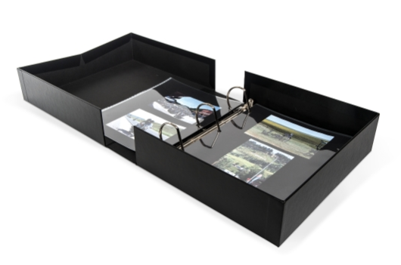
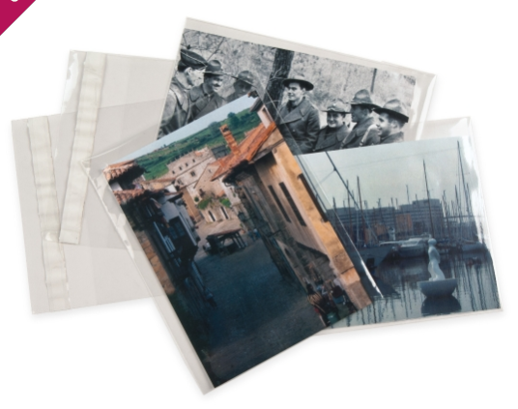
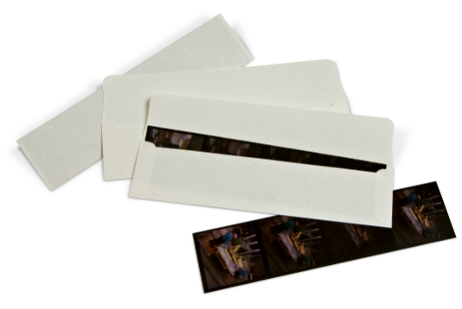
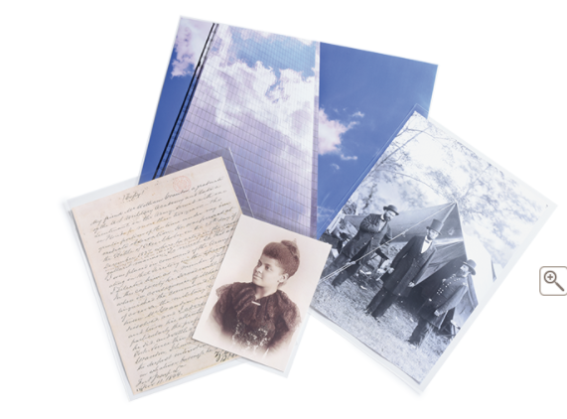
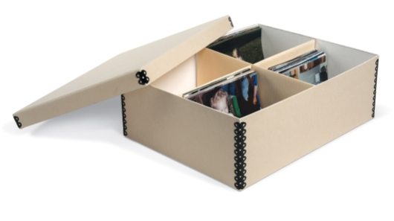
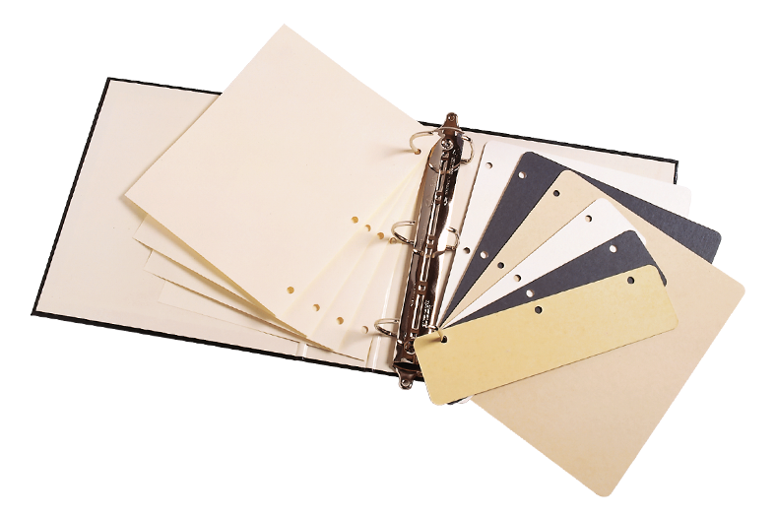
Notes:
Wide variety to fit your needs -
Archival Products www.archival.com
Gaylord Archival www.gaylord.com

Slide 7
Identifying Format and Process
Photograph Process, Photograph Type
Negatives and Prints
Ways to identify
Support material
Color and tone
Surface
Size
How the material is deteriorating
Notes:
Identifying photos - Why? Can use to find dates of photograph, information about context of photo, and importantly, to know how to best take care of the item.
Many different types of photographic processes, and the final results (prints) may vary.
Understand prints are the result of developing negatives = Print (developed or photomechanical), negative (black and white or color) -
There can be many different versions of a print, and copies of negatives and prints.
Can take a lot of detective work in your own collections, or researching other collections.
These slides will not tell you every type of photograph format and process.
Instead they will focus on HOW you might go about identifying - variety of methods, indicators, and outside resources to use -
Each way to identify in the following slides will include a couple examples of each measure.

Slide 8
Resources for Identifying
IPI Graphics Atlas website
Preservation Self Assessment Program - Collection ID Guide
Workshops
Books:
Care and Identification of 19th Century Photographic Prints
Photographs: Archival Care and Management
Notes:
http://www.graphicsatlas.org/
https://psap.library.illinois.edu/collection-id-guide/
https://www.worldcat.org/title/care-and-identification-of-19th-century-photographic-prints/oclc/901728120
https://www.worldcat.org/title/photographs-archival-care-and-management/oclc/70175019

Slide 9
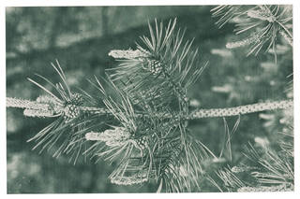
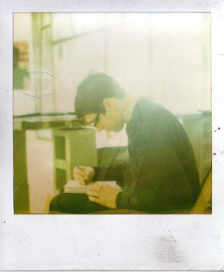
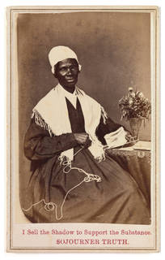
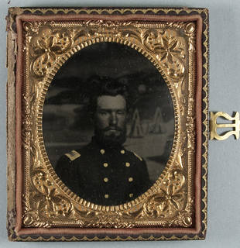
Support materials
Material on which the image is printed
Paper
Ex. Carbon print
Plastic
Ex. Instant Photo, polaroid
Metal
Ex. Tin type
Additional support materials
Ex. Cardboard cabinet card
Notes:
what the photo is printed on -
plastic border, wider on bottom of print - polaroids contain both the negative and positive elements (integral).
attached to a thick sturdy card - cabinet card or carte de visite.
metal! tintype, daguerreotype.
Image by Ryan Edge, available under a Creative Commons Attribution ShareAlike license (CC BY-SA).
Interdirectional (talk) (Uploads) / Public domain https://commons.wikimedia.org/wiki/File:Aaronkraten.jpg
Image by unknown photographer, original publisher Sojourner Truth, available in the public domain: Gladstone Collection, Prints and Photographs Division, Library of Congress; Reproduction Number: LC-USZC4-6165 (3-11b).

Slide 10
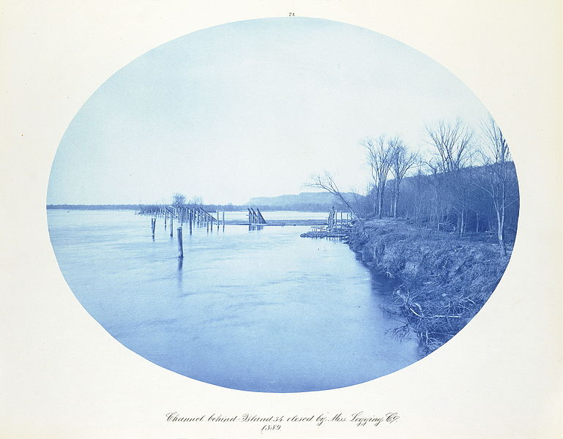
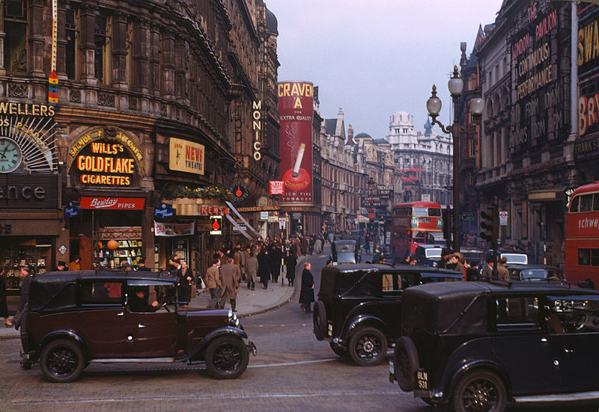
Color and Tone
Examples
Cyanotype
Distinctive blue tone
1870s to the 1930s
Still used today
Sensitive to light
Chromogenic color print
Ex. Kodachrome (pictured right)
Vivid full color
Layers of cyan, magenta, yellow dye
1942-present
Sensitive to light and humidity
Notes:
cyanotype - blue tone over entire photo.
autochrome slide transparency (rgb).
Henry Peter Bosse (1844-1903) / Public domain https://upload.wikimedia.org/wikipedia/commons/6/66/Henry-Peter-Bosse-Cyanotype-Mississippi-09.jpg
Chalmers Butterfield / CC BY (https://creativecommons.org/licenses/by/2.5) https://commons.wikimedia.org/wiki/File:London_,_Kodachrome_by_Chalmers_Butterfield_edit.jpg

Slide 11
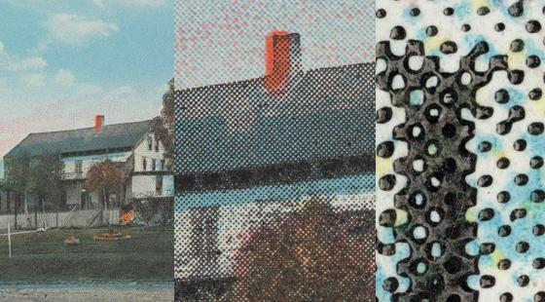
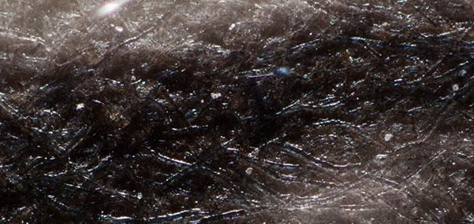
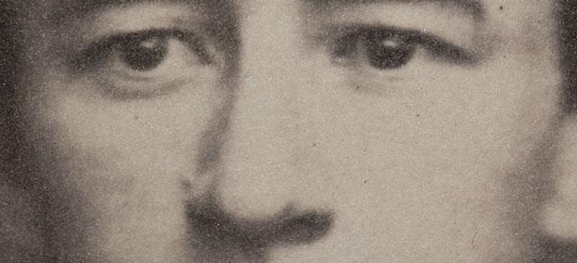
Surface and
Magnification
Letterpress
Photomechanical process
Comprised of dots in 2 or 3+ colors
Stable, monitor deterioration of support
Notice ink squeeze out
Salt Print
Paper fibers visible (can easily see paper through one layer structure)
Smooth continuous tone (tiny particles)
Matte or semi-matte surface
Warm, brown tones
Prone to image discoloration and fading
Notes:
letterpress (photomechanical - printing out print) comprised of dots, 3 colors.
salt print - developed out print - paper fibers visible, matte surface.
Matte or glossy.
Images from graphicsatlas.org

Slide 12
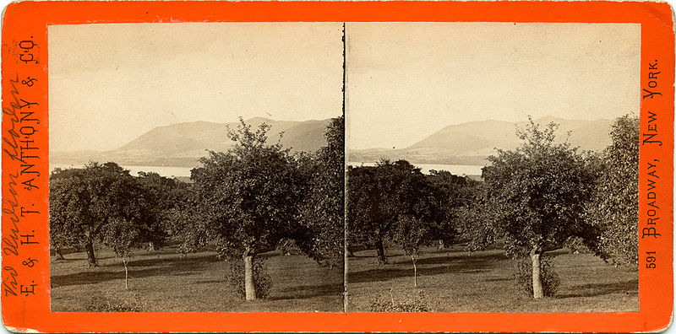
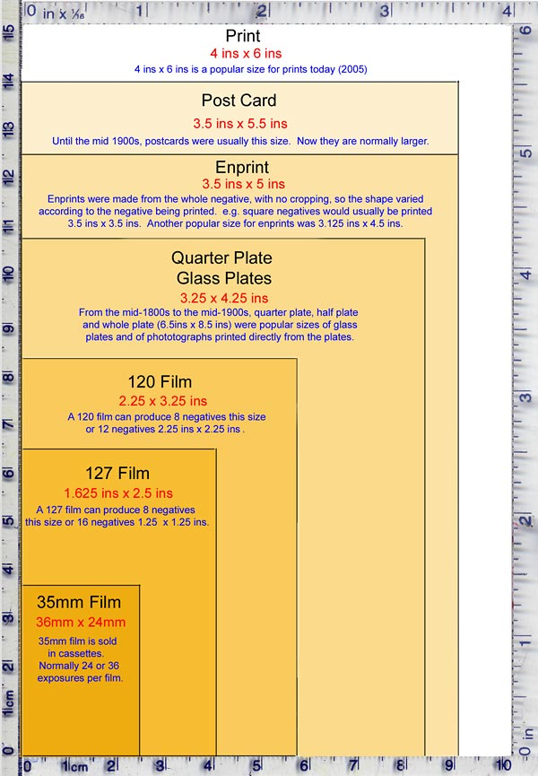
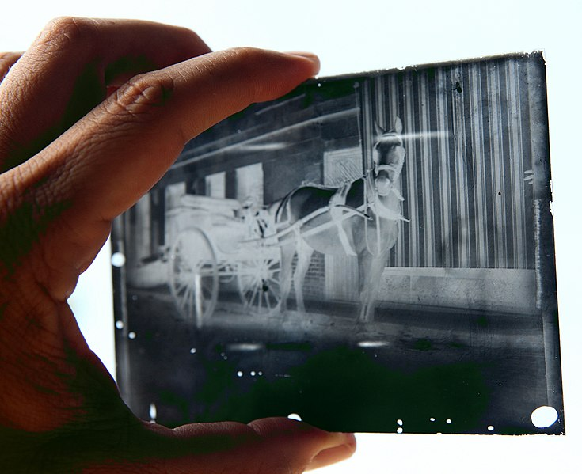
Size
Stereograph
Two images, mounted 2 ½ inches apart
Image captures from 2 angles
Viewed through stereoscope
Glass plate negative
Common: 4 x 5, 5 x 7, 5 x 8, 8 x 10, 10 x 12, 11 x 14
Glass support
Sharp and detailed image
Danger of cracks, fading, mirroring
Reproduced with acknowledgement to Peter Stubbs, www.edinphoto.org.uk
Notes:
Sizing information can help narrow down format.
standard sizes for different formats, also unique-looking types.
Svenska litteratursällskapet i Finland / No restrictions https://commons.wikimedia.org/wiki/File:Stereograph,_Hudson.jpg
Roy Boshi / CC BY-SA (https://creativecommons.org/licenses/by-sa/3.0) https://commons.wikimedia.org/wiki/File:Glass_plate_negative.jpg
http://www.edinphoto.org.uk/1_early/1_early_photography_-_sizes_of_plates_negatives_and_prints.htm
Sizes chart reproduced with acknowledgement to Peter Stubbs, www.edinphoto.org.uk

Slide 13
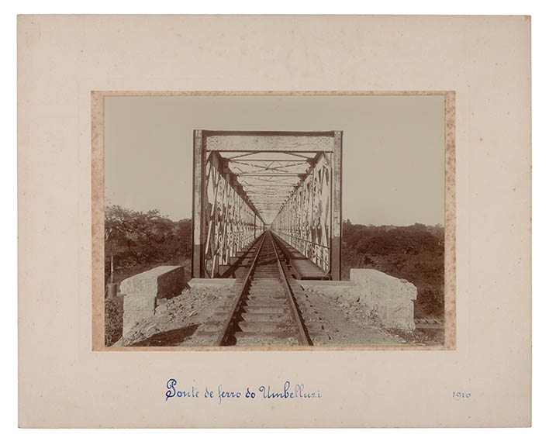
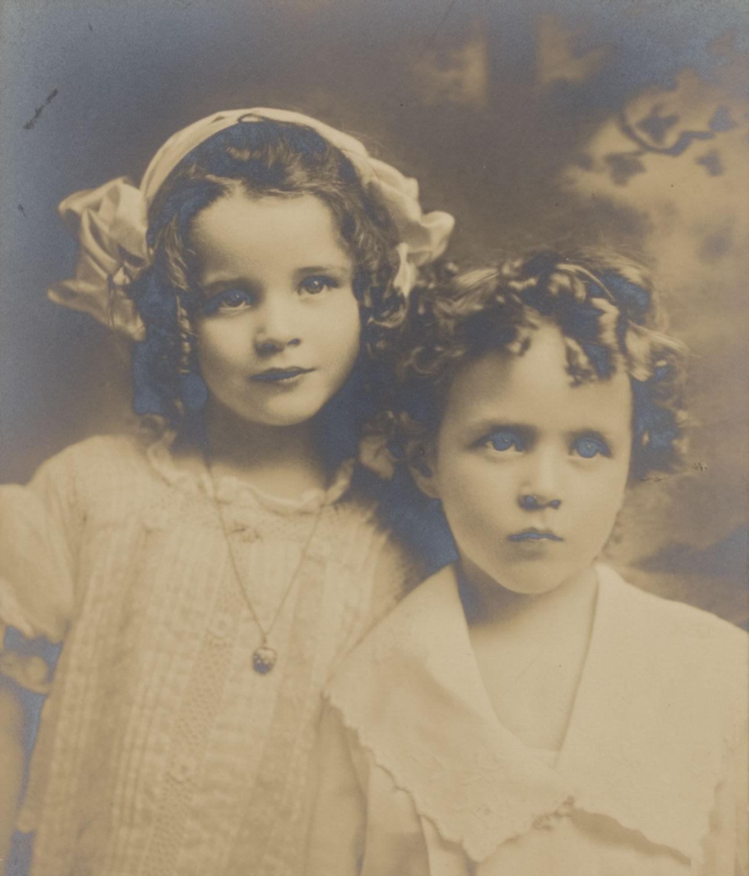
Deterioration
Foxing
Age stains
Red/brown spots
Often affects albumen prints
Silver mirroring
Develop reflective, cool tones in darkest areas
Worsens in humid conditions
Often affects silver gelatin, albumen, and other prints
Notes:
foxing - brownish red spots (stains that happen with age - unknown cause, perhaps fungal - humidity makes it worse) - often in albumen prints
silver mirroring - reflective, bluish hue in darkest shadows (humidity) - silver gelatin and albumin most common, but can happen to others.

Slide 14
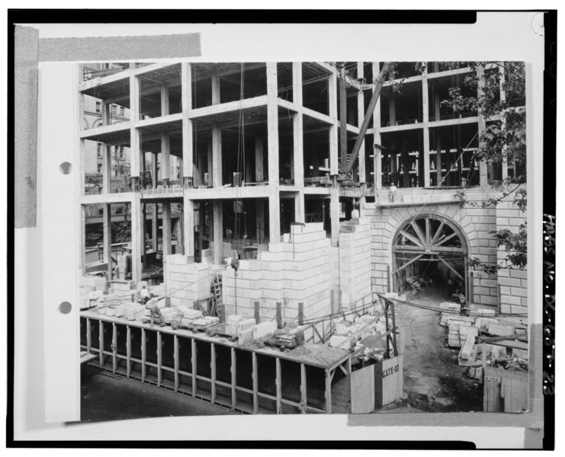
Dating Photographs
Family, community, land history
Clothing and hairstyles
Scenery, background, event information
Notes:
If you are working on descriptions and metadata, you can get a lot out of photos from viewing the image itself.
Photocopy of original black-and-white silver gelatin print, TWELFTH STREET DRIVEWAY ENTRANCE, August 31, 1929, photographer Commercial Photo Company - Internal Revenue Service Headquarters Building, 1111 Constitution Avenue Northwest, Washington, District of Columbia, DC
NPS Historic American Buildings Survey (HABS)Public domain -
https://upload.wikimedia.org/wikipedia/commons/d/db/Photocopy_of_original_black-and-white_silver_gelatin_print%2C_TWELFTH_STREET_DRIVEWAY_ENTRANCE%2C_August_31%2C_1929%2C_photographer_Commercial_Photo_Company_-_Internal_Revenue_Service_HABS_DC%2CWASH%2C657-23.tif

Slide 15
Metadata
Notch codes
Photographer information
Metadata written on or attached to photos, envelopes
Metadata from related items or collections
What else in your collections might give you assistance?
People
Can community members identify people, places, activities?
Notes:
If you have staff doing this work -
make VERY clear guidelines about what to look for, and what format to write descriptions in.

Slide 16
Credits
All images credits listed within slides
Presentation template by SlidesCarnival.
Minicons by Webalys
This template is free to use under Creative Commons Attribution license.
These slides contain changes to color scheme and content.

Slide 17
Using this Resource
The Digital Stewardship Curriculum is an Open Educational Resource created by the Center for Digital Scholarship and Curation.
All presentations and resources created by the CDSC are licensed under a Creative Commons Attribution-NonCommercial-ShareAlike 4.0 license (CC BY-NC-SA). Please share, reuse, and adapt the resources and provide attribution to the Center for Digital Scholarship and Curation, Washington State University.

