Slide 1
Why Digitize?
Digital Stewardship Curriculum

Slide 2
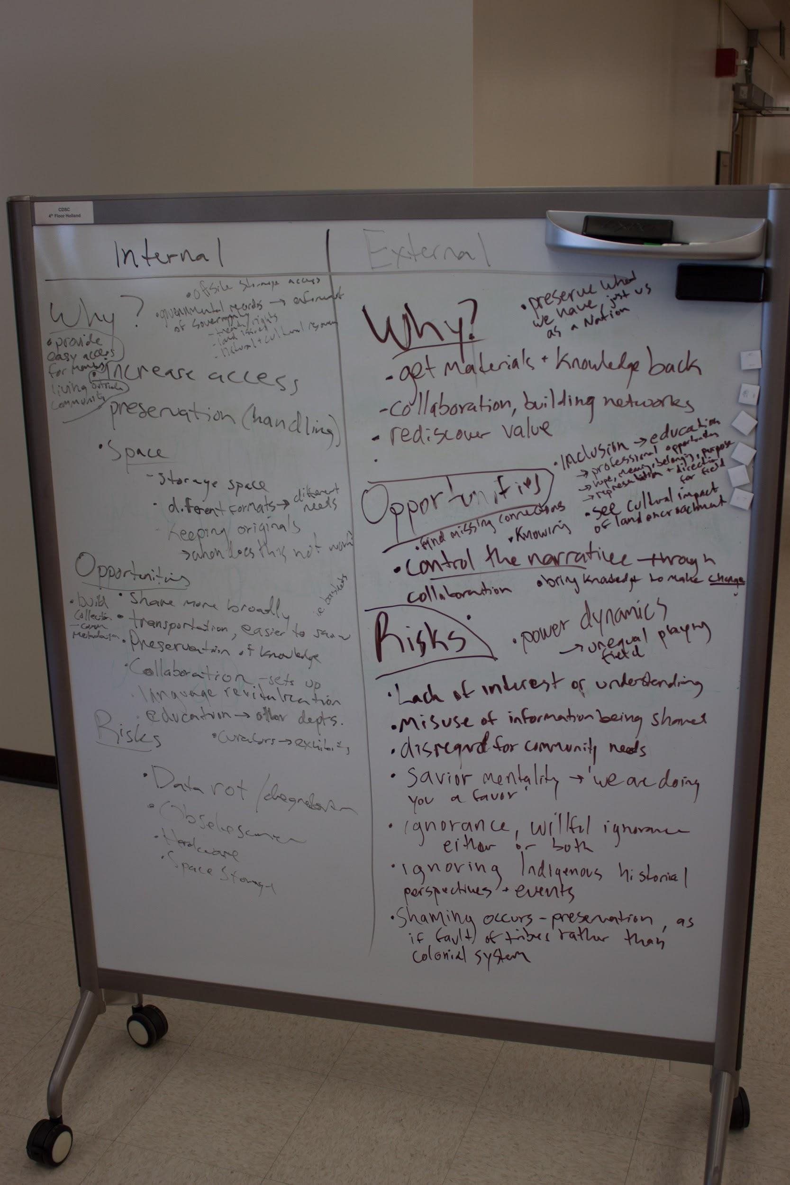
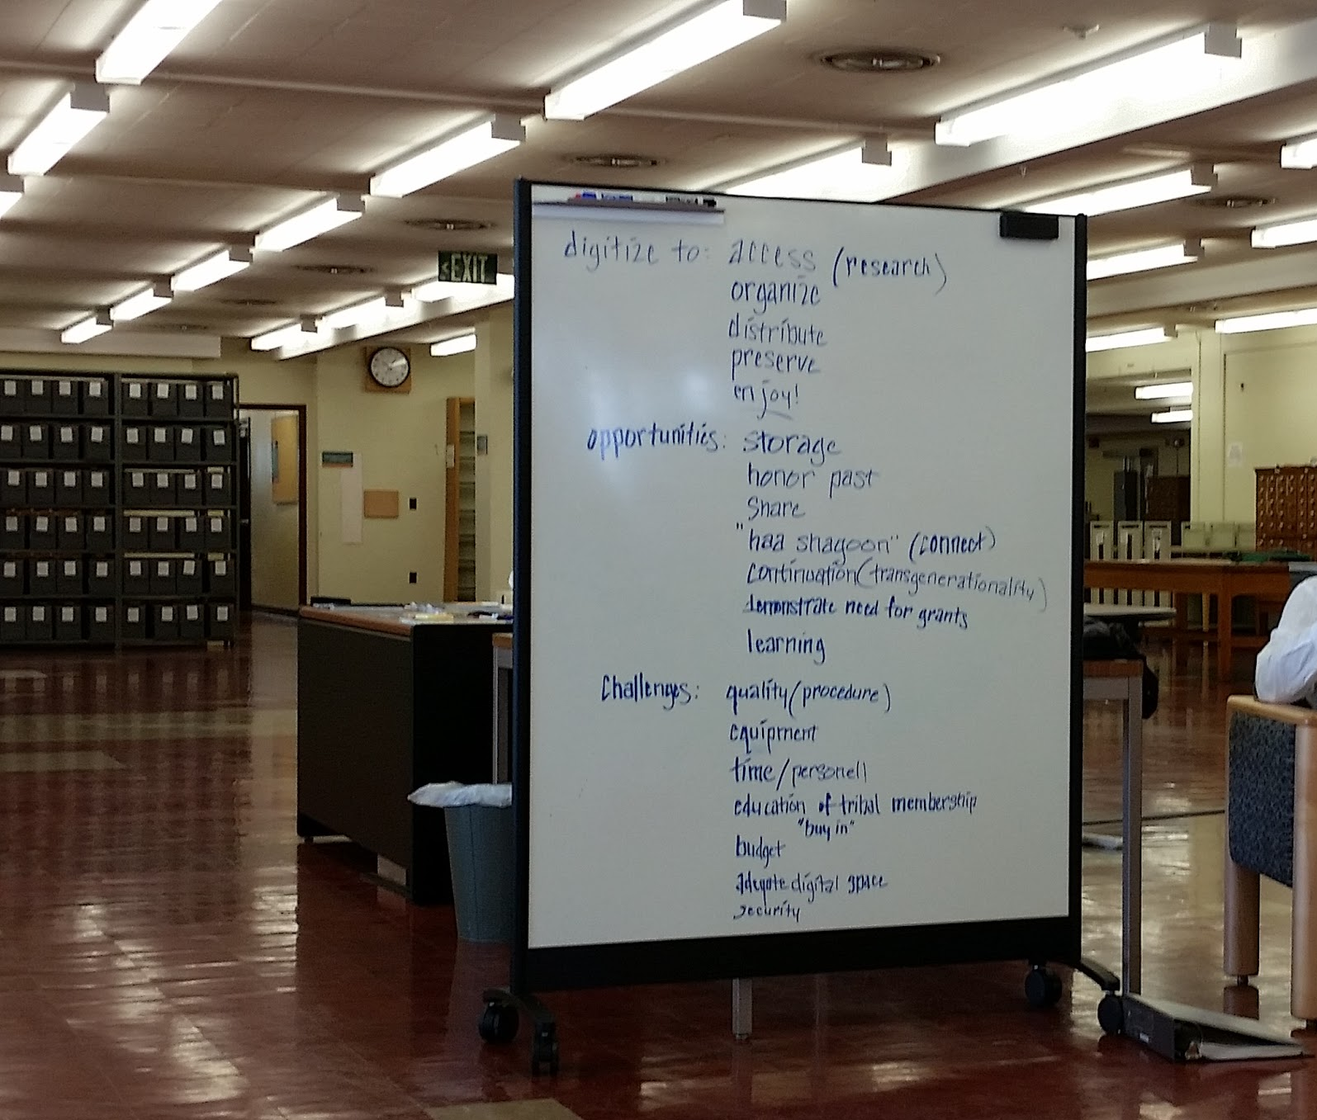
Why Digitize?
Notes:
This discussion and activity is something we do at the CDSC with large groups and with individual departments, to start identifying the REASONS for digitization.
You can’t digitize EVERYTHING, or at least you can’t digitize everything at once.
Starting to discuss these ideas is very important for planning.

Slide 3
Discussion Activity Why Digitize?
WHY do you want to digitize materials in your department?
WHY do you want to seek digital materials about your Tribe from other organizations?
List the main reasons you want to digitize materials, opportunities, and challenges
Notes:
This activity works best in a small group of 3-5 people
Take around 30 minutes to speak to each other and share your thoughts.
Someone should take the role of notetaker, and write down all ideas in a notebook, or on a whiteboard or large sheet of paper
DISCUSS
WHY digitize in your department?
LIST reasons
WHY seek digital materials from outside organizations?
LIST reasons
Then list for each
Opportunities
Challenges

Slide 4
Why Digitize? Internal/External
Why? (list reasons)
Opportunities
What can you do / do you want to do with digital materials that you can’t with analog/physical materials?
Challenges
What steps need to be taken, or what might impede digitization? (resources, planning documents, staff)
Create one list for Internal projects and one for External collaborations
Notes:
Two lists - one for internal, one for external
If you are only focused on internal digitization or external files for now, you can center one or the other in your discussion
The two topics work well to discuss side by side, but with separation as they may serve some different purposes and goals
Opportunities
What are the positive impacts?
What are your hopes?
What are you current projects that can be expanded?
What will it mean for your community?
Challenges
What are your concerns?
What steps might need to be taken first?
What resources do you need first?
What might impede projects?

Slide 5
Discuss
Notes:
This activity can be done alone if necessary, but we find this specific idea generation works best through conversation and sharing.
Gather some other people who have insight into your community needs and priorities.

Slide 6
Share
Notes:
If possible, share with others, keep the conversation going.
If in your own organization, you can add to the list you created in the first round

Slide 7
Digitization Goals Planning: First Steps
DEFINE goals and priorities based on:
Collections (current and/or future)
Collections policy (overall)
Cultural values
EXAMINE your Resources and list:
Human
Technical
Infrastructure
*Update goals based on current and future resources
Notes:
FIRST step:
Greate digitization goals - recreate this conversation in your own departments
Priorities -- create selection criteria
NEXT: examine Resources--make a list of what you have CURRENTLY, and what you would like to build in the future

Slide 8
Digitization Goals Planning: Next Steps
Define Outcomes
What will be produced?
What will be gained? (knowledge, collections, etc.)
Define Benefits
Institutional
Community-based
Educational
Notes:
Then, when you start narrowing down to SPECIFIC projects...
Define outcomes
what will be produced
what will be gained
Define benefits
WHO will benefit and how

Slide 9
Digital Stewardship Curriculum Resources: Planning and Policies for Digitization
Digitization purpose statement
Stems from your “Why Digitize” list and your mission statements
General statement of value of and need for digitization
Digitization policy
Outlines all aspects of digitization for your department (*or institution)
Notes:
These are other helpful resources and topics on the Sustainable Heritage Network Digital Stewardship Curriculum
Purpose statement first
Then, digitization policy (may take several weeks, months, or longer to fully draft)
May have multiple policies throughout different departments, or one overall policy for your institution

Slide 10
Credits
Image slide 1: Lotus Norton-Wisla, Washington State University Libraries
Presentation template by SlidesCarnival.
Minicons by Webalys
This template is free to use under Creative Commons Attribution license.
These slides contain changes to color scheme and content.

Slide 11
Using this Resource
The Digital Stewardship Curriculum is an Open Educational Resource created by the Center for Digital Scholarship and Curation.
All presentations and resources created by the CDSC are licensed under a Creative Commons Attribution-NonCommercial-ShareAlike 4.0 license (CC BY-NC-SA). Please share, reuse, and adapt the resources and provide attribution to the Center for Digital Scholarship and Curation, Washington State University.

