Slide 1
Accessioning
Digital Stewardship Curriculum
Notes:
Accessioning - the process of formally bringing new materials into your institution or department.

Slide 2
Accessioning defined
The legal transfer of responsibility for the physical and intellectual care of the material.
The material, called an accession, gets a unique identifying number.
All collections, whether donated, purchased or transferred, are accessioned.
Notes:
The first step in getting the collection into your TALM, and getting it documented.
This information is going to provide your first steps in description/knowing what is in the collection.
Done well it is extremely helpful in managing your collections

Slide 3
The Process of Accessioning
Once you accept a collection through legal transfer (deed of gift)
Assign an accession number
Ex: 2015-001
Common form is the year it is accepted, and sequential number in the order it is acquired
Notes:
The legal transfer process is aided by a donor form/deed of gift
You will want to assign a number to the “accession” to show when/what order it came to you

Slide 4
Accessioning process, continued:
Put material in a new box (or folder for digital files) or other housing
Identify obvious preservation problems
Eliminate duplicates (appraisal)
Create an inventory
Notes:
Preparing the collections for future use in our TALM; begin the first step in processing the materials (Intellectual and physical control)
Put in a new box, if needed, to give protection/support that is better than what it was donated in and an easy preservation step
Look for any obvious preservation issues - is there mold? Is there rodent or insect damage? Is there water damage? Is there anything else that needs to be taken care of right away?
This is a good time to check for duplicates/copies, and remove them
This is also a great time to create a preliminary inventory - your work down the line will be made easier by simple steps here

Slide 5
Accessioning process, continued:
May have multiple accessions for one collection
Make sure each addition is documented!
Wait to process until you are sure you have it all
Deal with any restriction issues
Have a set Deed of Gift form for donations
Notes:
Multiple accessions are a possibility. Many individuals and organizations donate records not all at once, but in stages or periodically. Multiple accessions might happen:
On a regular basis - for example tribal council minutes
Sporadically, in multiple parts - for example a family donating multiple parts of their grandmothers photographs as they find multiple sets of photos stored in the home and in a storage unit
These multiple accessions can be important for the story of the collection; a frequent question in archives is, “how did you get that?”
Make sure the person donating has the permission to donate, and that they will be okay to have the whole collection open to your community or to the public - and if not, then what restrictions need to be in place? And do those restrictions align with your mission?
Donor Form/Deed of Gift, important to have a standard form/procedure for dealing with donors

Slide 6
Accessioning digital files
Digital files can’t wait on a shelf as well as other collections- and need to be dealt with sooner
Digital types: Born digital and digitized
Notes:
Important step, even if you don’t have time to fully process collections - get it a number set, transfer files safely, add some brief description in the accession form
Capture other digital data as able
Especially in digital collections, it can be really easy to let things get out of control, doing these steps will help you have better control over collections

Slide 7
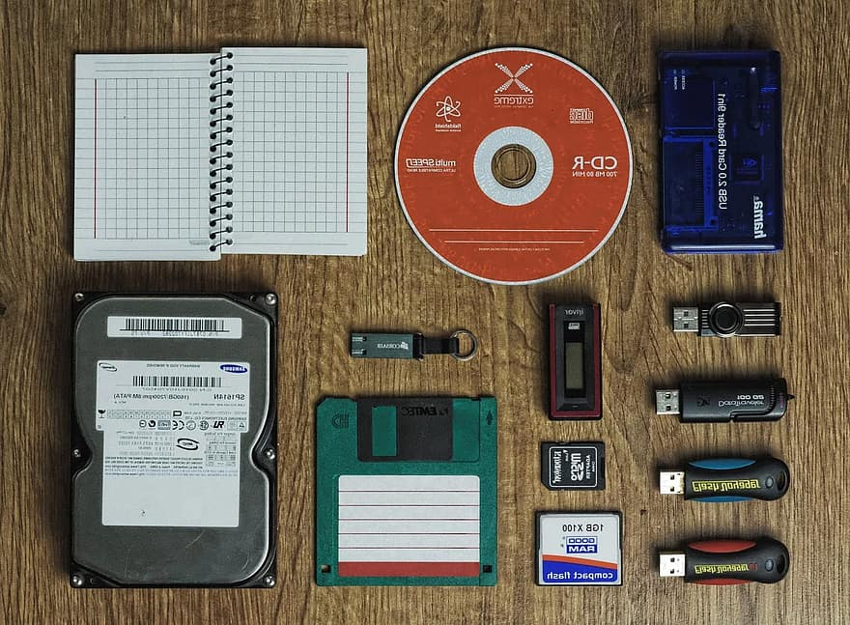
Notes:
If you get the accessioning step done - you at least know what you have, and what you might need to do as next steps
Image credits
Wikimedia Commons User Spsan12 https://commons.wikimedia.org/wiki/File:High_Compatibility_File_Format.png This file is licensed under the Creative Commons Attribution-Sharealike 4.0 International license CC-BY-SA-4.0
Images in public domain used from pikist.com
https://www.pikist.com/free-photo-szqxk
https://www.pikist.com/free-photo-xvoft

Slide 8
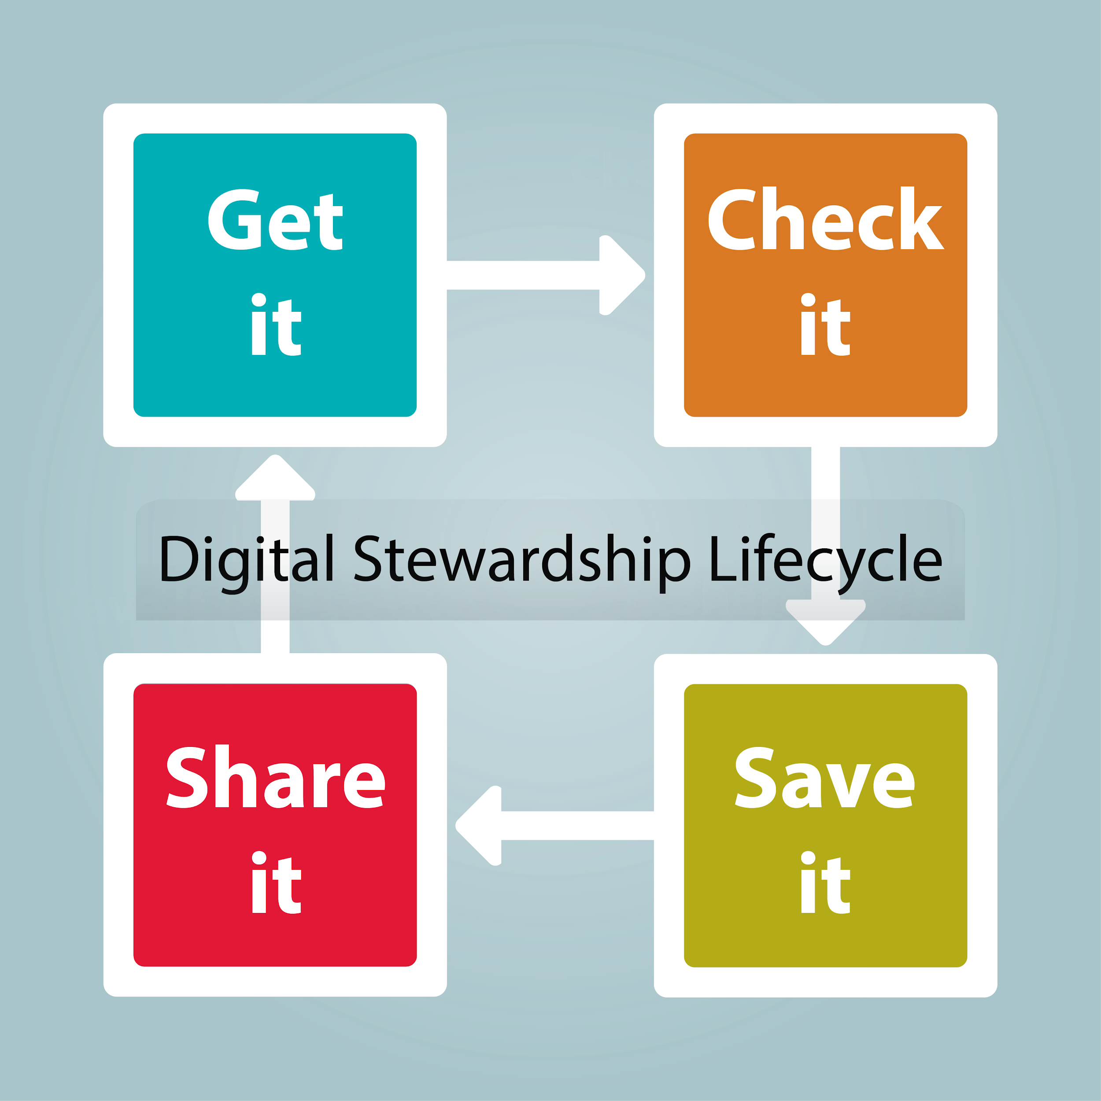
Notes:
Accessioning falls in the get it and check it stage of a Digital Stewardship Lifecycle
Reminder:
get it - bring materials into your institution (donations, collecting, scanning documents at another institution)
check-it - check and manage - check for quality, description. make sure they come in safely - make sure they stay safe/intact.
save it - secure storage, suited to your size requirements, with potential to grow - systematically backed up (multiple copies in multiple locations), meaningful organization
share it - providing access to materials - online, exhibits, education, research

Slide 9
Digital Stewardship Lifecycle
Get it (transfer to your institution)
Check it (flag issues, inventory)
Accessioning is the first step in multiple functions of the digital lifecycle.
Notes:
Accessioning is the “Get It” of the digital lifecycle and the start of the “Check it”

Slide 10
Discuss or Reflect
What is the most challenging collection that you’ve had donated?
Notes:
Discuss with coworkers or colleagues or reflect on your own.
What is the most challenging collection that you’ve had donated?
Think through the issues you encountered. What steps would you want to put in place for your accessioning process to be prepared for these issued?
If you have never dealt with collections being donated, what are some of your hopes or concerns about beginning to accept donations?

Slide 11
Credits
Text revised from a presentation by Jennifer O’Neal
Slide 7 images
Wikimedia Commons User Spsan12 https://commons.wikimedia.org/wiki/File:High_Compatibility_File_Format.png
This file is licensed under the Creative Commons Attribution-Share Alike 4.0 International license CC-BY-SA-4.0
Images in public domain used from pikist.com
https://www.pikist.com/free-photo-szqxk
https://www.pikist.com/free-photo-xvoft
Slide 8 image: Center for Digital Scholarship and Curation, WSU
Presentation template by SlidesCarnival.
Minicons by Webalys
This template is free to use under Creative Commons Attribution license.
These slides contain changes to color scheme and content.

Slide 12
Using this Resource
The Digital Stewardship Curriculum is an Open Educational Resource created by the Center for Digital Scholarship and Curation.
All presentations and resources created by the CDSC are licensed under a Creative Commons Attribution-NonCommercial-ShareAlike 4.0 license (CC BY-NC-SA). Please share, reuse, and adapt the resources and provide attribution to the Center for Digital Scholarship and Curation, Washington State University.

