Slide 1
The Digital Stewardship Lifecycle
Digital Stewardship Curriculum
Notes:
These slides are part of a series of resources to aid in developing a “Digital Stewardship Lifecycle”

Slide 2
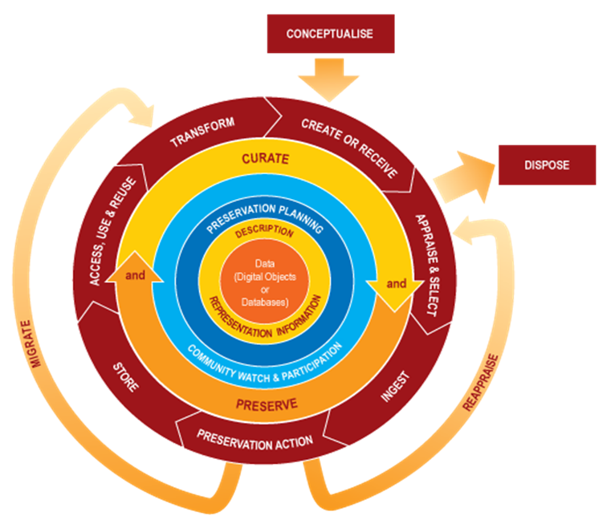
Digital Life Cycles
Digital Curation Centre
https://www.dcc.ac.uk/
Notes:
Many kinds of options for “digital life cycles” out there, many steps, sometimes a little too detailed to adapt to our own situations.
This one is from the Digital Curation Centre, and contains all possible digital curation program functions and processes.
If this looks confusing to look at right off the bat, you are not alone.
Models like this, while very educational and helpful, can be intimidating when you are at the beginning stages of stewarding and preserving digital collections in your institution.
They also don’t leave a lot of room for your own philosophies and processes - which might be technical, but also cultural and community-oriented.

Slide 3
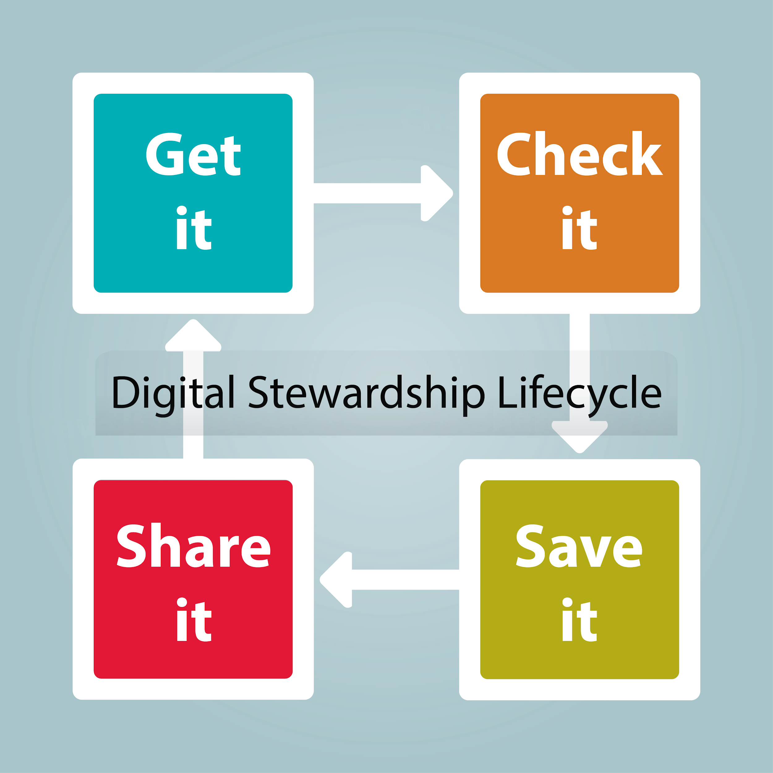
Notes:
In the Digital Stewardship Curriculum training, we wanted to simplify a model for the digital collections stewardship over the entire process.
This starting point provides a more flexible base to design your own “Digital Stewardship Lifecycle”
4 big buckets of “Get it” “Check it” “Save it” and “Share it.”
The life cycle of digital stewardship can be pieced out into these buckets.
Important note on language: Our WSU Digital Stewardship Curriculum staff member’s primary language is English, so that is what we have used for this training material, but most organizations who create a Digital Stewardship Lifecycle translate and transform the Lifecycle into their own language (either entirely, or use bilingual representation). This is an important part of adapting a Digital Stewardship Lifecycle to your needs.

Slide 4
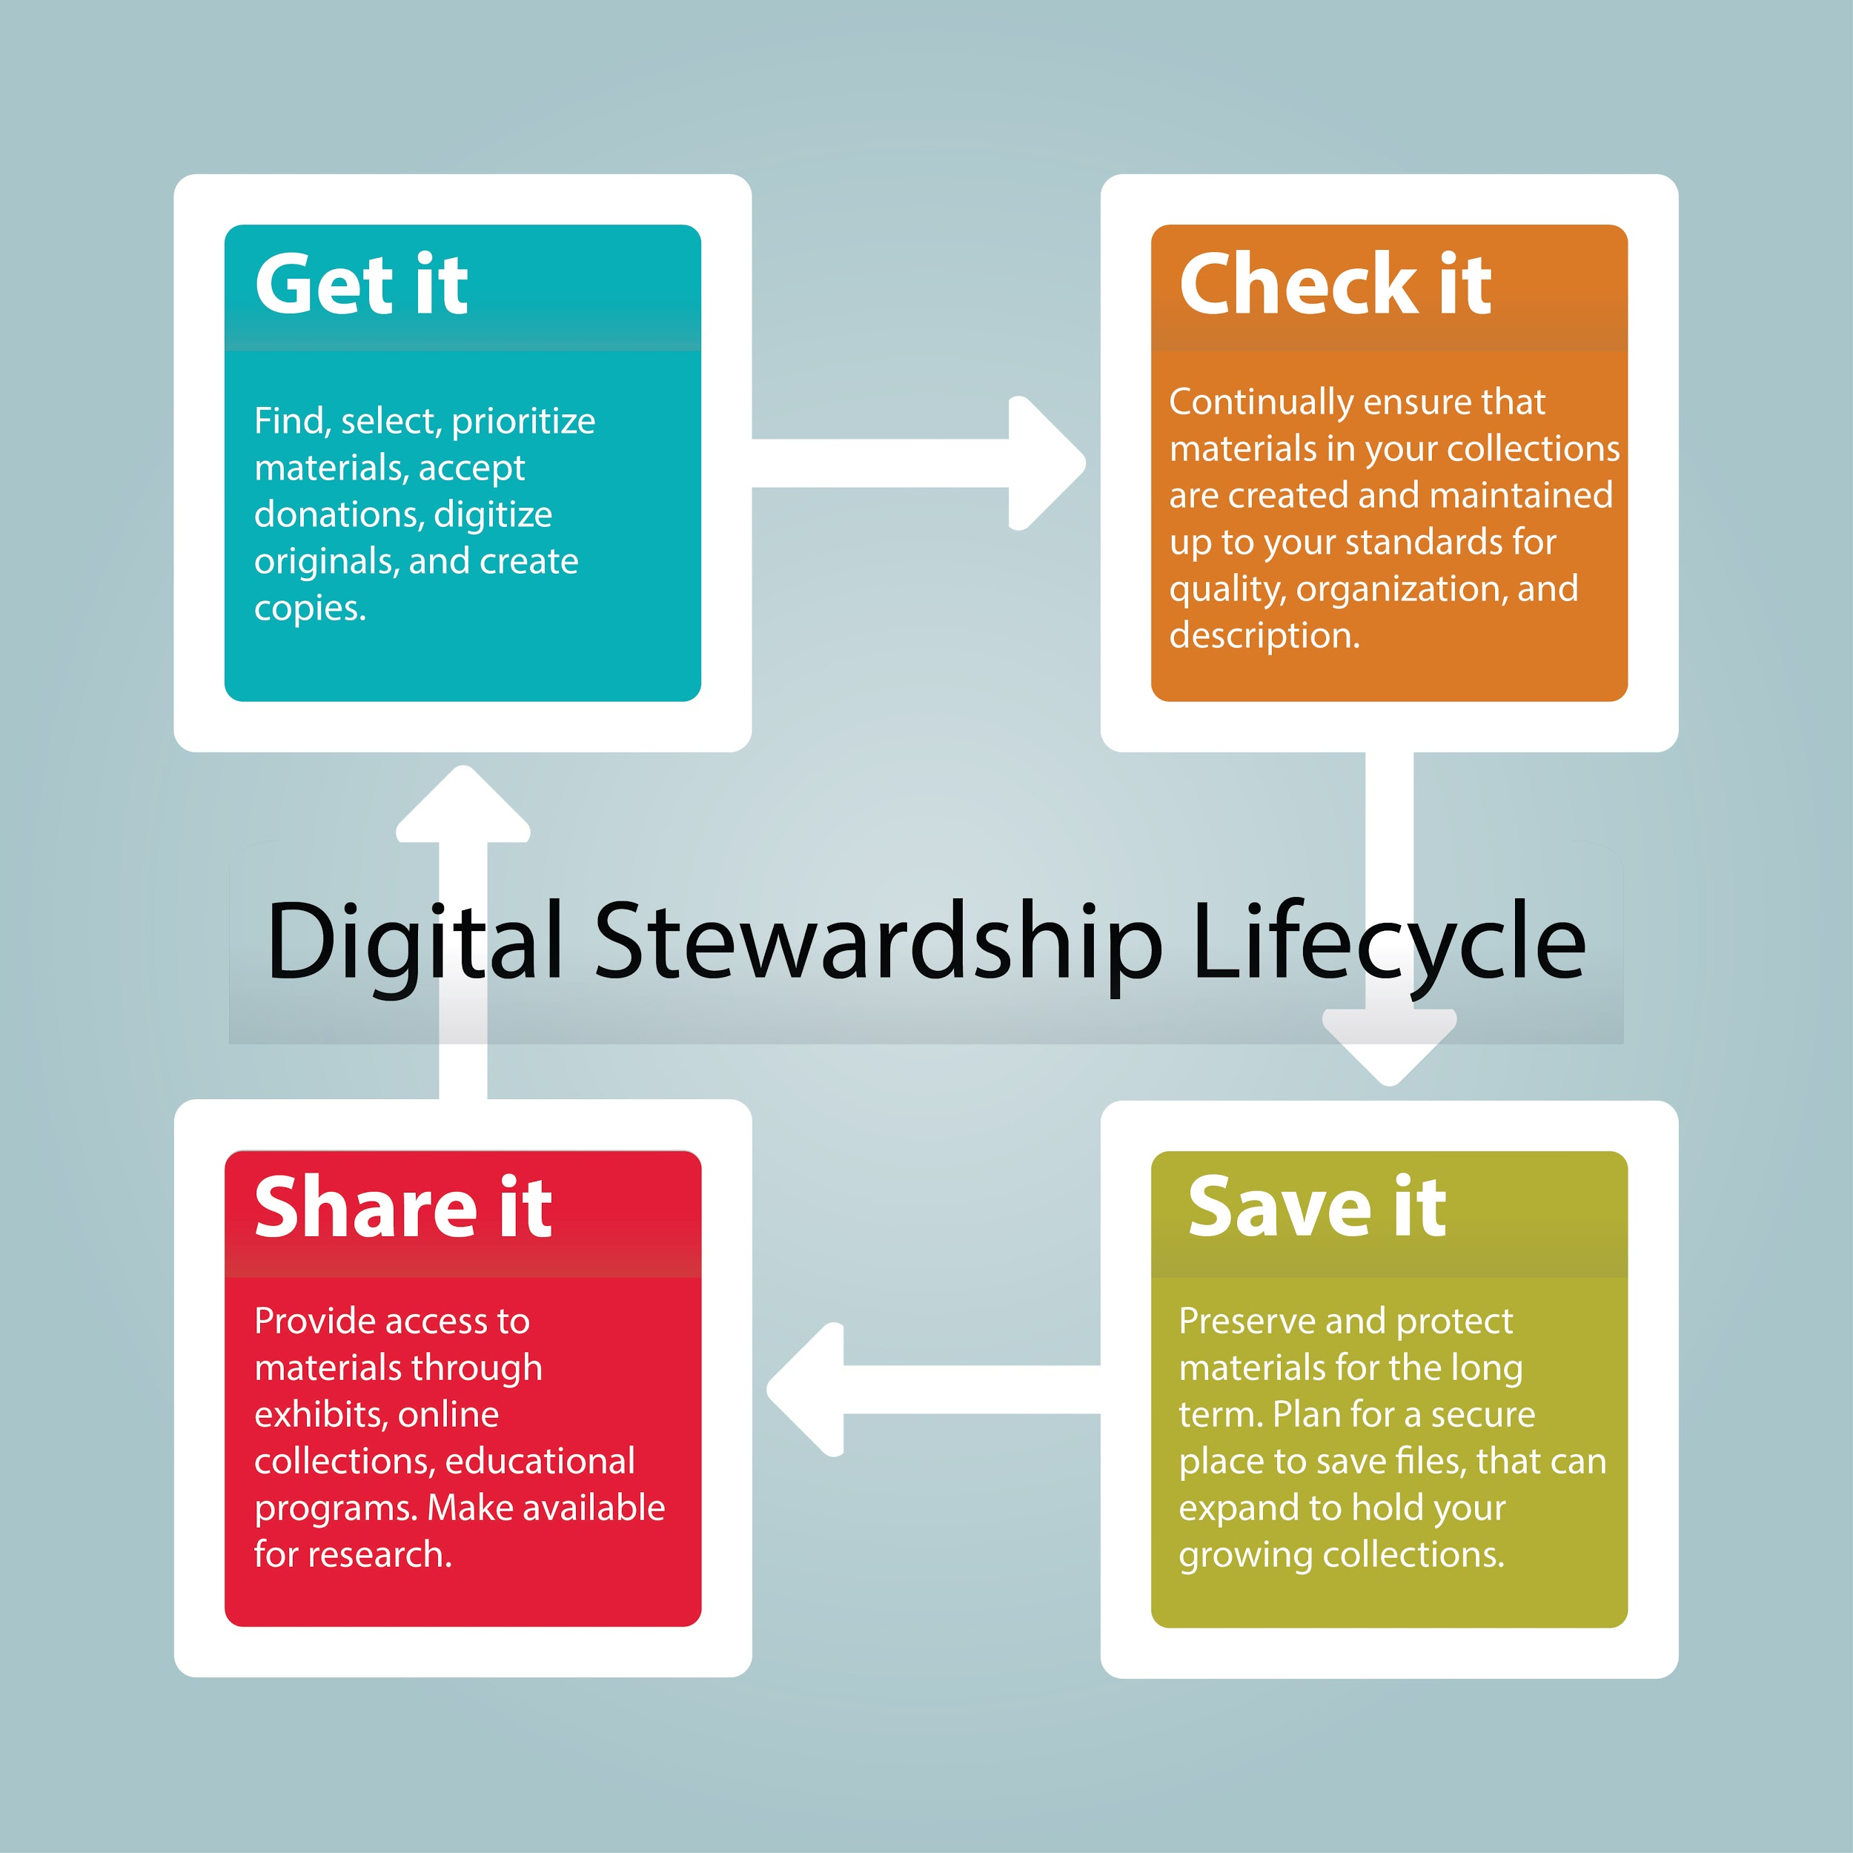
Notes:
We will look at each of these individually
get it - check-it - save it - share it -

Slide 5
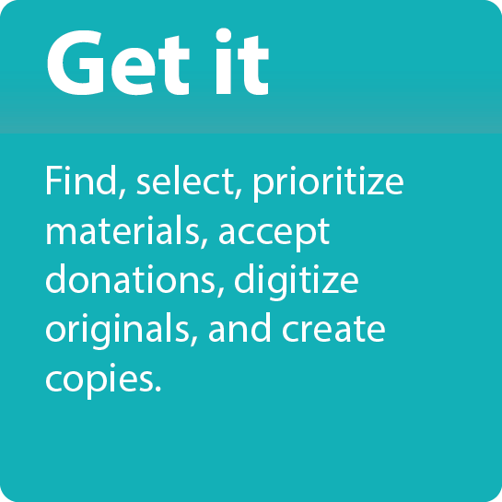
Notes:
Get is involves bringing materials into your institution (donations, collecting, scanning documents at another institution).
In this stage, you might also be supporting your community in caring for their family or shared materials.
There are many ways to GET digital materials
Find materials,
Select materials,
Accept donations,
Make copies of state or federal records,
create digital copies
Create digital copies in your community (for example a community scanning day)
Work with others to expand your collections
BUT you’ll need to be SELECTIVE--not all physical material needs to be digital,
Select based on your own collections needs, the needs of your researches and the goals and plans of your repository/tribe (other topic to look at: Mission and Vision and Collections Development).

Slide 6
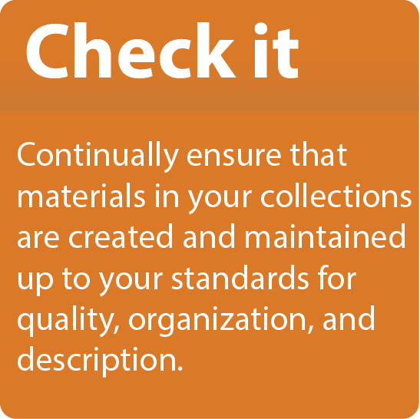
Notes:
Check it is all about managing, organizing, and understanding collections and materials in your care.
Check for quality and description. make sure they come in safely and intact.
Make sure that materials are up to your standards for quality and description so that they remain intact.
There are different factors for checking: -- you are trying to UNDERSTAND what you have..
What is the quality -- file size, type… is it a common format or do you need special equipment/software to read it?, is it corrupted?, can you open it?
What are the levels of description (existing)-- does it have metadata associated with it already? Description information can be embedded in files, in a collection guide or attached document, a sticky note, someone’s verbal sharing of their memory of the materials, etc.
How is it organized? Is there more work to do to make things understandable and findable?

Slide 7
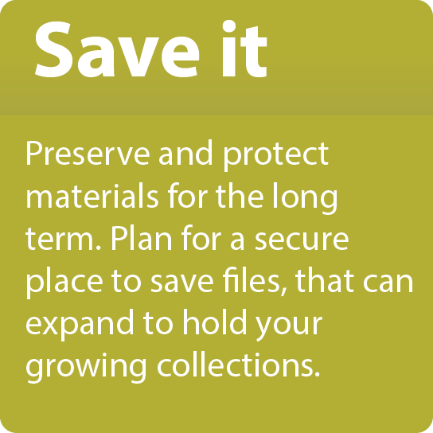
Notes:
SAVE IT: this is about security, storage and organization -- (meaningful organization)
Inventory -- all materials you “get” should be inventoried as part of your larger collection and subcollections
(this overlaps with processing and describing collections/items. Check It, but is equally important for digital storage)
Storage -- types of digital storage and preservation (check out resources on Digital Preservation for more information)
If you are just starting out, think about WHERE you store digital files and the WAYS you store them and HOW you PROTECT them (multiple copies, back-ups off site)
Provide meaningful organization:
Organizing is part of saving (if you can’t find it you, saving doesn’t help!)

Slide 8
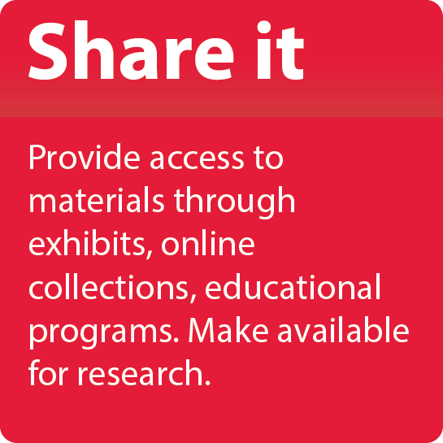
Notes:
Share it is providing access to materials, which might happen in many ways: Online digital collections, exhibits, educational materials and curriculum, research and reference
This stage is where it gets interesting! What are the POINTS OF ACCESS for your collections?
Check out resources for Mukurtu CMS and other platforms to share your content with your communities
As you plan, you should be thinking of all the ways you can show or SHARE your materials (different audiences)
For your institution and community, what does this entail in relation to the types of ACCESS that meet your cultural protocols and values
Are there materials that only elders should have access to?
Are there materials that should only be seen or used at a certain time of year?
Are there materials which should only be shared within your Tribe, Nation, or community, and not with outsiders?
Are there materials that are geared towards youth in your community?

Slide 9
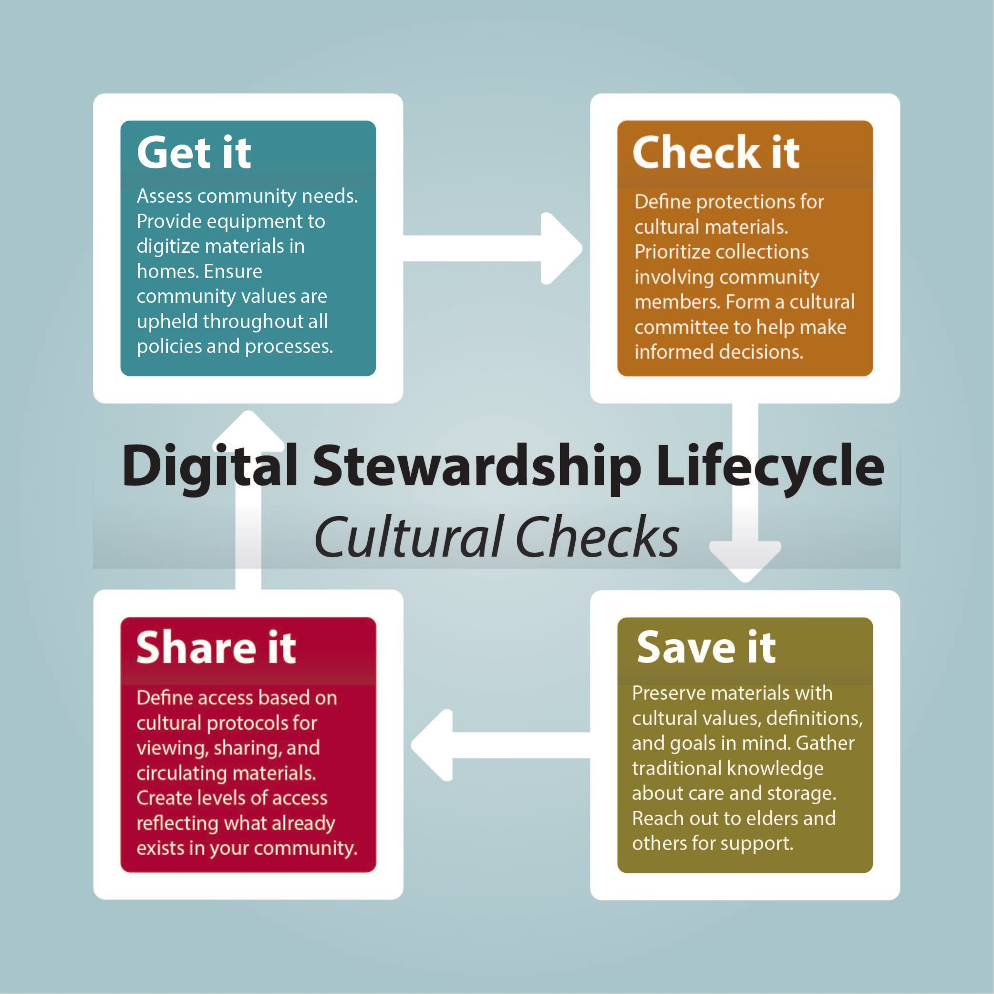
Notes:
After thinking through the stages of Get It, Check It, Save It, and Share It
You will add in your own Cultural Checks to this basic model
These “Cultural Checks” add layers to the general lifecycle model steps and are specific to your community
By working through these important considerations, you can create a Digital Stewardship Lifecycle which is first and foremost grounded in your cultural protocols and practices and community values

Slide 10
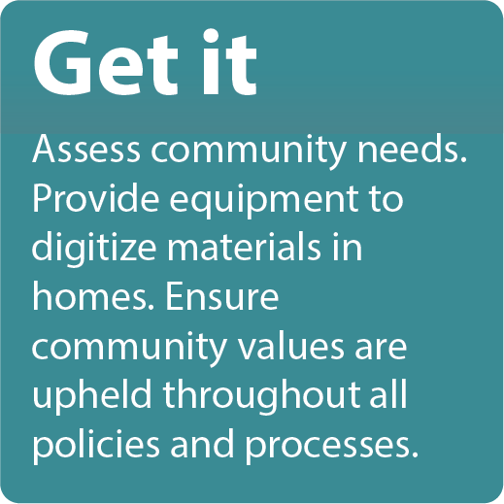
Notes:
In the Get It stage, cultural checks surround gathering materials from your community (in appropriate ways), knowing community needs and goals, and enlisting appropriate partners to help
Think about the ways in which you do this already, or policies or practices you want to implement.
When working with outside institutions, what are the important cultural values to uphold? What necessary steps should be followed when working with another repository (such as the Library of Congress, State historical society, or a nearby University) from a cultural and political perspective?

Slide 11
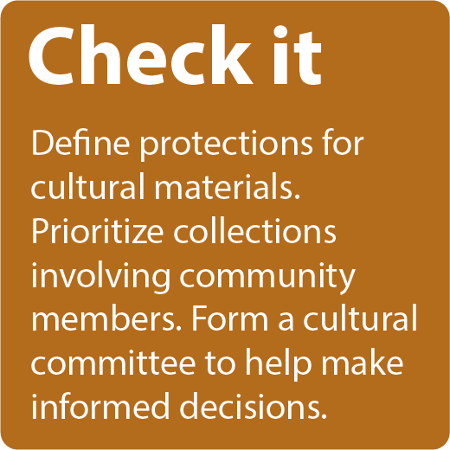
Notes:
Check it considerations for Cultural Checks:
Define cultural, linguistic, social, needs for materials: are there sacred materials, or gender specific? Or ones that should only be viewed or heard by elders etc.
Make sure you have the correct attribution and permissions - both in content and descriptions -- this is where you may have to do some detective work to ensure that tribal members are attributed not only the non-Native collectors, scholars, missionaries etc.
Do you need a committee to review these? This is where policy making comes in, and outreach to work with existing committees or form a new group to help review, advise, and make decisions.

Slide 12
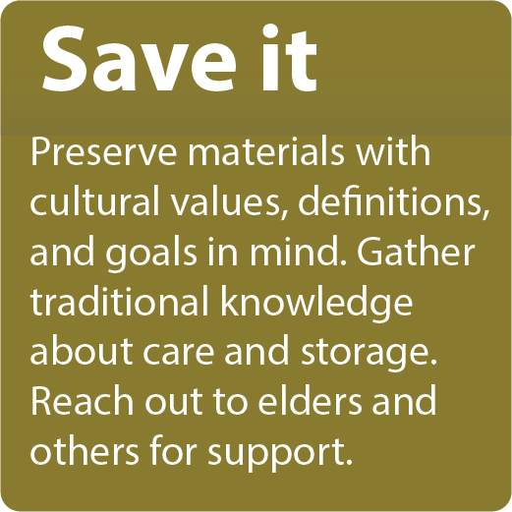
Notes:
Save it focuses on sustainability of these materials, for cultural checks:
Organize with cultural values and goals in mind -- there is no one way to organize your collections--this model helps you define HOW you want to ensure that cultural values are part of the organization from the beginning
Gather and preserve traditional knowledge (saving what you might not have gotten otherwise, writing text, capturing audio or video, related materials)
Speak with Elders, culture committee, community groups, for support

Slide 13
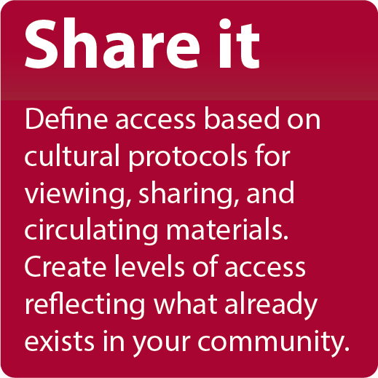
Notes:
Share it -
Define accessibility based on cultural protocols (viewing, sharing, recirculating)
Define your own levels of access
Implement in policies and through use of Mukurtu CMS for access to digital materials

Slide 14
Cultural Checks
Emphasize in your:
Digital Stewardship Lifecycle
Policies
Procedures
Workflows
Notes:
Cultural checks and prioritizing your cultural concerns, values, and community goals can be present through more than just the Digital Stewardship Lifecycle
Big picture is Lifecycle-- then policies, procedures and workflows reflect what you define in your lifecycle and other strategic planning
The CHECKS are put into action in your:
policies (top level)
procedures (mid level) and
workflows (daily level)

Slide 15
Audience for your Lifecycle
Staff in your department
Other departments/governance
Community members
Non-community allies
Funding agencies
Notes:
Think about who your audience is for this Lifecycle
You could create more than one version
Could be an important piece to a grant proposal
So as you start to create your lifecycles you want to think about:

Slide 16
General Questions for your Digital Stewardship Lifecycle creation:
technical needs
informational needs
management needs
preservation needs
Notes:
When you are ready to start brainstorming and creating your Lifecycle, consider these types of questions for each stage...
technical needs: what do I need technically to “get, check, save and show” my content?
informational needs: what do I need to know about this piece of content and how am I going to describe it?
management needs: how am I going to manage this content?
preservation needs: how do I ensure this lasts--that I can open this file in 5 years?

Slide 17
Digital Stewardship Lifecycle questions for Tribes, Nations, and Communities
Adding cultural values, needs:
Cultural checks:
What are your important checks?
When do they occur in your model?
How do they get put into practice?
Notes:
Again, cultural checks will make your Lifecycle specific to your community. Consider:
WHAT are your important “checks”
WHEN do they occur
HOW do they get put into practice
Examples for starting to think about cultural checks:
“When an audio file comes in, we need to have a knowledgeable person review for sacred or sensitive content”
“When cataloguing images we need to have all files go through the cultural committee to define access permissions”
“We need a tribal specific controlled vocabulary for describing ceremonial materials in our CMS, because standard subject headings are not applicable”

Slide 18
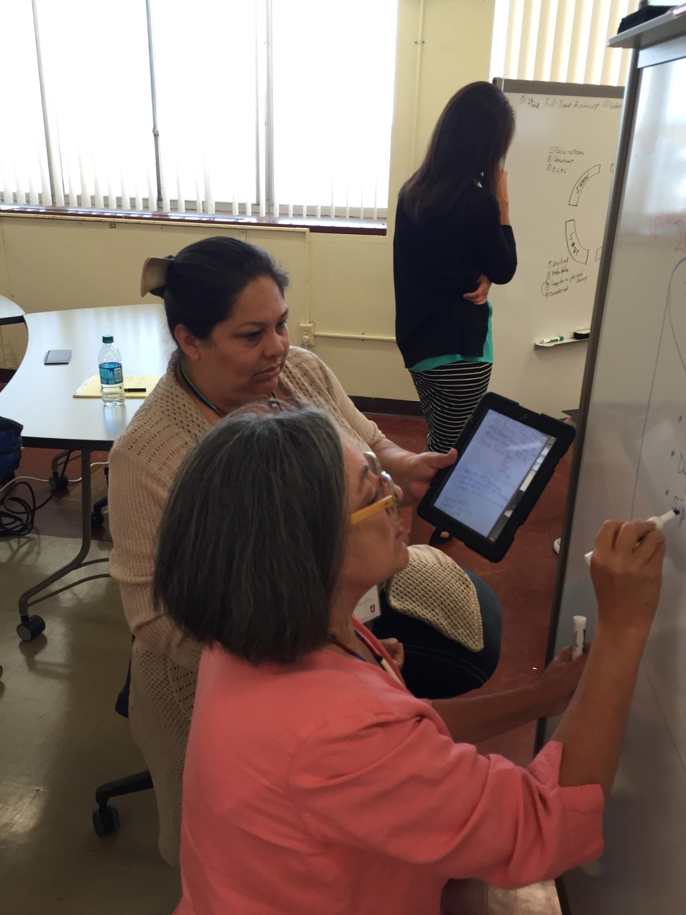
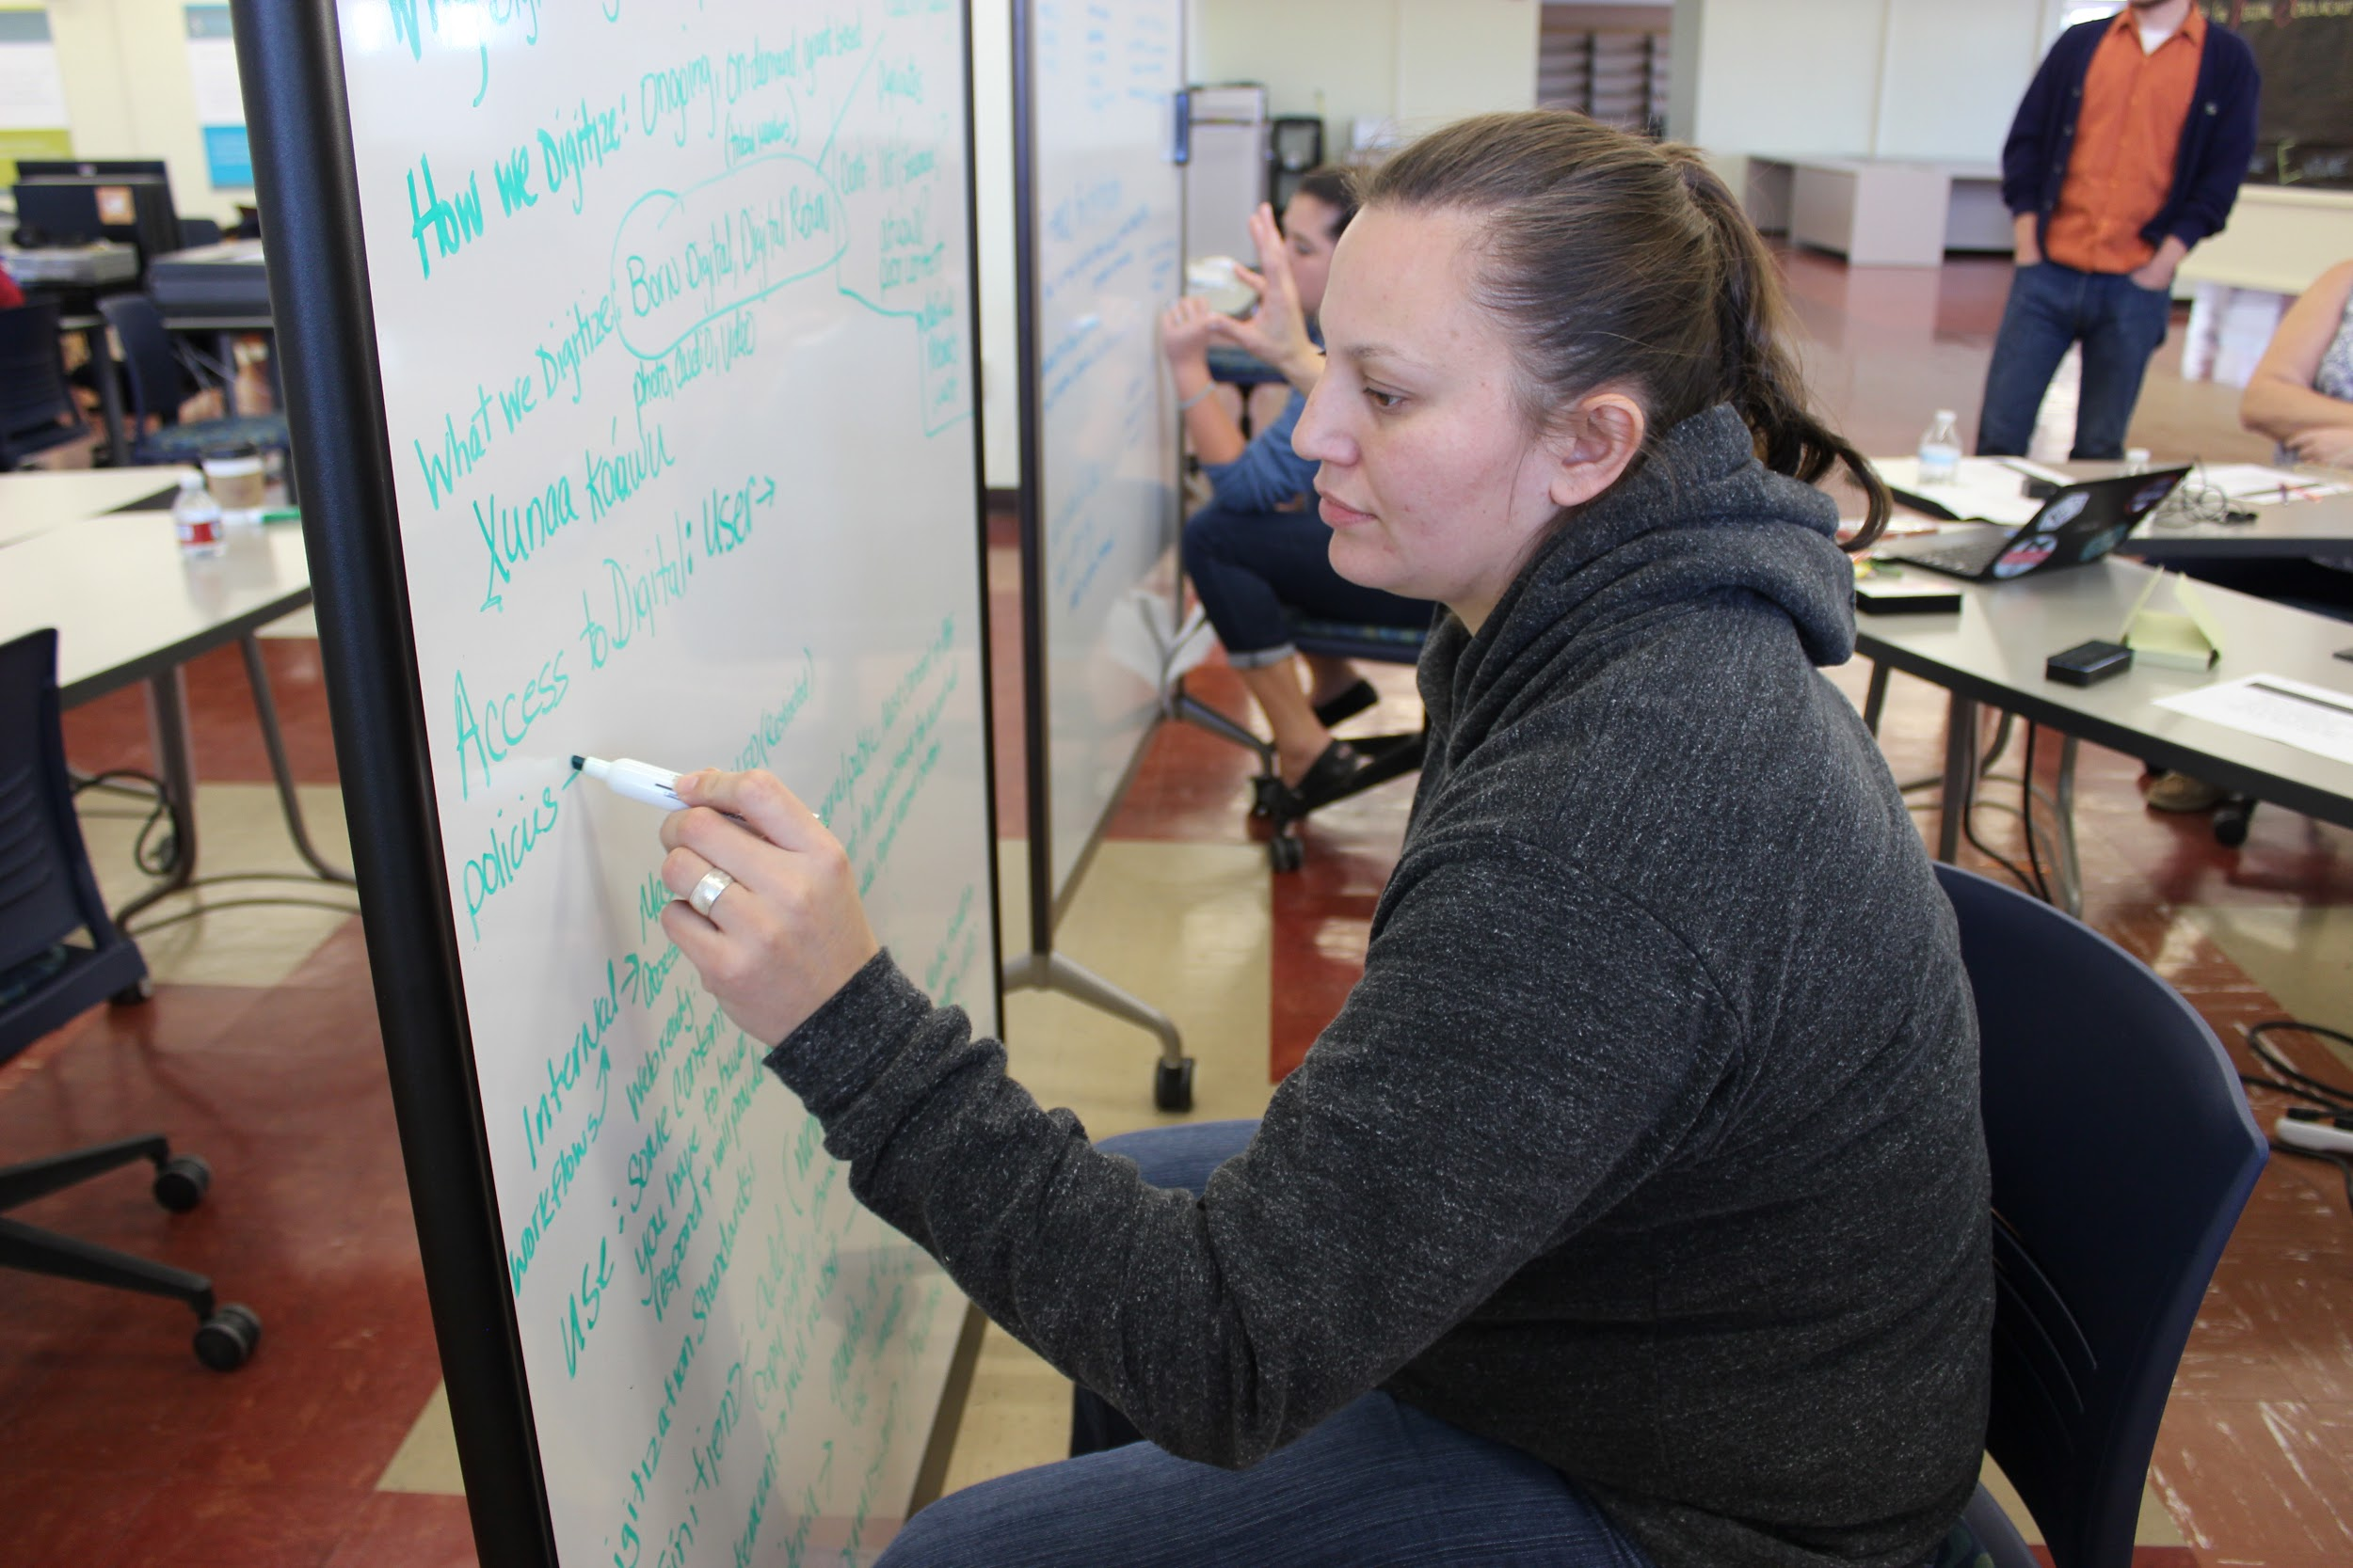
Work Time, TSCP 2015-2017
Angela and Bari, Sarah, Arlan and Moe, and Ashley
Notes:
In past training at WSU (through the Tribal Digital Stewardship Cohort Program) dedicated work time has been very important. Try to set time aside for you and your team to get discussion and brainstorming going, sketching out ideas, and making concrete steps like writing or drawing
Whiteboards, chalkboards, or easel pads are a great tool in this work!

Slide 19
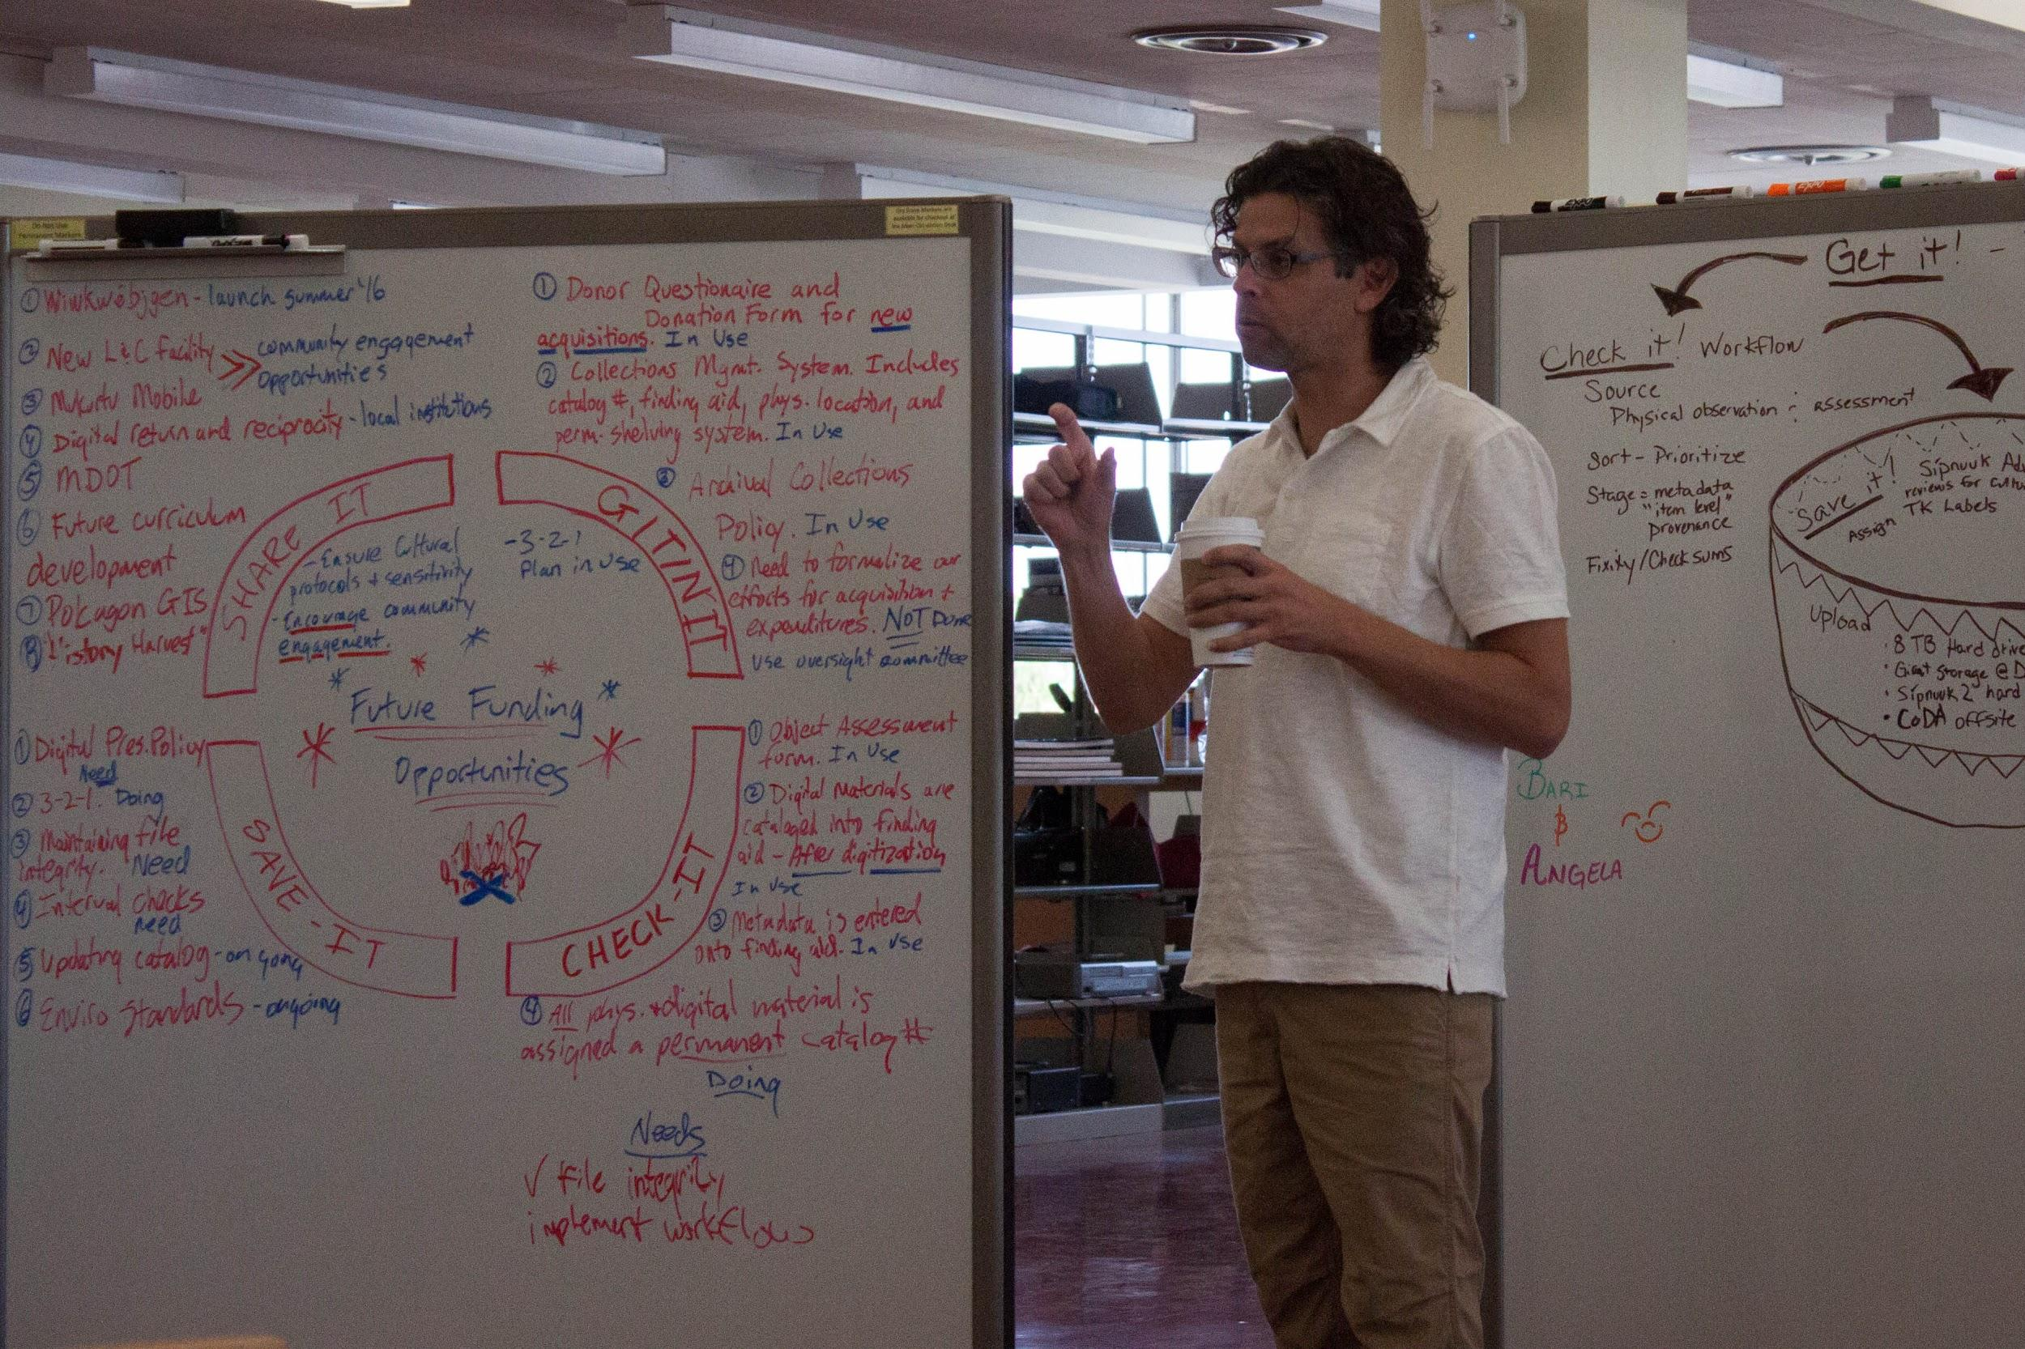
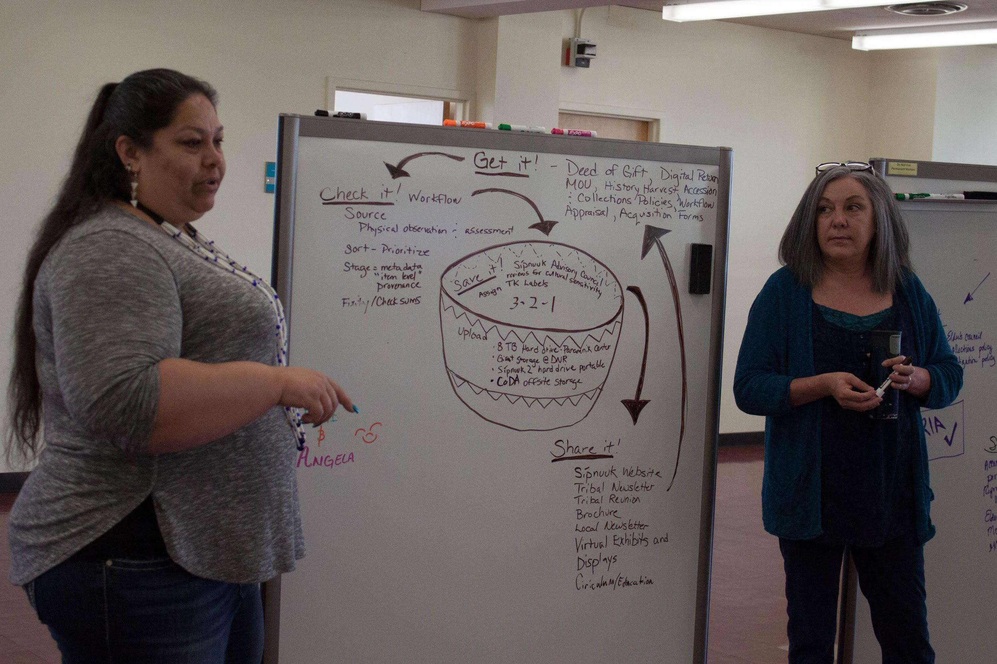
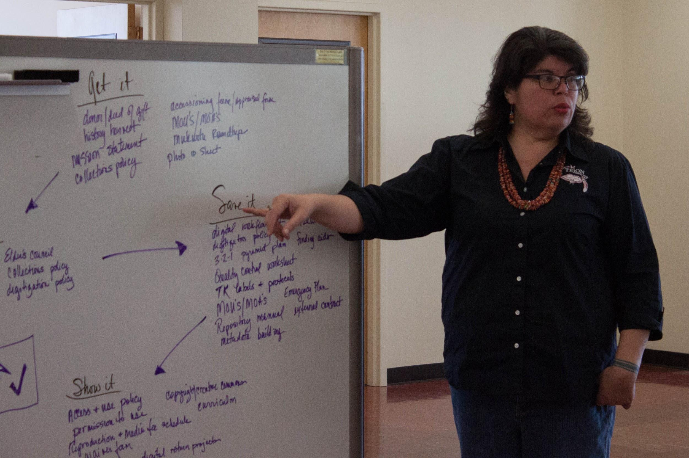
Presenting, TSCP 2016-2017
Elizabeth, Jason, Angela, and Gloria
Notes:
Additionally, Tribal Digital Stewardship Cohort Program members presented their Lifecycles to each other during their last training week. This was always one of the favorite times to learn from others.
Who can you share and present with?
At first for feedback and practice
Then to your community, supervisors, colleagues, Tribal council, governance, outside organizations, or others depending on your audience and intentions.

Slide 20
Digital Stewardship Lifecycle: Timeline
Create a timeline
Work on alongside other policies/plans
Past trainings - 1 year
4 weeks of intensive work (August, November, February, May)
Revising between
Notes:
Give yourself a timeline that works for you
Include a breakdown of work
Do this along with other planning and development
In past trainings, participants created theirs in 1 year

Slide 21
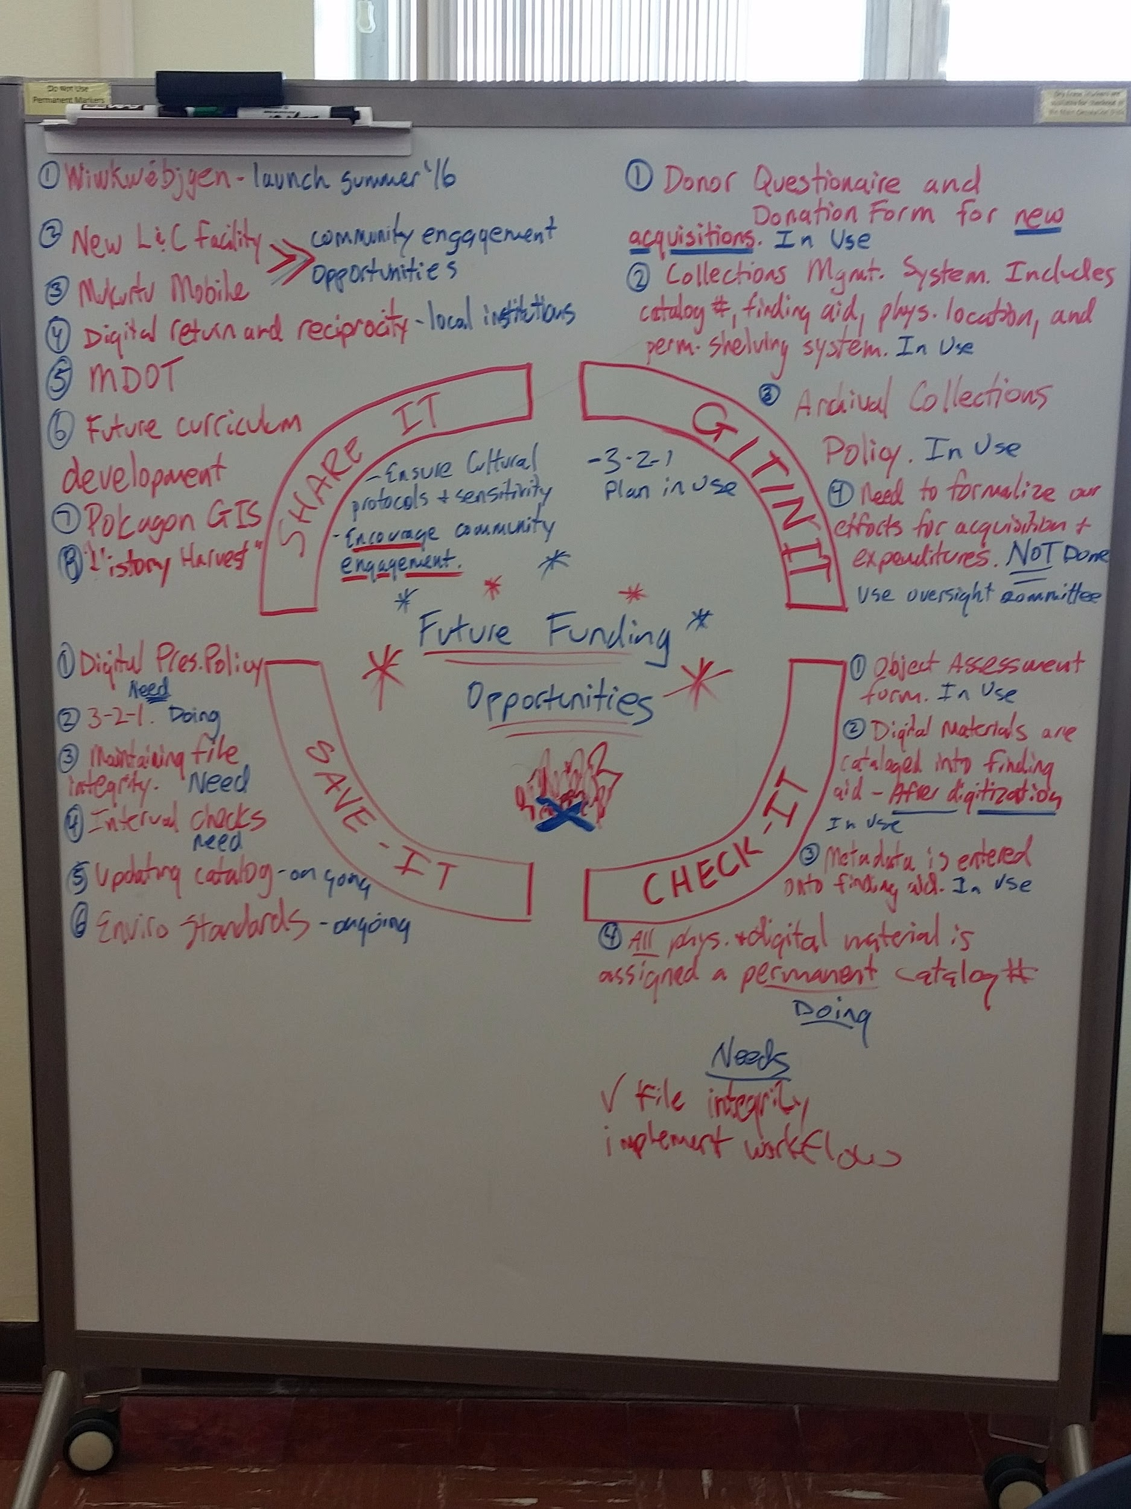
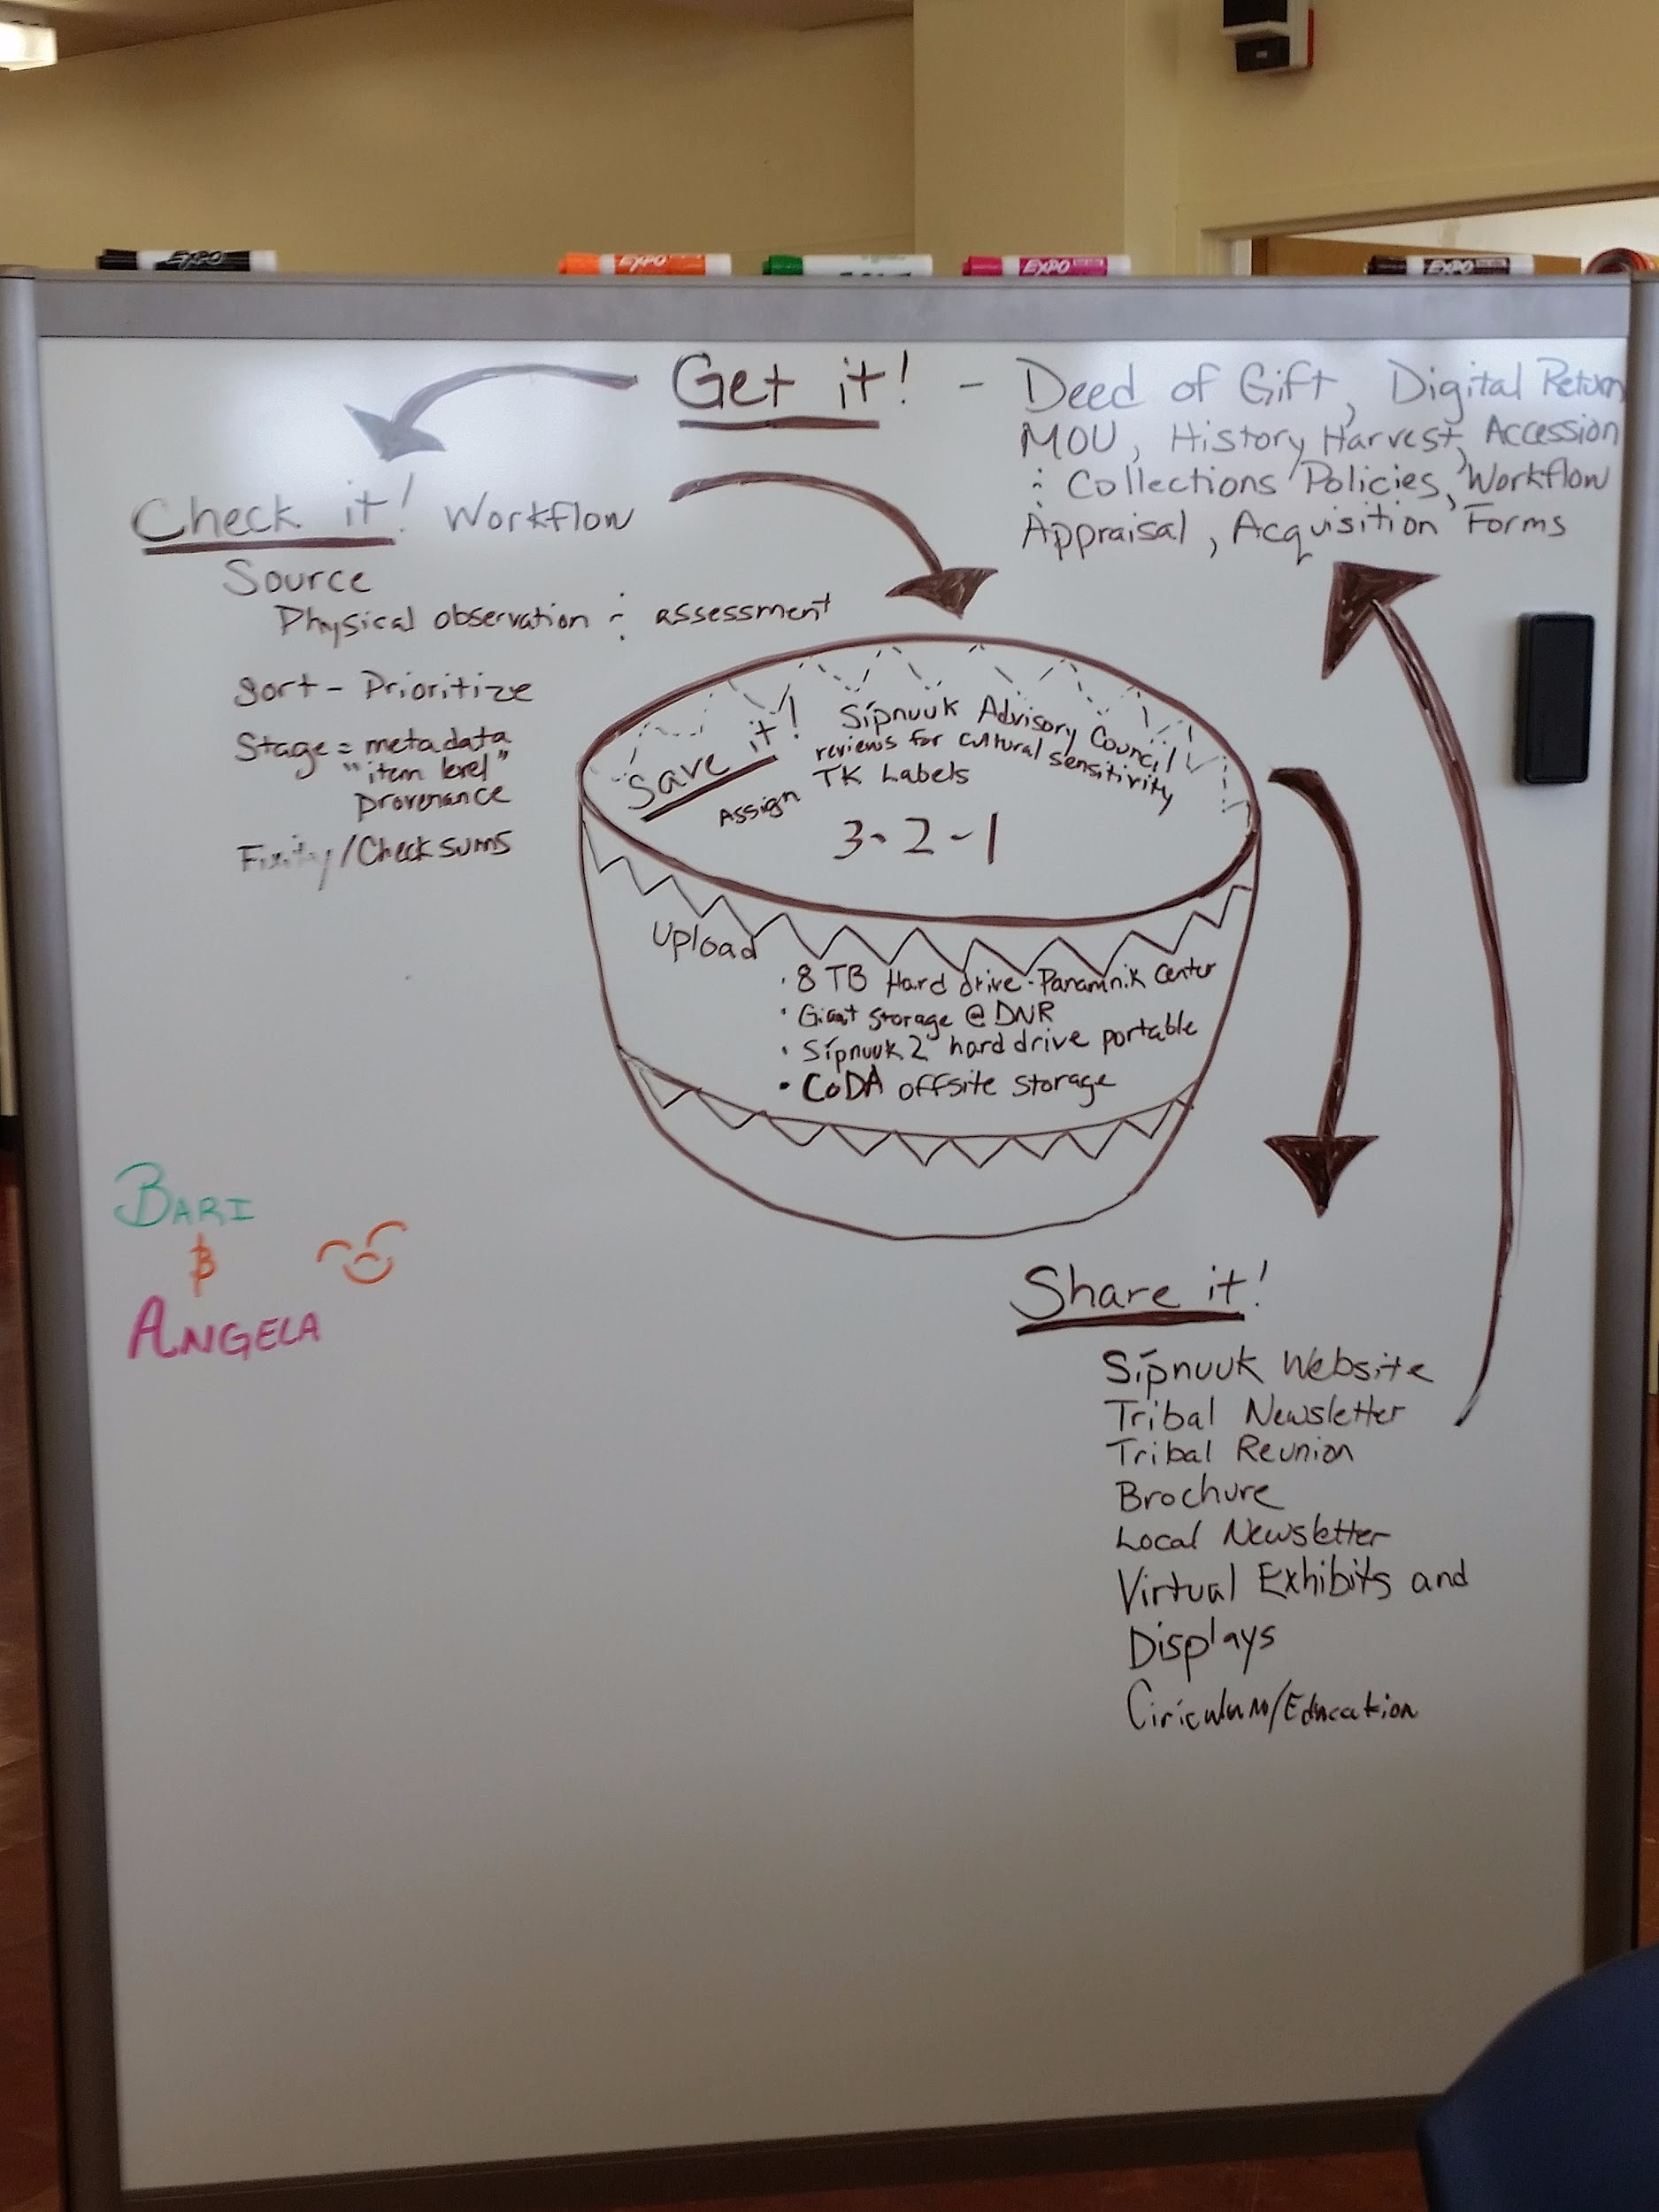
Lifecycles, TSCP 2015-2016
Jason and Katie - Pokagon Band of Potawatomi Indians
Bari and Angela - Karuk Tribe
Notes:
Pokagon Band members listed funding as the piece at the center that keeps resources flowing and allows digital work to happen, another piece that they developed was an in depth donor questionnaire and form
The Karuk Tribe Sípnuuk Digital Library team chose a gathering basket as a symbol for their, for digital materials and resources across departments)

Slide 22
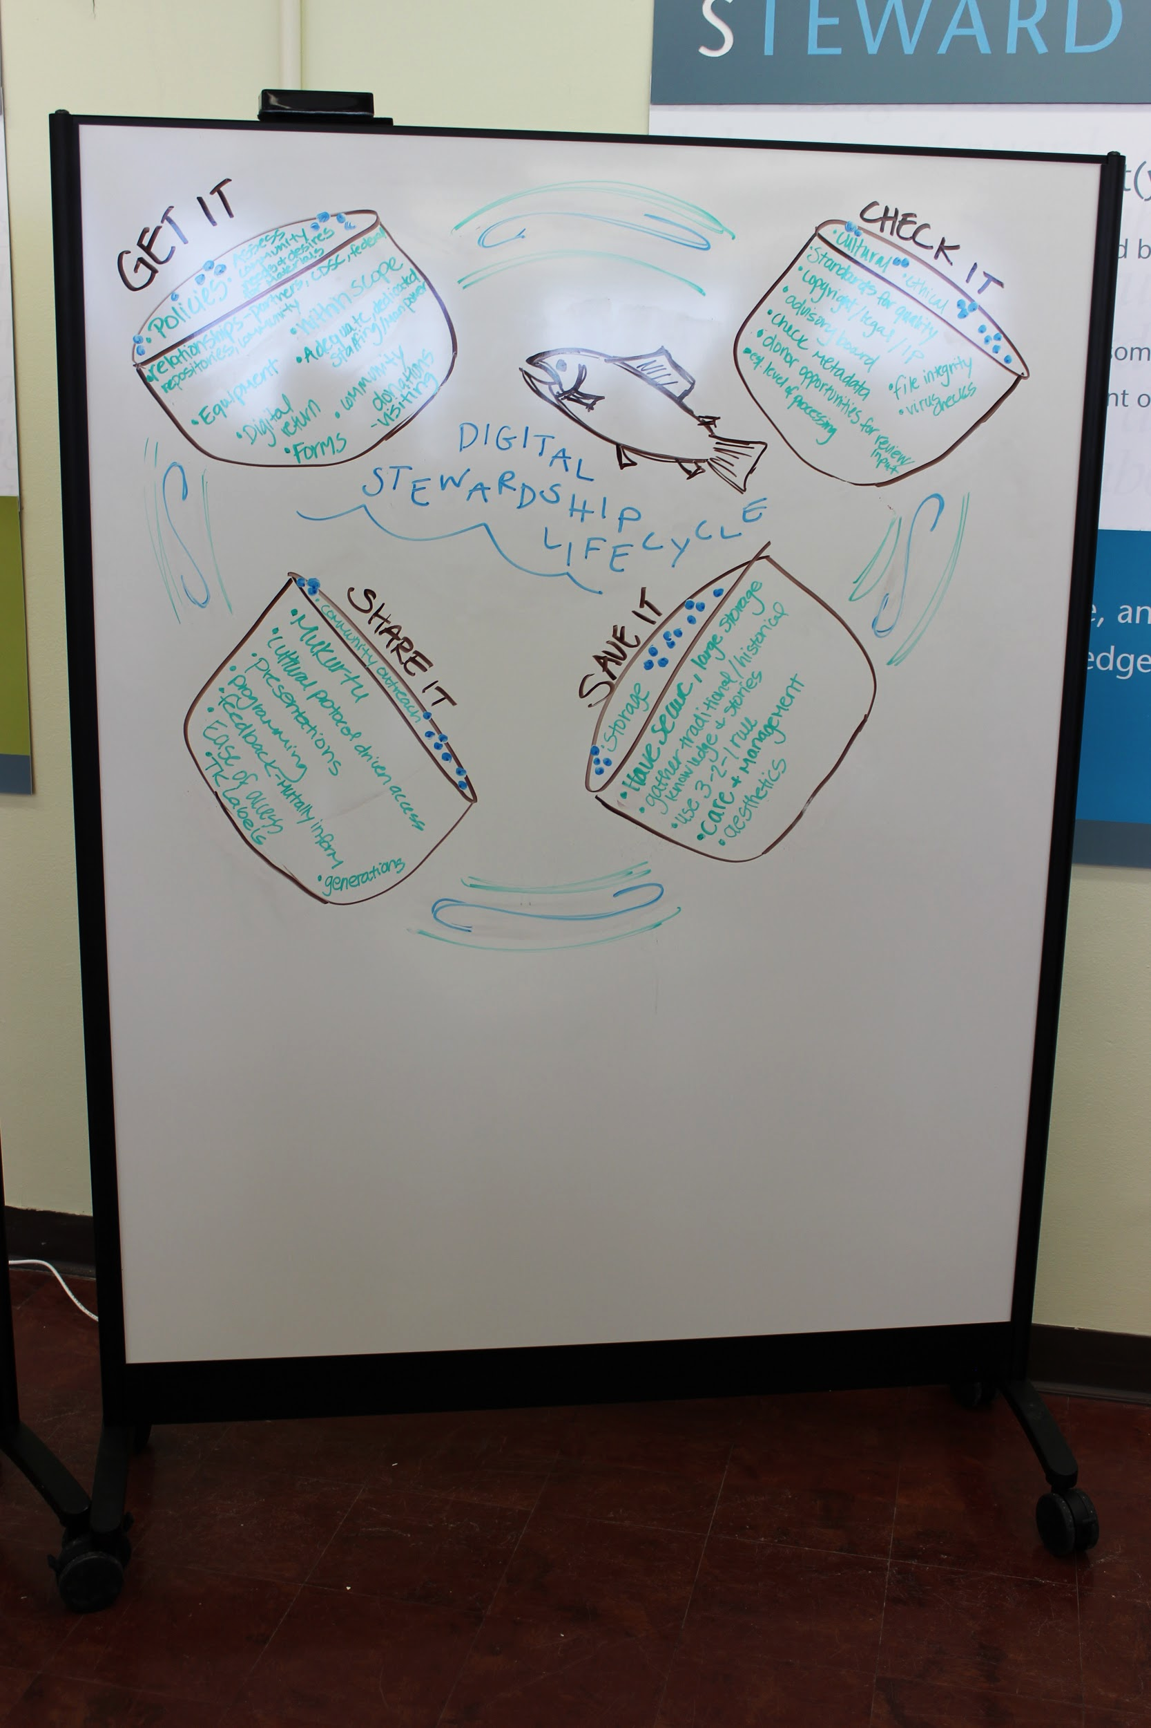
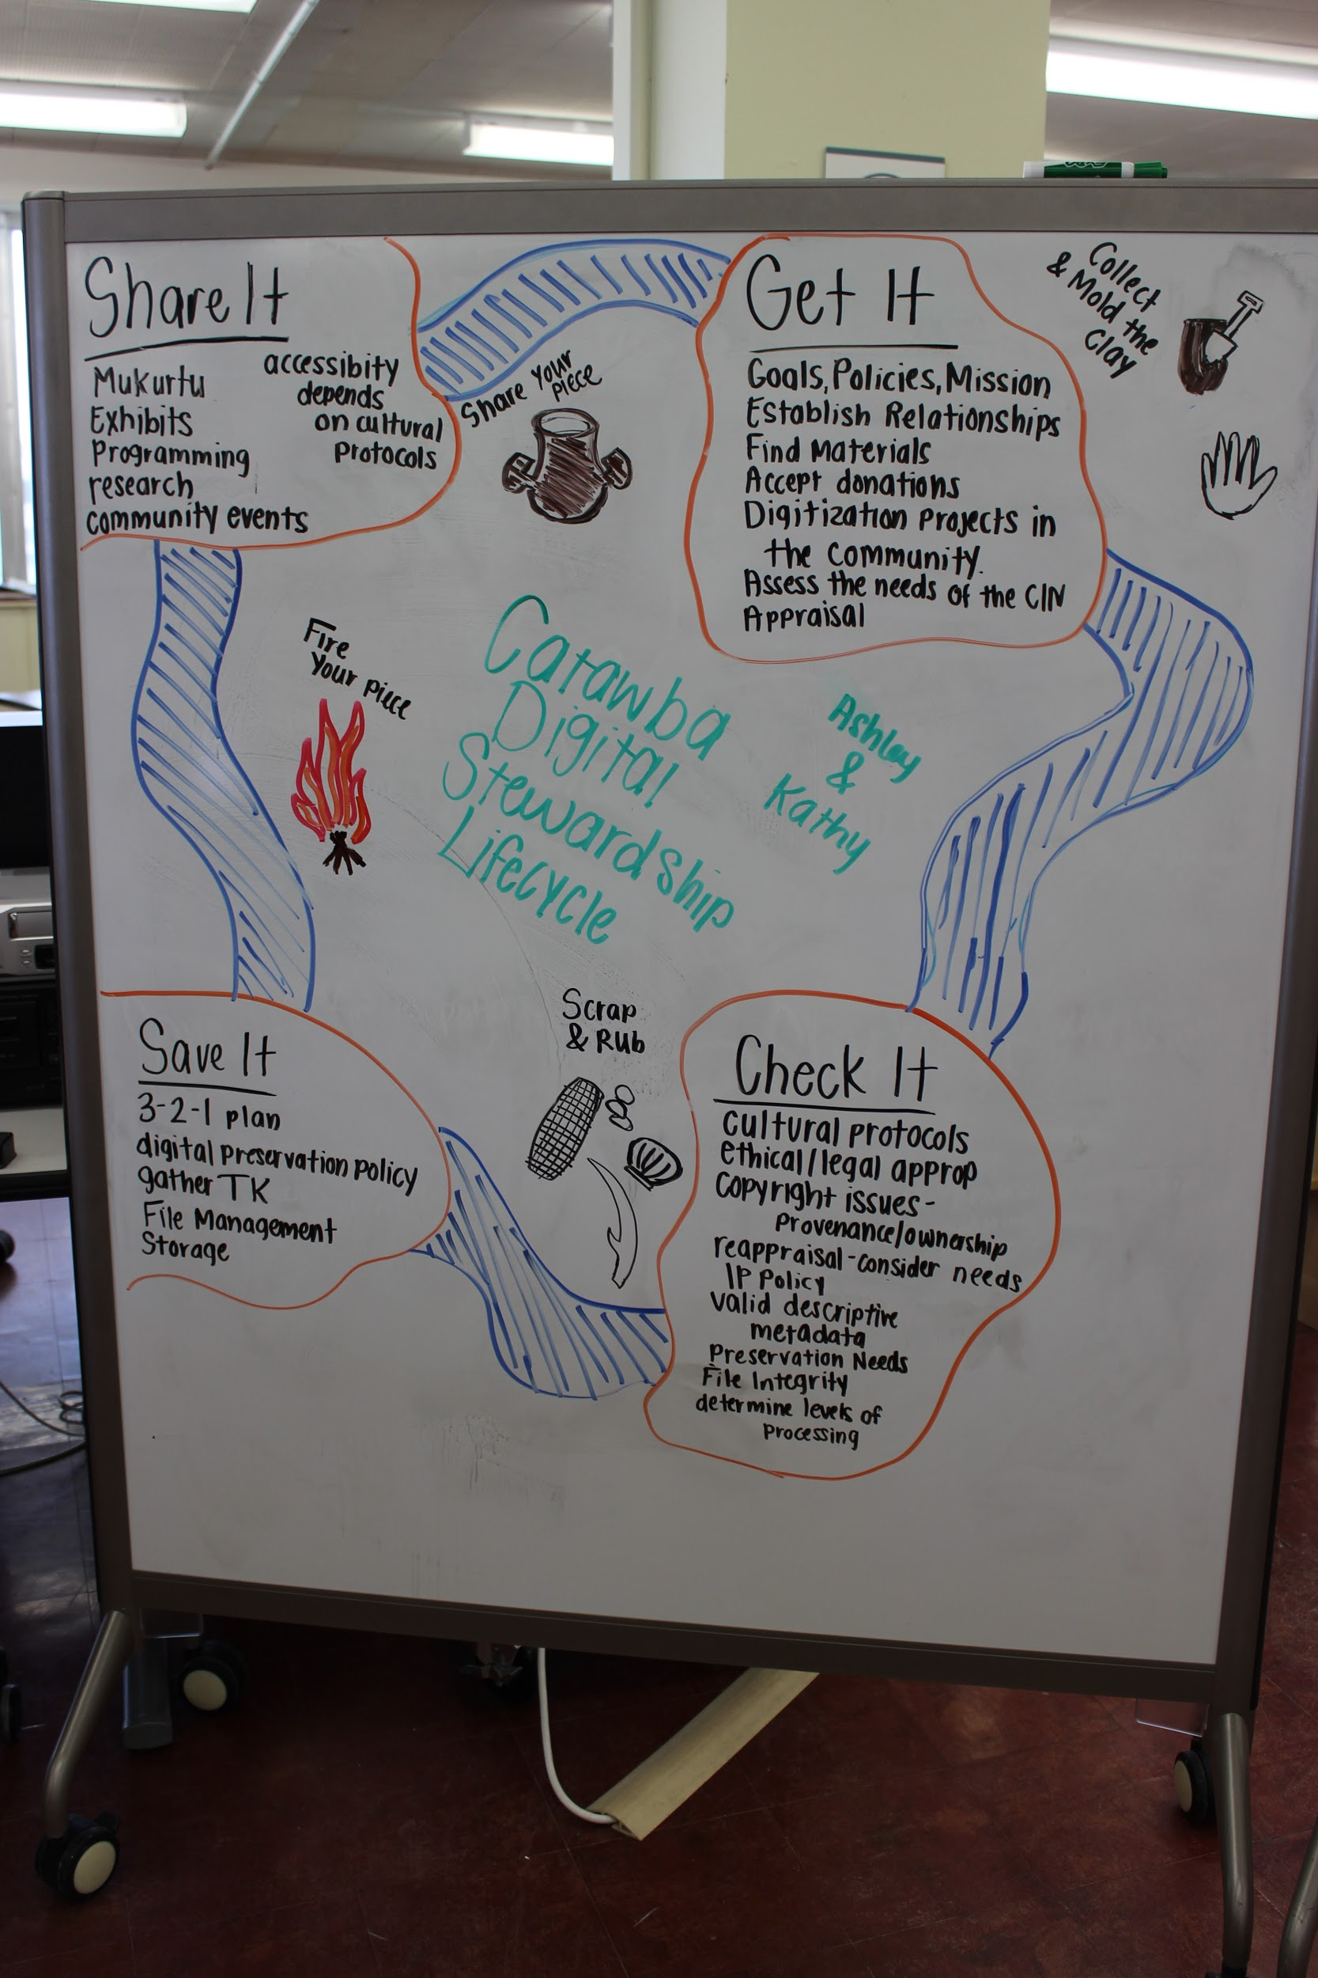
Lifecycles, TSCP 2017-2018
Amelia and Sarah - Huna Heritage Foundation
Ashley and Kathy - Catawba Indian Nation
Notes:
Huna Heritage Foundation
From day one of the training, Amelia thought about how she would explain all these complex digital concepts to elders and others in her community. She thought of preserving and sharing blueberries for feasts.
She came up with the analogy of gathering, cleaning/processing, canning and sharing blueberries. The flow of blue in their drawing shows the importance of the water and fishing in Hoonah, an island community.
Amelia focused on important steps like forming an advisory board, gathering information from community members about their memories of events and people in photographs, and sharing appropriate content online
Catawba
Ashley used the example of creating pottery to show the stages of her lifecycle
Clay pottery is a major focus of Catawba culture and artistry, and the archives photograph collection too. The master potters in the community are highly respected and treasured.
Her stages of Get it, Check it, Save it, and Share it map to Collect and mold the clay, Scrape and rub the clay, fire your piece, and share your piece with others.
As someone who was often working solo in her department, Ashley added steps like ensuring MANAGEABLE digital preservation to “Save it”, and connected “Share it” to other institutional goals like working with the Education and Language departments to connect with youth programs

Slide 23
Next Steps
Start brainstorming your own Digital Stewardship Lifecycle Model
Start to tailor/adapt “Get it, Check it, Save it, Share it” to your needs
Add in community specifics and cultural checks
Notes:
Start writing ideas - it may be a circle, a square it may have more than the four parts...it is up to YOU
These Digital Stewardship Lifecycle concepts are repeated throughout the structure and content of our Digital Stewardship Curriculum
The Digital Stewardship Lifecycle Worksheet is an option for writing down ideas and notes

Slide 24
Credits
Graphic on Slide 2 https://www.dcc.ac.uk/
Digital Stewardship Lifecycle created by Center for Digital Scholarship and Curation and Dr. Kim Christen, graphics designed by Lotus Norton-Wisla
Images by Lotus Norton-Wisla and Nella Letizia, Washington State University Libraries
This template is free to use under Creative Commons Attribution license.
Presentation template by SlidesCarnival.
Minicons by Webalys
These slides contain changes to color scheme and content.

Slide 25
Using this Resource
The Digital Stewardship Curriculum is an Open Educational Resource created by the Center for Digital Scholarship and Curation.
All presentations and resources created by the CDSC are licensed under a Creative Commons Attribution-NonCommercial-ShareAlike 4.0 license (CC BY-NC-SA). Please share, reuse, and adapt the resources and provide attribution to the Center for Digital Scholarship and Curation, Washington State University.

