Slide 2
Center for Digital Scholarship and Curation
Washington State University
Image: Smithsonian American Art Museum, Transfer from the General Services Administration

Slide 3
Image: Jon 'ShakataGaNai' Davis, CC BY-SA 3.0, via Wikimedia Commons

Slide 4
Tools for Editing Images in Cultural Heritage Organizations
Presented by Lotus Norton-Wisla
Center for Digital Scholarship and Curation
Washington State University
CDSC Spring Webinar Series

Slide 5
Webinar
Housekeeping
Need tech support?
Use the chat box
Send private chat to “Tech Support” a.k.a. Jess @ the CDSC
cdsc.info@wsu.edu
Mute unless asking a question
I am recording this webinar
Use the chat box for questions and comments
Slides and handout have been shared in the chat box

Slide 6
Today’s Goals
Understand basic concepts and terms
Learn about some tools available
Start to assess your software and training needs
Learn about resources for further education
*Share with others*
Image: Stairs by miza bin from the Noun Project

Slide 7
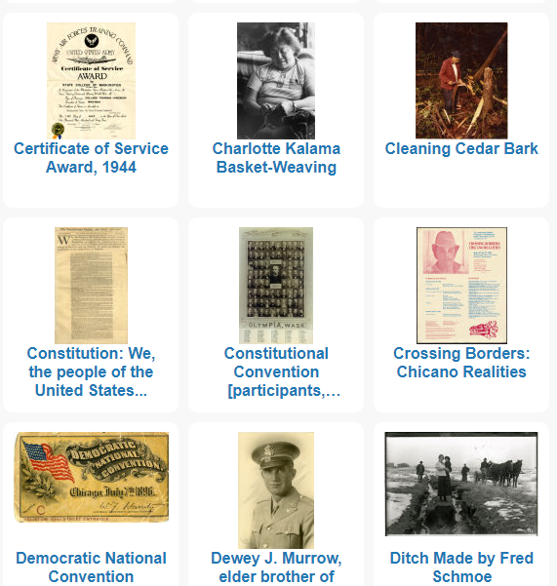
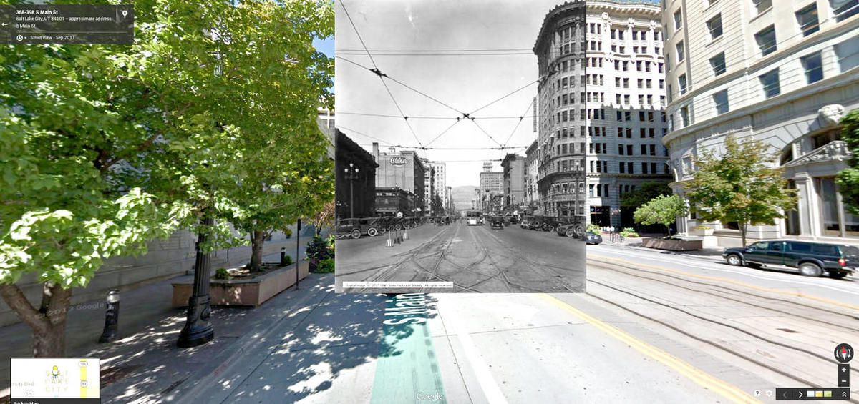
Why edit images?
Basic image processing
Slight corrections
Access copies to share
Engagement
Images: https://www.deseret.com/, Utah State Historical Society; https://content.libraries.wsu.edu/

Slide 8
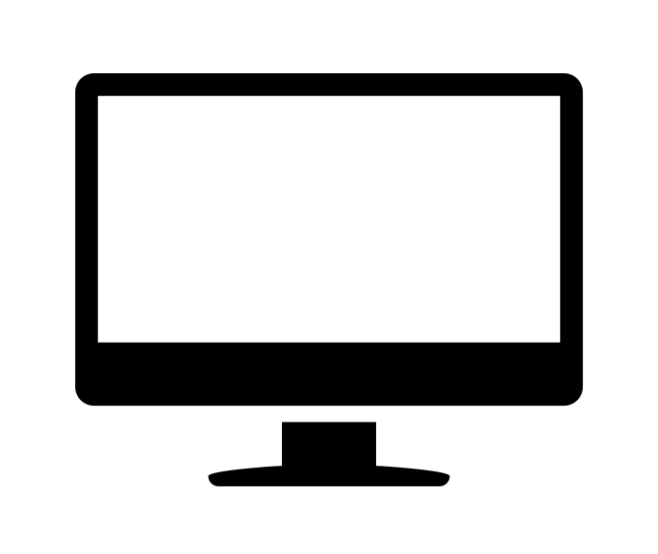
Hardware
Monitor and graphics card
Accuracy of colors
Color profile (ICC or ICM file)
Adobe RGB
Capture device*
Digitization specifications
Image: Monitor by Javi Ayala from the Noun Project

Slide 9
Versions of Files
Preservation copies
Access copies
Created from preservation files
Smaller
Lower quality
Other derivatives

Slide 10
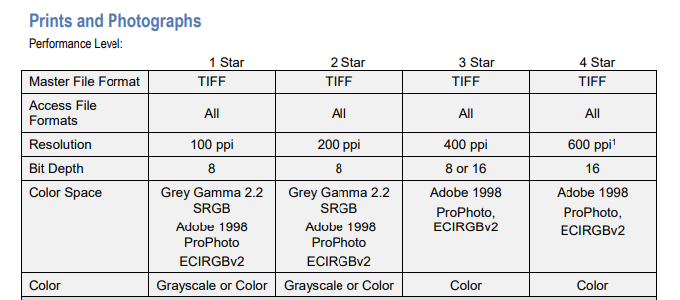
Standards and recs
FADGI
Stanford
Mukurtu CMS

Slide 11
Managing File Formats
Document what formats you use
For each version of your content (preservation, access copies, etc.)
Avoid proprietary formats
Search for examples of file lists/registries
Example: Library of Congress Recommended Formats

Slide 12
Light Image Editing
Image: image edit by shashank singh from the Noun Project

Slide 13
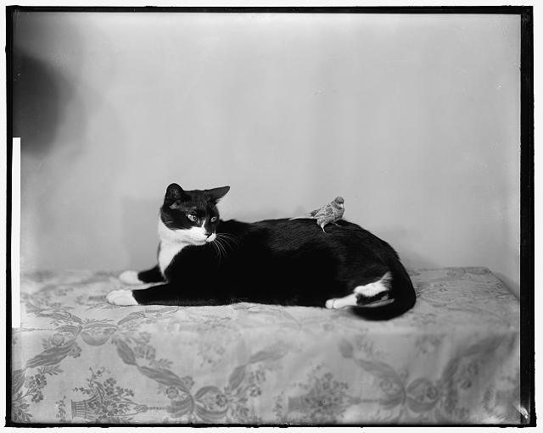
Key terms for light image editing
Save As
Export
Crop
Rotate
Flip
Resize
Resample
Resolution
Image: https://www.loc.gov/resource/hec.21589/

Slide 14
300 ppi
714kb
150 ppi
228kb
50 ppi
89.1kb
25 ppi
72.8kb

Slide 15
Tool Spotlight
Windows 10 Photo App
IrfanView
Windows
Open source
Free for non commercial use

Slide 16
?
Questions?
Image: Speech Bubble by Tatyana from the Noun Project

Slide 17
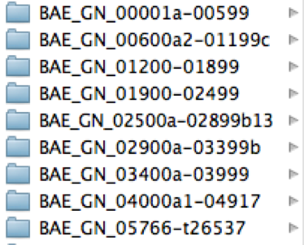
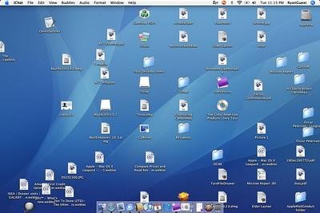
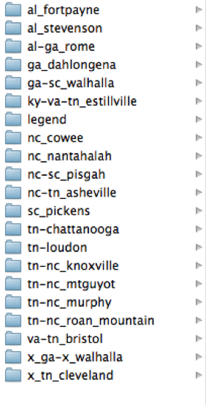
File Management Considerations
Always edit a copy
Be cautious about saving over previous versions
Avoid proprietary formats
Stay organized
Collections
Design files
Image: folders by Jeanine Nault, National Anthropological Archives; My Messy Desktop by Flickr User saaby CC BY-SA 2.0

Slide 18
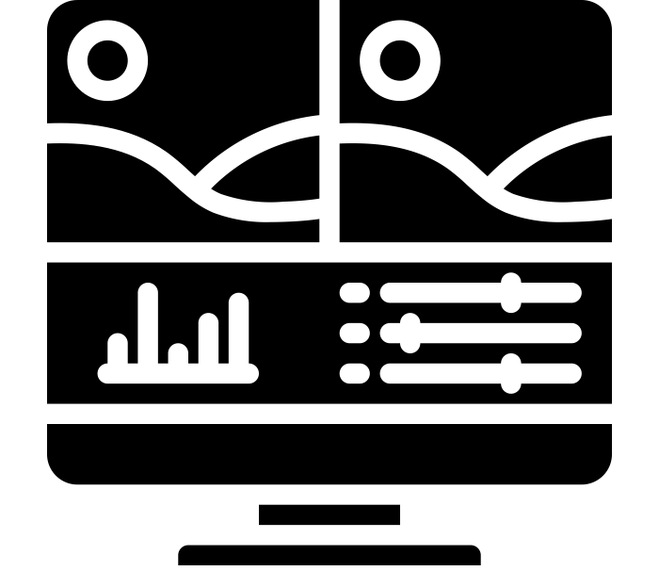
Advanced Image Editing
Image: Sliders by Creaticca Creative Agency from the Noun Project

Slide 19
Key terms for advanced image editing
Change bit depth
Adding text to images
Add a watermark
Fix flaws
Change/correct brightness, contrast, sharpening, color, and tone
Stitch images together

Slide 20
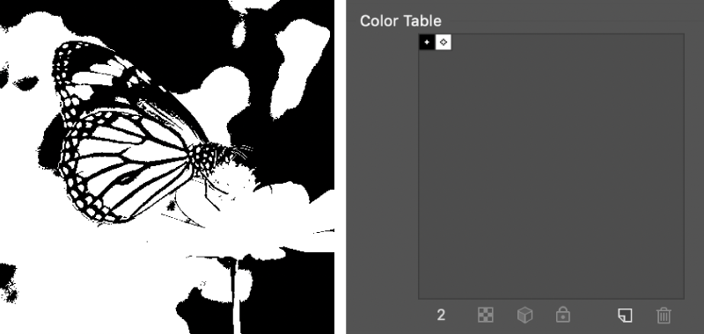
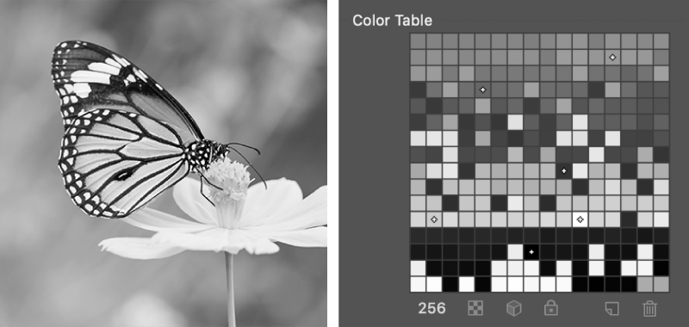
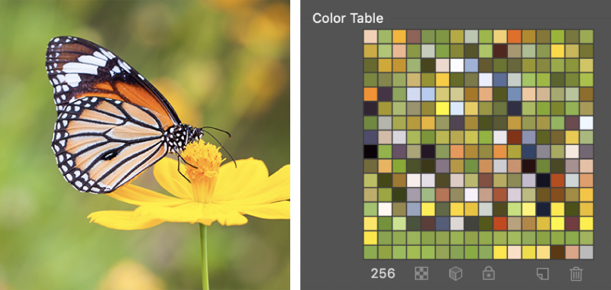
Bit depth example
1 bit
8 bit
8 bit
Bit depth:
The color information stored in an image (2^X)
The higher the bit depth, the more colors an image can store.
Access
8 bit
Preservation
Grayscale 8 bit
Color: 16 bit to 48 bit

Slide 21
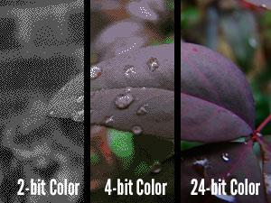

Slide 22
Tool Spotlight
GNU Image Manipulation Program (GIMP)
Free, open source
Windows, OS X (Mac)
Similar features to Adobe Photoshop
Layers
Additional plugins

Slide 25
Tool Spotlight
Adobe Photoshop
Cost (monthly)
Widely used
Pricing:
All Creative Cloud apps $52.99/month
Photography plan $9.99/month (Ps and Lr+)
Adobe Photoshop Express, Photoshop Elements, Lightroom Free

Slide 26
?
Questions?
Image: Speech Bubble by Tatyana from the Noun Project

Slide 27
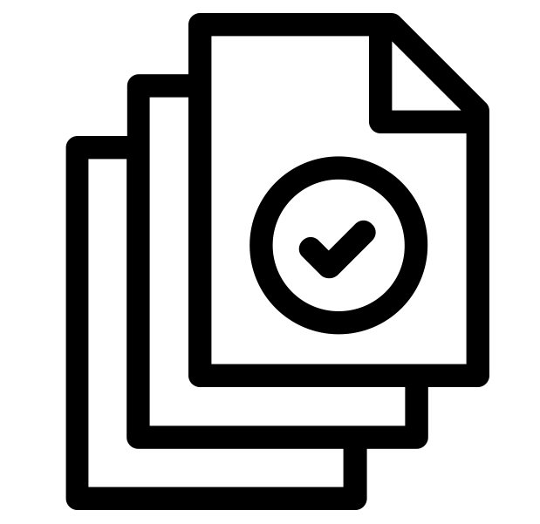
Batch Editing
Image: batch by Adrien Coquet from the Noun Project

Slide 28
Tool Spotlight
IrfanView
Convert, rename
Adobe Photoshop
Actions
GNU Image Manipulation Program (GIMP)
Batch Image Manipulation Plugin

Slide 29
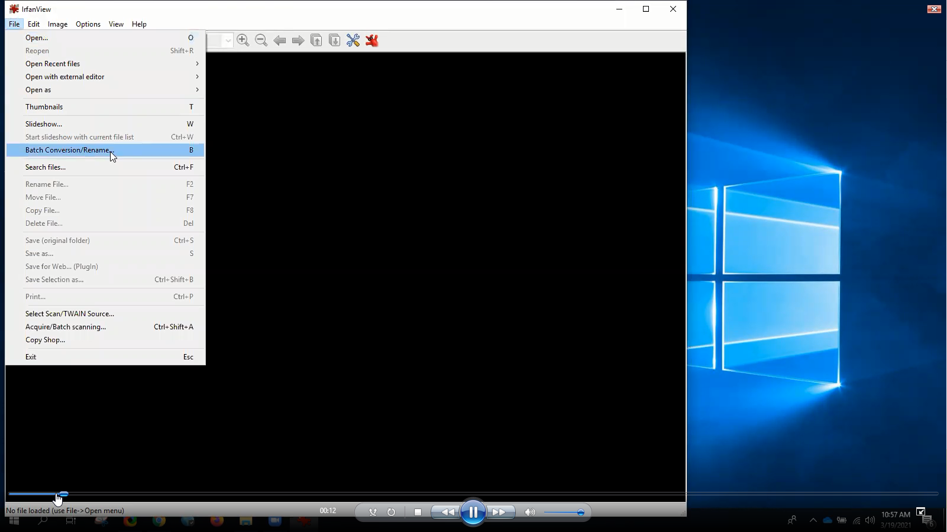

Slide 30
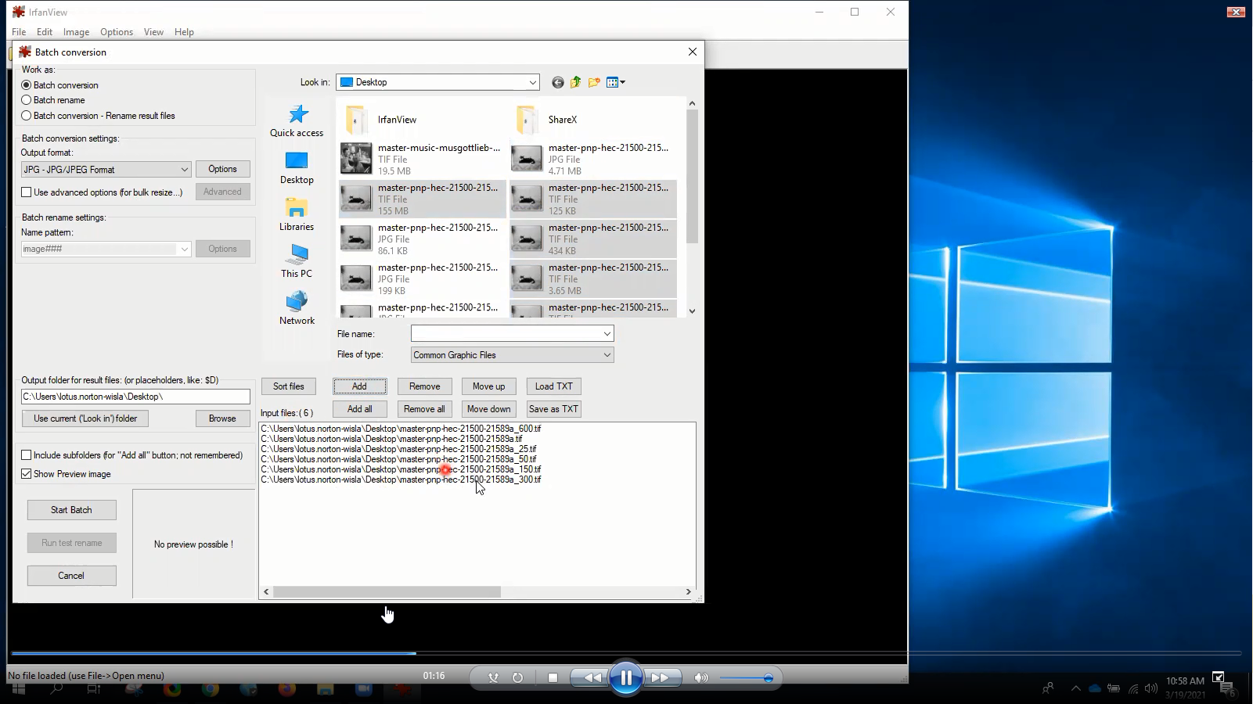

Slide 31
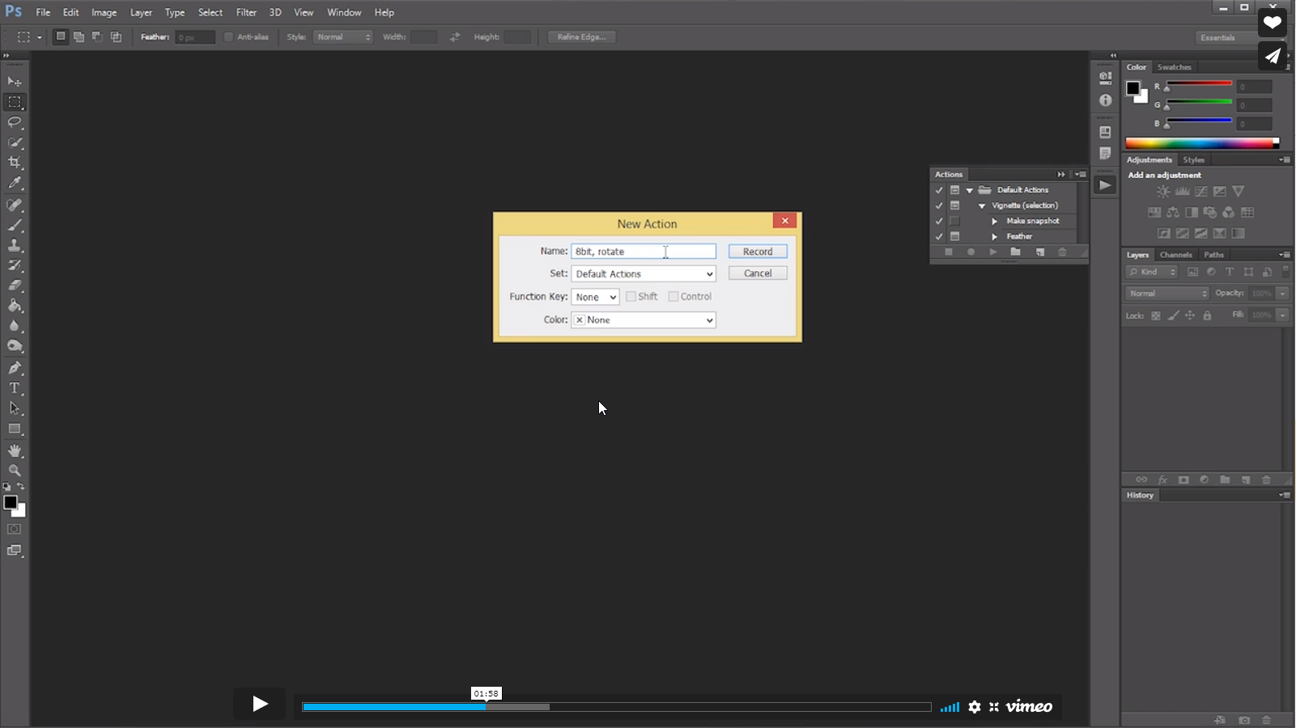

Slide 32
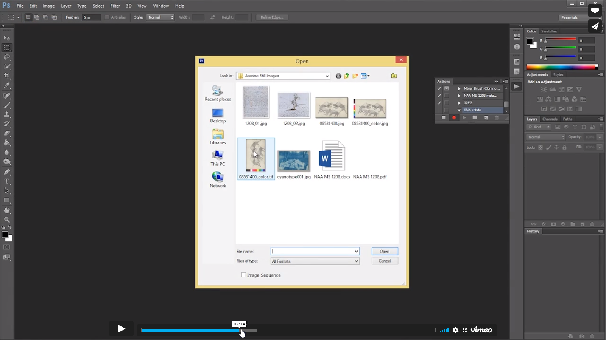

Slide 33
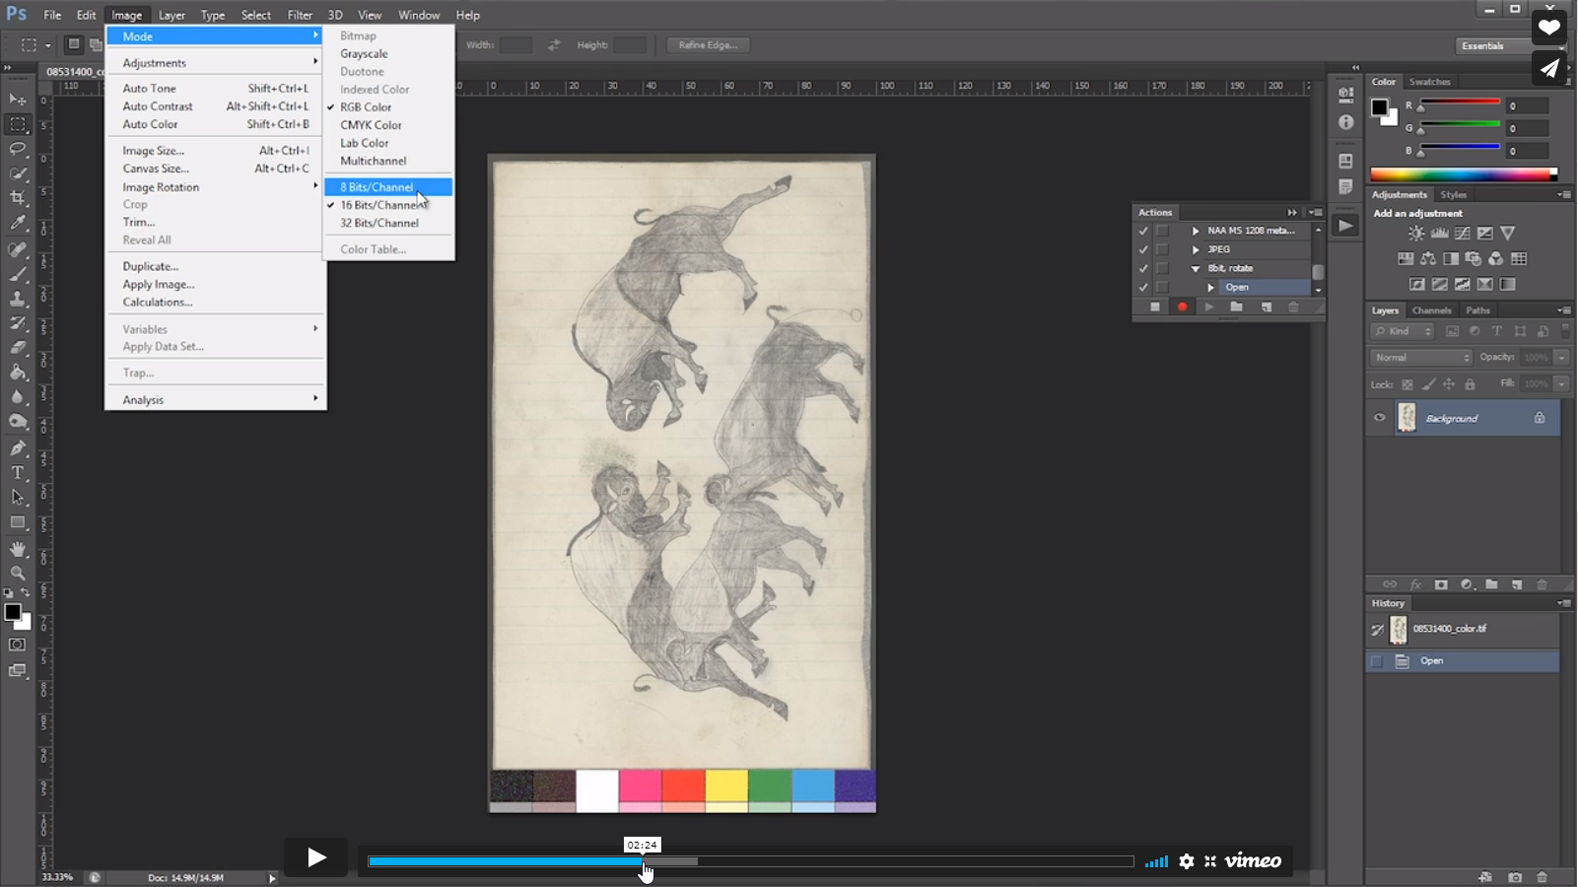

Slide 34
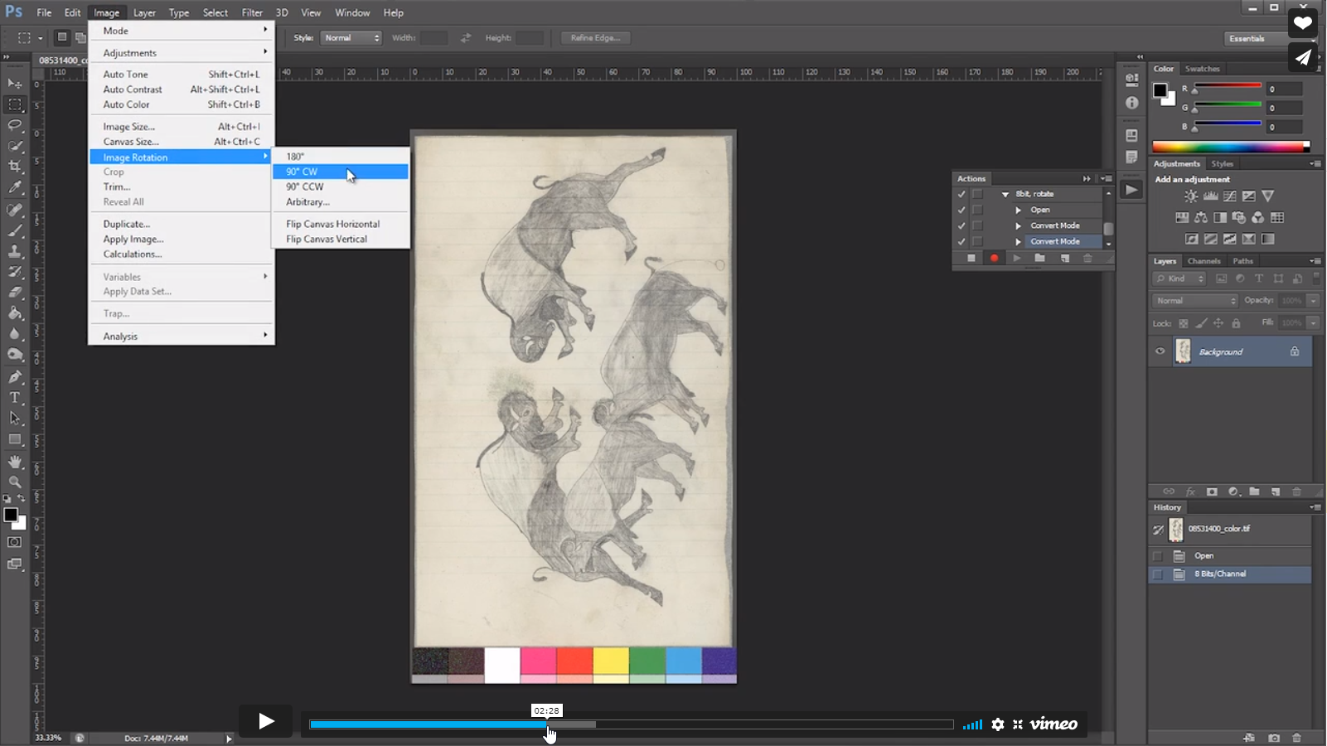

Slide 35
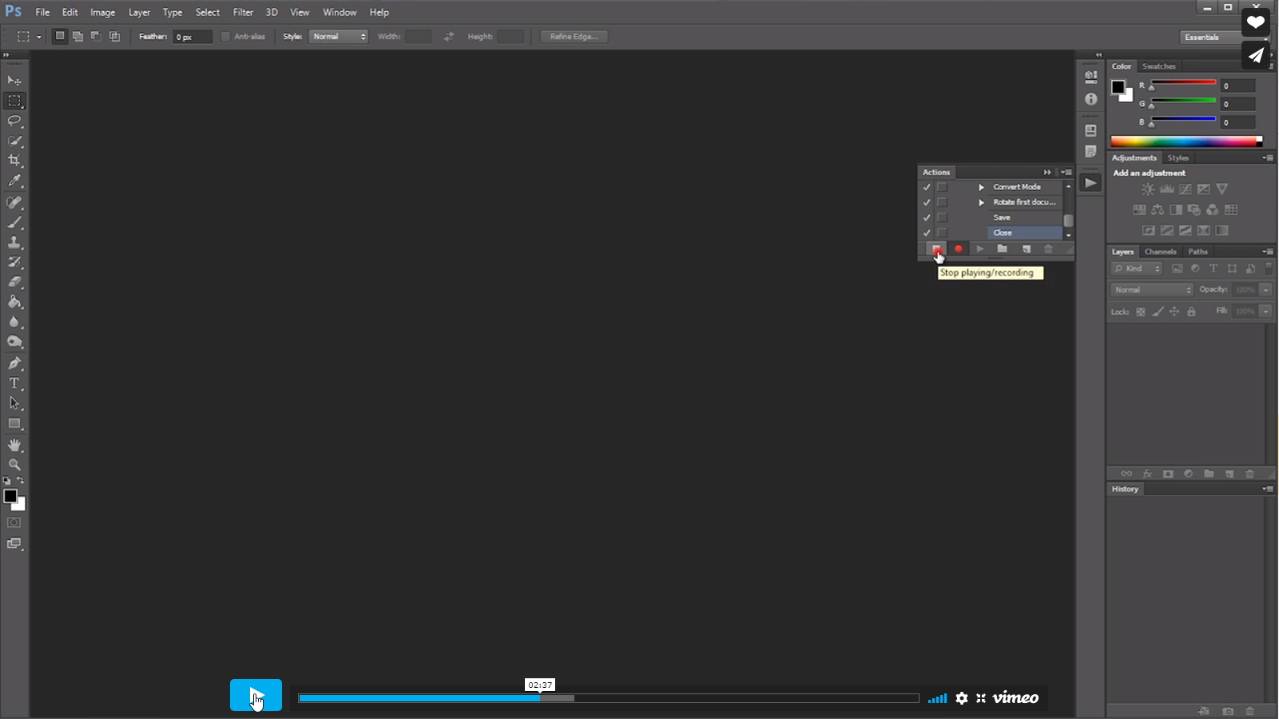

Slide 36
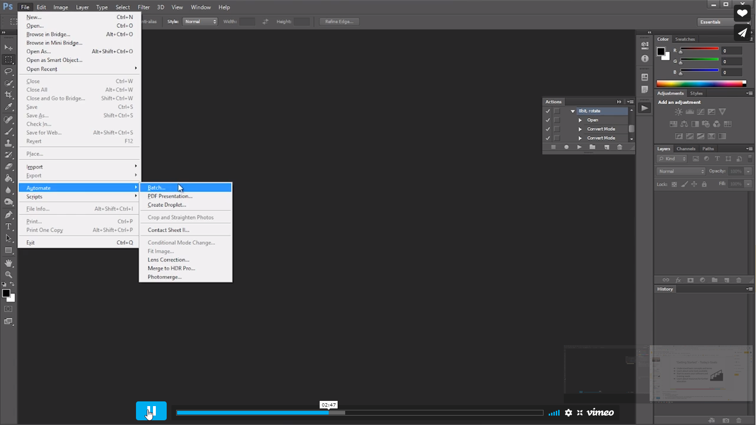

Slide 37
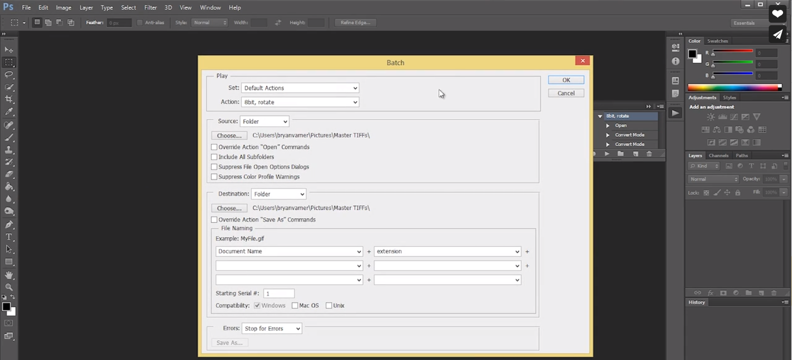
https://sustainableheritagenetwork.org/digital-heritage/processing-scanned-images-using-photoshop-tutorial

Slide 38
?
Questions?
Image: Speech Bubble by Tatyana from the Noun Project

Slide 39
Screen Capture
Image: Research by ibrandify from the Noun Project

Slide 40
Tool Spotlight
Snipping Tool (Windows)
Screenshot (Mac) Shift+Cmd+5 (or 4) Launchpad > Other >Screenshot
ShareX
OBS - screen+audio recording, streaming

Slide 41
?
Questions and Discussion
Image: Speech Bubble by Tatyana from the Noun Project

Slide 42
Resources
Image: Earth by Mattia Lombardini from the Noun Project

Slide 43
Help and tutorials
Search Youtube, search engine
Help menus, manuals
https://www.gimp.org/tutorials/
https://helpx.adobe.com/
Sustainable Heritage Network (Photoshop with Jeanine Nault)
Skillshare
Lynda (LinkedIn Learning)

Slide 44
Searching for assistance
Search [software] + [action]
“Demo,” “tutorial,” “instructions,” “steps”

Slide 45
Thank you!
Contact information:
support@sustainableheritagenetwork.org
lotus.norton-wisla@wsu.edu
Recording available within one week
Check out our other upcoming webinars! https://cdsc.libraries.wsu.edu/events-and-news/join-us/ cdsc.info@wsu.edu for additional webinar questions

Slide 46
Credits
This template is free to use under Creative Commons Attribution license.
Presentation template by SlidesCarnival.
These slides contain changes to color scheme and content.

