Slide 1
Preservation
Digital Stewardship Curriculum

Slide 2
Discussion
What materials are you most concerned about?
For preservation or conservation?
Anything that you know needs to be digitized soon?
Notes:
Confer with your partner for a few minutes, then share
2 or 3 types of materials that come to mind

Slide 3
“Preservation”
Activities that aim to prolong the life of a record
Trying to slow decay of materials
Notes:
Preservation is a series of activities to try to slow inevitable decay

Slide 4
Conservation
Treatment and repair of an item
Taking action to restore an item
Intervening
Notes:
Conservation is more active, preservation is more passive

Slide 5
Environmental Controls
Temperature: 65-68 degrees fahrenheit, 40-55 for film and photography collections
Humidity: Relative humidity 30-50%
Notes:
High temp and high/low RH are damaging, and so are fluctuations
Light - accelerates deterioration of library and archival materials. It leads to weakening and embrittlement of cellulose fibers and can cause paper to bleach, yellow, or darken. It also causes media and dyes to fade or change color, altering the legibility and/or appearance of documents, photographs, art works, and bindings. -Vaults in darkness, windows covered, lights low, incandescent lighting, lights on timers. Display very shortly or display copies.
-Pollutants - can be gaseous like sulfur dioxide, nitrogen oxides, peroxides, and ozone OR particulates like soot, dust, smoke - air exchange should be clean, windows closed, think about polluntants coming from indoors too (paint, storage, cleaning supplies). If there are serious concerns, there are measures like “mollecular traps”.

Slide 6
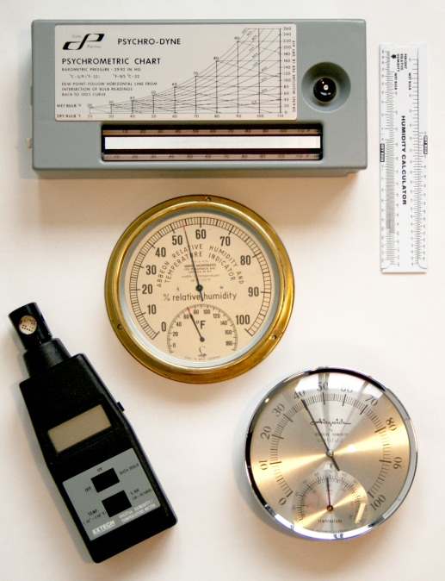
Controlling and Monitoring
Many tools available
Some basic, some more advanced/automated
Measure to monitor levels, notice fluctuations
Notes:
For temp and relative humidity - can monitor over time
-show fluctuations that would be hard to notice otherwise
-tell you how to better control environment, show that there is a problem
https://www.nedcc.org/free-resources/preservation-leaflets/2.-the-environment/2.2-monitoring-temperature-and-relative-humidity
Image attrributed to Northeast Document Conservation Center
Creative Commons License, http://creativecommons.org/licenses/by-nc-nd/4.0/

Slide 7
Other Threats to Materials
Light: UV rays are damaging
Air Quality: Pollutants
Notes:
Light coming in through windows, light from lightbulbs
-easy and more advanced ways to block rays
-consider when displaying
-also air quality - for example - wildfires in WA and ID last year, smoke can be very damaging

Slide 8
Handling
Learn and train employees and users on proper handling techniques
Clean hands
Gloves (sometimes)
Touch edges of pages, books
Clear rules for Reading Room
Book rests, book snakes, page turners
Digitization
Notes:
-
digi - overhead scanners are best for bound volumes. cameras for researchers, always do a strict assessment to make sure that digitization will not endanger the item. Have a procedure for digitization projects so you don’t lose the original order of the collection.

Slide 9
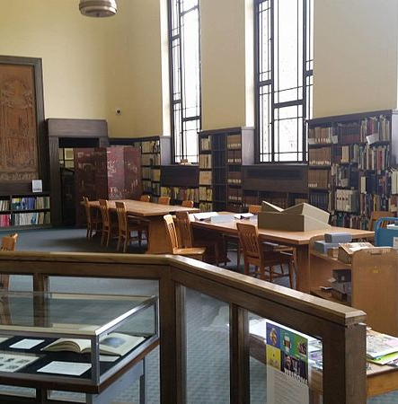
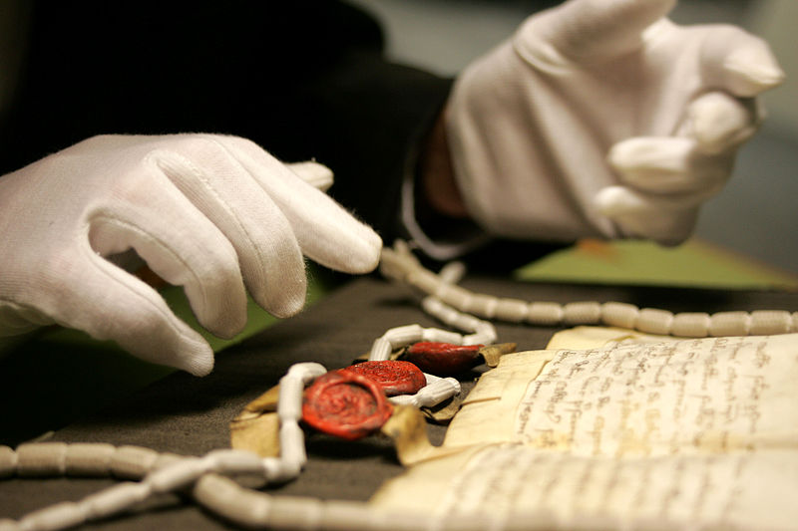
Notes:
Post rules, make sure they are followed
-no pens, sign in, no backpacks Photos attributiion and licensing clockwise, from left to right.
https://commons.wikimedia.org/wiki/File:Paulson_Reading_room_at_the_Special_Collections_%26_University_Archives,_University_of_Oregon.jpg
Attribution: 80atUO at English Wikipedia. License, Creative Commons Attribution-Share Alike 4.0 International license.
https://commons.wikimedia.org/wiki/File:A_gloved_pair_of_hands_at_The_National_Archives.jpg
Image attributed to the National Archives (UK) June 4, 2008. Creative Commons Attribution 3.0 Unported license.

Slide 10
Housing and Storage
Papers:
Acid free folders and boxes
Properly fitting housing to material
Separate acidic or damaging papers, interfile sheets of blank paper
Notes:
-Fitting housing to material - boxes or folders should not be too full, OR not full enough, use spacers if needed
-No labels, post its, stickers, any adhesives. Some places use book plates with water soluble adhesives. Stick to pencils.
-Making housing the right size is really important, gravity can destroy things!

Slide 11
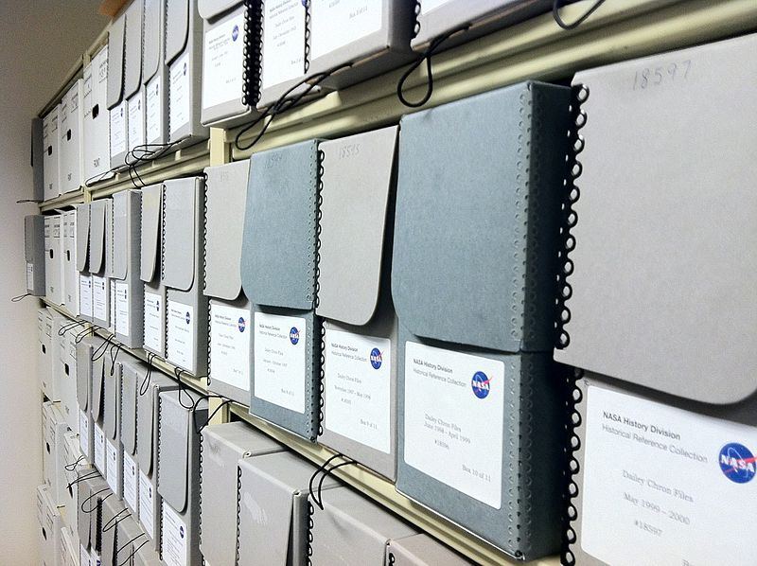
Notes:
Images, left to right.
shelves of archive boxes in the history office at NASA headquarters, Washington DC., January 25, 2012.
https://commons.wikimedia.org/wiki/File:NASA_history_archives.jpg
Image attributed to RadioFan. License, Creative Commons Attribution-Share Alike 3.0 Unported

Slide 12
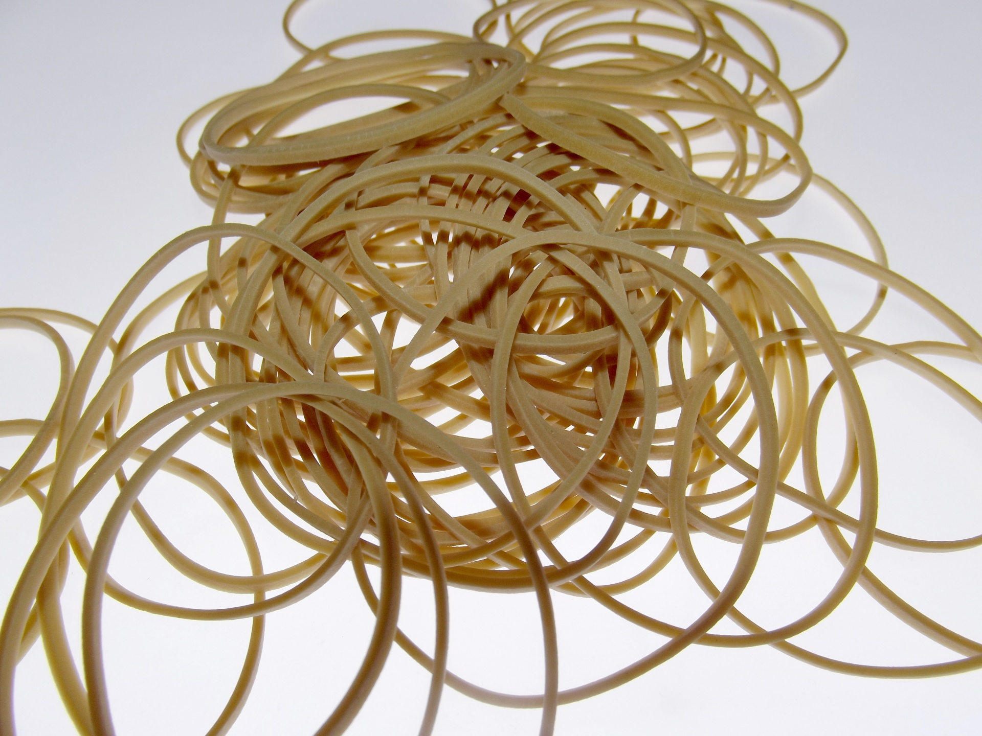
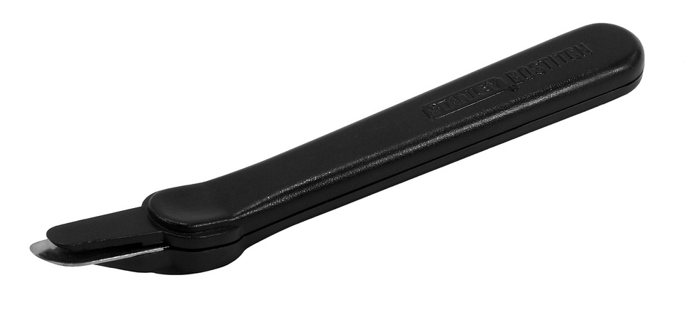
Notes:
If you have time...Remove rubber bands, rusty staples, old tape
Images clockwise, from left to right.
http://maxpixel.freegreatpicture.com/Office-Supply-Holder-Tag-Pin-Paper-clip-Equipment-308487
Attributed to Max Pixel. License, Creative Commons Zero - CC0.
http://www.publicdomainpictures.net/view-image.php?image=180064&picture=rubber-bands
Image attributed to PublicDomainPIctures.Net. License, http://creativecommons.org/publicdomain/zero/1.0/
http://maxpixel.freegreatpicture.com/Remover-Staple-Flat-2202216
Attributed to Max Pixel. License, Creative Commons Zero - CC0.

Slide 13
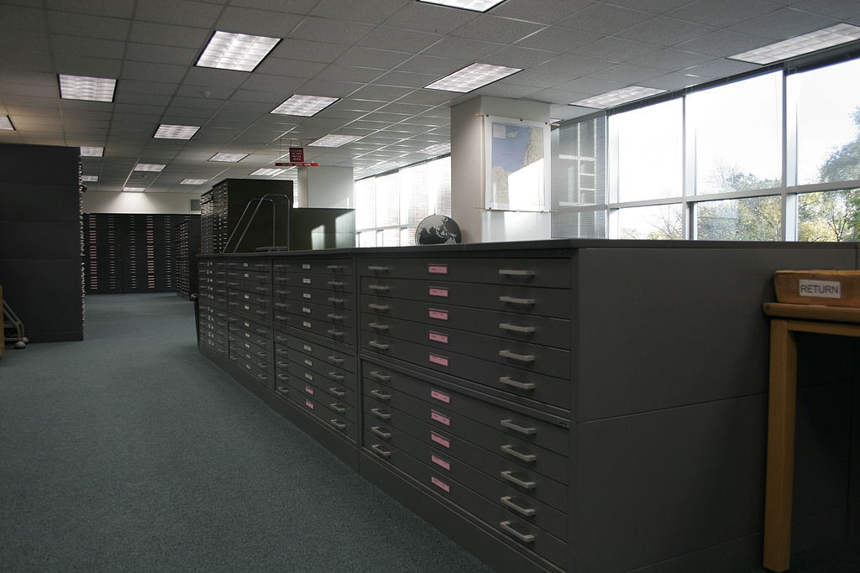
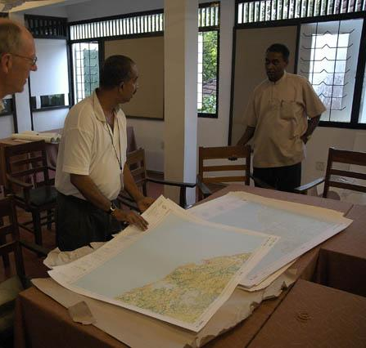
Notes:
Separate from regular sized collections
-might need a large surface to work on,
Images, from left to right.
Inside the Map Library
https://en.wikipedia.org/wiki/Michigan_State_University_Libraries#/media/File:Michigan_State_Map_Library.jpg
Image attributed to https://en.wikipedia.org/w/index.php?curid=13848574 License, Creative Commons Attribution 3.0
Map room, Sarvodaya HQ 1
https://www.flickr.com/photos/sarvodaya/2767180/in/photostream/
Image attributed to Sarvodaya Shramadana. License, https://creativecommons.org/licenses/by/2.0/

Slide 14
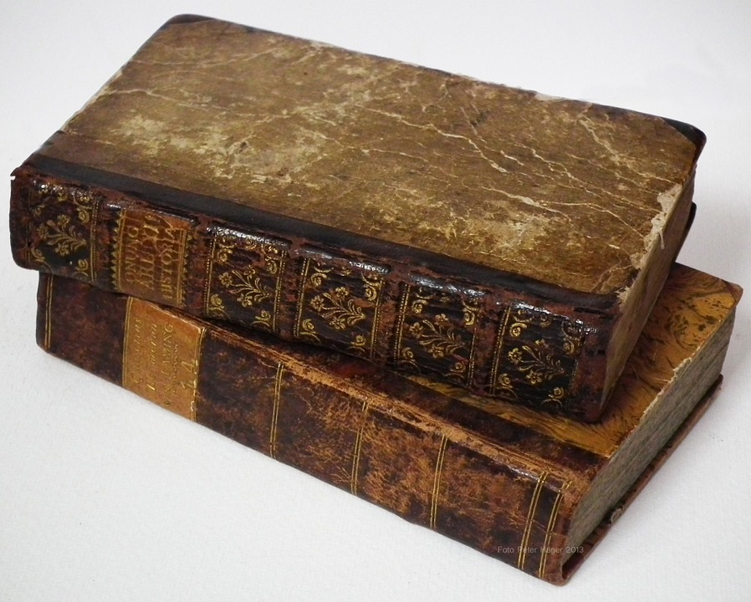
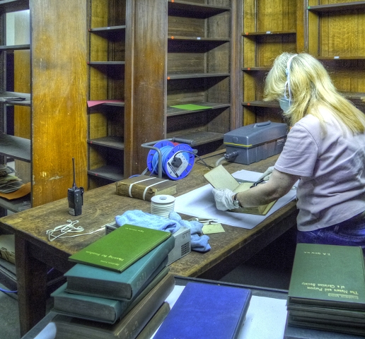
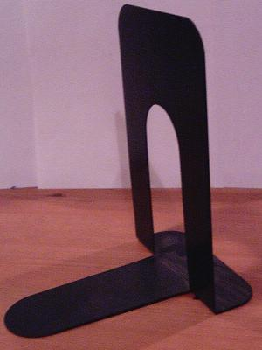
Notes:
Images clockwise, left to right.
https://pixabay.com/en/old-books-old-rare-books-library-164262/
Image attributed to Pixabay. License, https://pixabay.com/en/service/terms/#usage
Book Conservation and Restoration, John Rylands Library
http://www.geograph.org.uk/photo/4052590
Image attributed to © Copyright David Dixon. License, https://creativecommons.org/licenses/by-sa/2.0/
Black metal bookend, May 2007.
https://commons.wikimedia.org/wiki/File:Black_metal_bookend.jpg#filelinks
Image attributed to The Epopt. License, N/A, Public Domain.

Slide 15
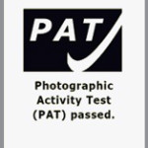
Photos
Envelopes, enclosures, folders, boxes
Plastic sleeves, encapsulation
Especially sensitive to light, temperature
Housing materials - Photographic Activity Test (PAT)
Notes:
-acid free and lignin free
Advantages and disadvantages to paper vs. plastic
Plastic protects from atmospheric conditions, able to view. However, it can trap in harmful chemicals released by the photo, can trap moisture, difficult to write on, need extra support at times. Paper is cheaper, and “breathes” more, but is not see-through, so must be removed to view photo -PAT test -
-Cold storage, esp film negatives

Slide 16
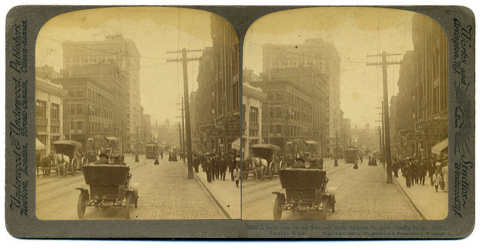
Notes:
2nd Ave., Seattle, Washington Stereoview 1907
https://www.flickr.com/photos/crackdog/4083751079
Image attributed to William Creswell. License, https://creativecommons.org/licenses/by/2.0/

Slide 17
Audio, Film, Video
Specific problems to look out for based on format
Cold storage
Store upright, in plastic, vented cans
Properly wound
Notes:
-Tears or scratches Chemical damage- nitrate decomposition, Vinegar syndrome in film (shrinking, cupping), sticky shed in magnetic media

Slide 18
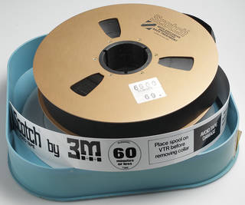
20-50% Relative Humidity
40-50 degrees F
Notes:
2" open reel videotape with plastic case
https://psap.library.illinois.edu/collection-id-guide/videotape#video2inOR
Image attributed to Flickr user DRs Kulturarvsprojekt. License, Creative Commons Attribution ShareAlike license (CC BY-SA 2.0). Courtesy of the Danish Broadcasting Corporation.

Slide 19
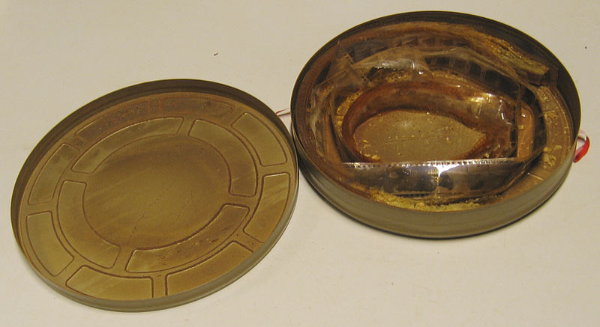
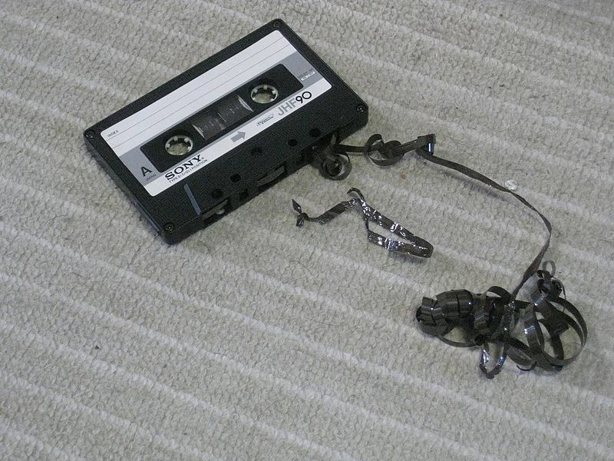
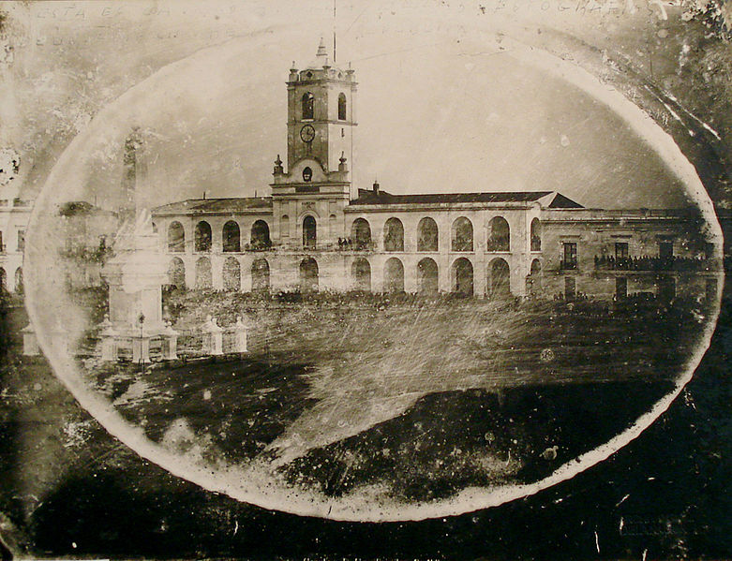
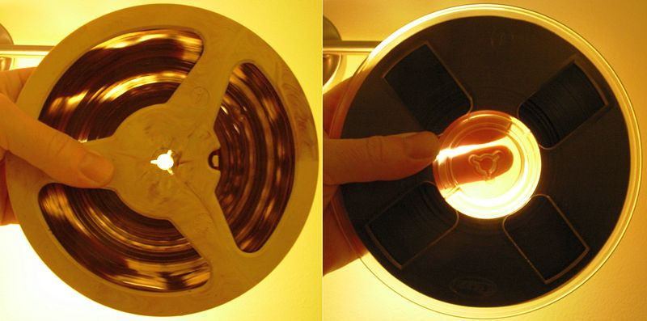
Notes:
Images clockwise, from left to right.
Film can with decayed nitrate film, EYE Film Institute Netherlands, Amsterdam, December 18, 2014.
https://commons.wikimedia.org/wiki/File:EYE_Film_Institute_Netherlands_-_Nitrate_film_decay_-_2.jpg
Image attributed to Hansmuller. License, Creative Commons Attribution-Share Alike 4.0 International
Broken Cassette Tape
https://commons.wikimedia.org/wiki/File:Broken_Cassette_Tape.jpg
Image attributed to 町田瑞樹. License, Creative Commons Attribution-Share Alike 4.0 International
Magnetic audio reel-to-reel tapes: acetate backing (on the left) and polyester backing. Light can be seen coming through the tape windings of the tape with acetate backing. Acetate backing is chemically less stable than polyester backing, May 9, 2012.
https://commons.wikimedia.org/wiki/File:Magnetic-tape-acetate-vs-polyester-backing.jpg
Image attributed to Jyrr. License, Creative Commons Attribution-Share Alike 3.0 Unported
Cabildo of Buenos Aires
https://commons.wikimedia.org/wiki/File:Primera_foto_del_cabildo.jpg
Image attributed to Charles DeForest Fredrick (1823-1894). License, N/A Public Domain

Slide 20
Discussion
Have you had issues with pests, mold, or disasters in the past?
What did you do?

Slide 21
Preservation Assessment
UI and IMLS - Preservation Self Assessment Program
IMLS CAP - Conservation Assessment Program
AAM - Museum Assessment Program
Notes:
University of Illinois at Urbana Champagne - go through format ID guide, glossary
CAP in transition
American Alliance of Museums

Slide 22
Resources!
NEDCC Leaflets
PSAP Preservation Self Assessment Program
CCAHA Conservation Center for Art and Historic Artifacts
SHN!
Notes:
More grants with preservation components - NEH Preservation Assistance Grant

